Slide 1
The Duty to Warn: Legal v Commercial Risks
Holly Doyle

Slide 2
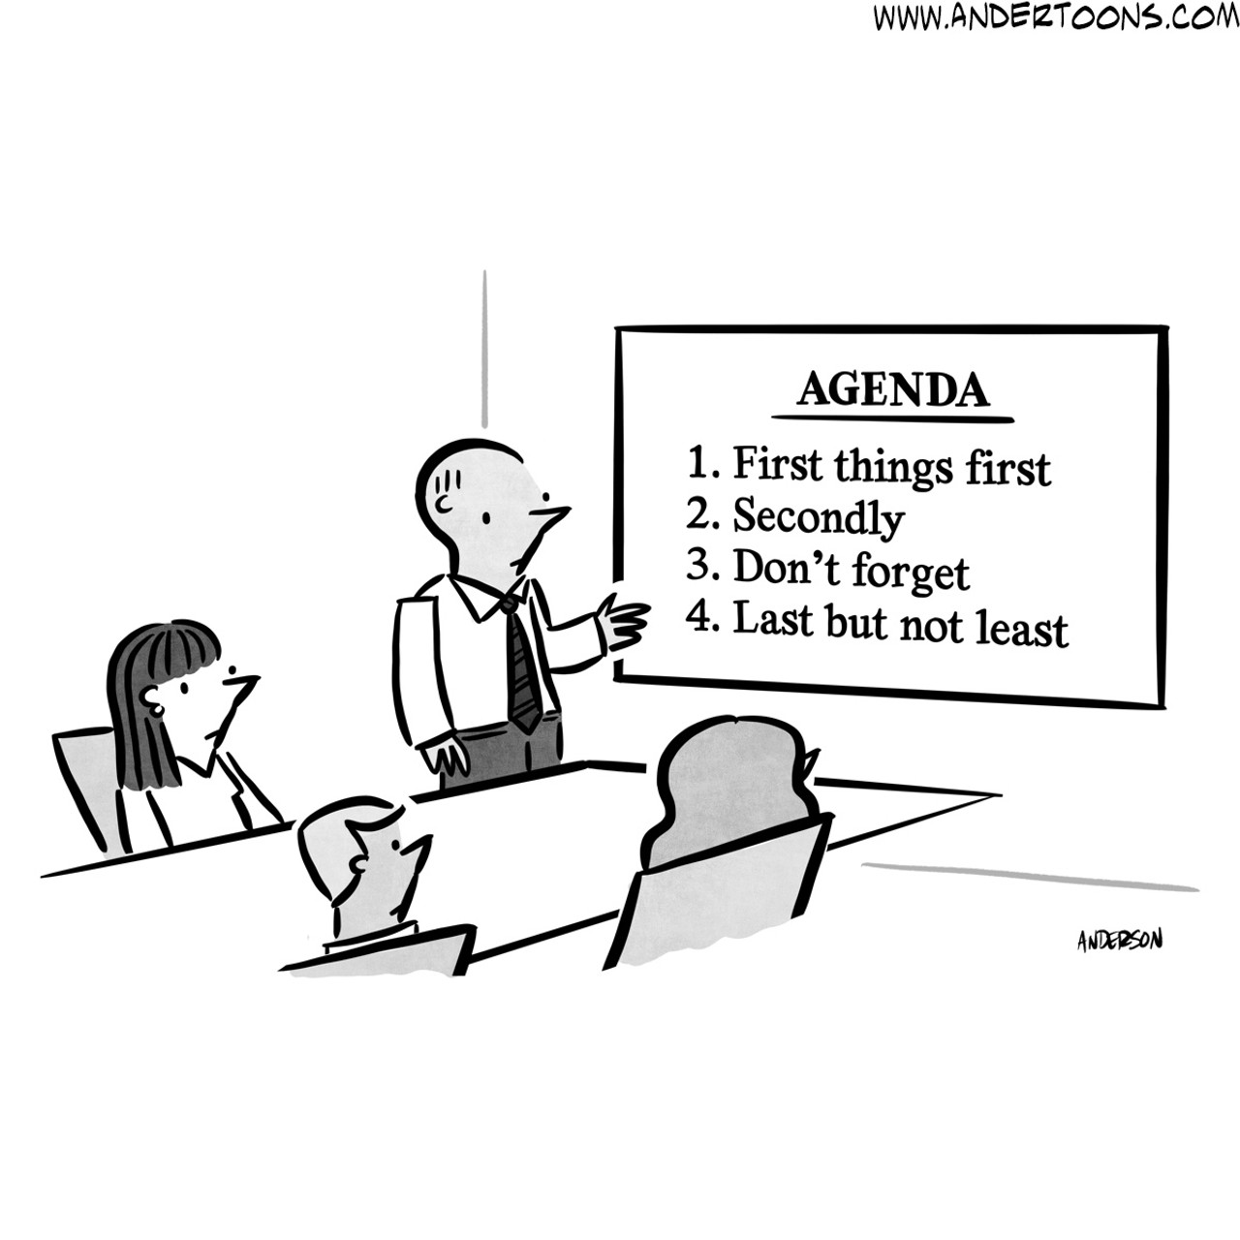
Agenda
What is the “duty to warn” ?
Drawing the line: legal risk v commercial risk
Inexperienced and Vulnerable clients – an exception?
Is there a better way?

Slide 3

The “Duty to Warn”
“… If a dentist is asked to treat a patient’s tooth and, on looking into the latter’s mouth, he notices that an adjacent tooth is in need of treatment, it is his duty to warn the patient accordingly. So too, if in the course of carrying out instructions within his area of competence a lawyer notices or ought to notice a problem or risk for the client of which it is reasonable to assume the client may not be aware, the lawyer must warn him.”
Credit Lyonnais v Russell Jones & Walker [2002] EWHC 1310

Slide 4
The Classic Statement
“(i) A solicitor’s contractual duty is to carry out the tasks which the client has instructed and the solicitor has agreed to undertake.
(ii) It is implicit in the solicitor’s retainer that he/she will proffer advice which is reasonably incidental to the work that he/she is carrying out.
(iii) In determining what advice is reasonably incidental, it is necessary to have regard to all the circumstances of the case, including the character and experience of the client.
Minkin v Landsberg [2015] EWCA Civ 1152, [38]

Slide 5

Interplay with Retainer
“…the solicitor’s obligation to bring to the client’s attention risks which become apparent to the solicitor when performing his retainer does not involve the solicitor in doing extra work or in operating outside the scope of his retainer. The risks in question are all matters which come to his attention when performing the tasks the client has instructed him to carry out and which therefore as part of his duty of care he must make the client aware of.”
Lyons v Fox Williams LLP [2018] EWCA Civ 2347, [41]

Slide 6
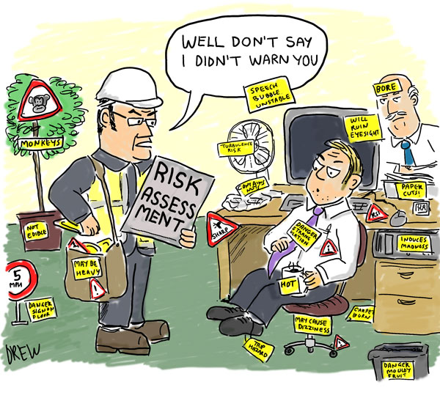
Examples
Credit Lyonnais SA v Russell Jones & Walker (A Firm) [2002] EWHC 1310 (Ch); [2003] PNLR 2
Contrast the decision in Minkin with Lewis v Cunningtons Solicitors [2023] EWHC 822 (KB)7

Slide 7
“Commercial Risks”
“When a client in full command of his faculties and apparently aware of what he is doing seeks the assistance of a solicitor in the carrying out of a particular transaction, that solicitor is under no duty whether before or after accepting instructions to go beyond those instructions by proffering unsought advice on the wisdom of the transaction. To hold otherwise could impose intolerable burdens on solicitors”
Clarke Boyce v Mouat [1994] 1 AC 428, page 437

Slide 8
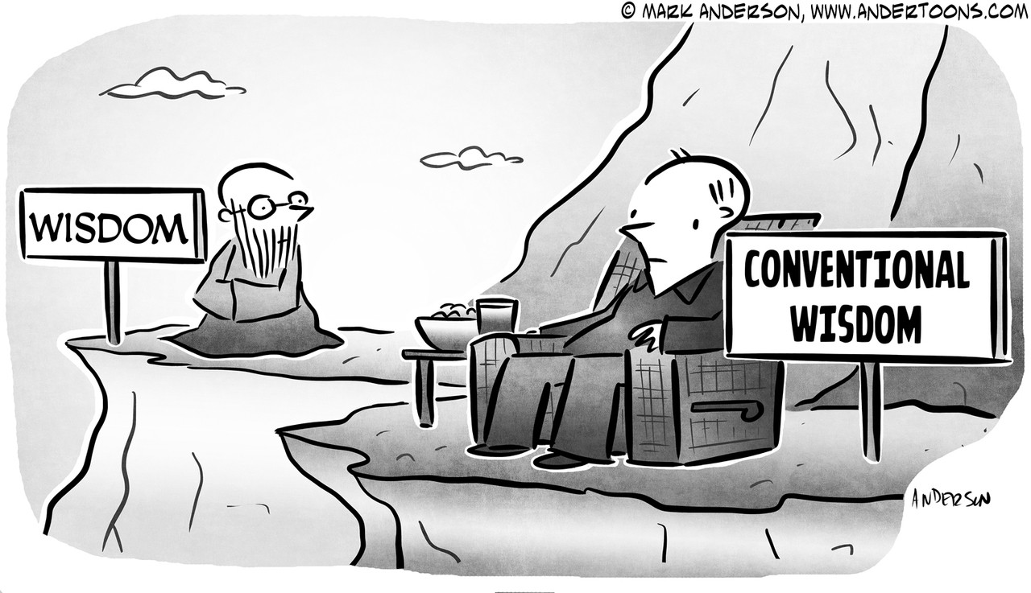
Illustration
Football League v Edge Ellison [2006] EWHC 1462 (Ch)

Slide 9

Drawing the line
County Personnel v Pulvers [1987] 1 All ER 289
“I cannot accept the distinction drawn between legal consequences and financial implications, because in this case the significance of the legal consequences lay in the financial implications.”
Contrast with: Reeves v Thrings & Long [1996] PNLR 265
Luffeorm and Kitsons [2015] PNLR 30

Slide 10
Inexperienced Clients & Disastrous Ventures
Haigh v. Wright Hassell [1994] EGCS 54
“The solicitor is not a business advisor. Although most good solicitors offer business advice and will to some extent try to protect clients from themselves, it would be wrong, in my opinion, to hold that there is an invariable legal duty to do so. It must of course depend upon the facts of the case. There will be situations in which it is clear that the client is commercially wholly inexperienced and is deluding himself. In those circumstances there may well be a duty on the part of the solicitor to probe further”
Contrast Neushul v Mellish & Harkavy [1967] 1 WLUK 347
With Searles v Cann and Hallett (A Firm) [1999] P.N.L.R. 494

Slide 11

A recent example…
Niprose Investments Ltd v Vincents Solicitors Ltd
- [2024] EWHC 801 (Ch) (strike out/Summary Judgment)
[2025] EWHC 14 (Ch) (amendments)
“to the extent that such matters are raised as justifying a higher-level duty to explain, they must be fully pleaded, so that [D] may know the nature of the case they have to meet. It is not sufficient for this simply to be left to the witness statements” [70]

Slide 12

A better way?
Is it more meaningful/ transparent to ask:
In all the circumstances
(including the terms of the retainer, the experience and sophistication of the client and the solicitor’s own advertised expertise),
was the risk:
(1) one the client could reasonably be expected to appreciate for himself; or
(2) one which the solicitor would be expected to be in a better position to appreciate?

Slide 13
(Back to the Dentist)
“If a dentist is asked to treat a patient’s tooth and, on looking into the latter’s mouth, he notices that an adjacent tooth is in need of treatment, it is his duty to warn the patient accordingly. So too, if in the course of carrying out instructions within his area of competence a lawyer notices or ought to notice a problem or risk for the client of which it is reasonable to assume the client may not be aware, the lawyer must warn him.”
Credit Lyonnais v Russell Jones & Walker [2002] EWHC 1310

