Slide 1
Fiduciary duties, bribery, undisclosed commission and the motor finance litigation
Lucy Walker

Slide 2

What will we talk about today?
The background to and implications of the motor finance litigation in Johnson v. FirstRand Limited:
a typical motor finance transaction;
the role of the dealer;
the role of the finance house;
the duty to disclose commission.

Slide 3

What will we talk about today?
A legal analysis of a motor finance transaction:
the 2024 decision of the Court of Appeal in Johnson;
fiduciary duty;
bribery;
the 2025 decision of the Supreme Court in Johnson.

Slide 4

What will we talk about today?
The aftermath…..
the current state of the law;
the future for motor finance claims;
the Financial Conduct Authority (the “FCA”) redress scheme;
application to other sectors and transactions.

Slide 5
A typical motor finance transaction
A tripartite transaction:
the customer, wishing to purchase a motor vehicle;
the motor dealer, wishing to sell a motor vehicle;
the finance house, offering to finance the purchase of the motor vehicle by the customer.
The dealer will usually work with a limited number of lenders (a ‘panel’) to whom it will introduce customers.
Once the lender has made an offer of finance to the customer, the dealer will sell the vehicle to the lender and the lender will enter into a hire purchase or conditional sale agreement with the customer.
The dealer will receive a commission from the lender in consideration of the introduction of the customer.

Slide 6
A typical motor finance transaction
In the transactions with which we are concerned today, the finance agreement between lender and customer will be a regulated credit agreement under the Consumer Credit Act 1974, (the “CCA”).
The rules governing commission disclosure for regulatory (as distinct from common law) purposes are found in the Consumer Credit Sourcebook (CONC) within the FCA Handbook of Rules and Guidance.
Primary regulatory responsibility for commission disclosure rests with the credit broker, not the lender, (CONC 4.5.3).

Slide 7
A typical motor finance transaction: commission disclosure
A credit broker must disclose to the customer the existence and nature of any fee or commission payable to the credit broker by a third party in good time before a credit agreement is made, where the existence or amount of the commission or fee could actually or potentially:
affect the impartiality of the broker in recommending the credit agreement to the customer;
if the remuneration was known to the customer, have a material impact on the customer’s transactional decision making process.
(See CONC 4.5.3).

Slide 8
A typical motor finance transaction
By introducing the customer to the lender for the purposes of entering into the finance agreement, the motor dealer acts both as seller of the vehicle and as credit broker under the CCA.
Under s.56 CCA, the motor dealer is the agent of the lender for the purposes of pre-contract negotiations with the customer about the vehicle and the finance agreement.

Slide 9
A typical motor finance transaction
Prior to the Court of Appeal judgment in Johnson, at common law the dealer was considered generally to act for its own account to further its commercial interests (Branwhite v. Worcester Works Finance [1969]).
The dealer might perform some functions for the lender and was the statutory agent for the lender under s.56 CCA.
The dealer might perform some functions for the customer, but the dealer was not the agent of the customer.
BUT the Court of Appeal turned the law on its head in Johnson……

Slide 10

The Court of Appeal decision in Johnson
The Court segregated the function of the dealer when selling the vehicle, from the function of the dealer when arranging finance for the the customer and the function of the dealer when acting as agent for the lender under s.56 CCA.
The Court held that there was no contradiction in finding that the dealer could act on behalf of one party for certain purposes in a transaction whilst simultaneously acting for another party for different purposes and owing different duties to each.
This Photo by Unknown Author is licensed under CC BY-SA

Slide 11
The Court of Appeal decision in Johnson
The Court of Appeal held that the dealer owed the customer a ‘disinterested duty’ impartially to provide information, advice and to source a suitable and competitive finance deal for the customer, (Wood v. Commercial First Business Ltd [2021]).
The Court considered that it was within the customer’s reasonable expectations that the dealer would act in their best interests.
From the extant ‘disinterested duty’ the Court extrapolated that the dealer owed the customer a ‘fiduciary duty’ – a duty of the utmost loyalty - to act in the customer’s best interests and source the best available finance deal for the customer.

Slide 12
The implications: a fiduciary duty?
The dealer was the fiduciary agent of the customer.
The dealer owed the customer a duty of the utmost loyalty and fidelity.
The dealer, as fiduciary of the customer, was bound not to prefer its own commercial interests to those of the customer.
The dealer could not place itself in a position of conflict with the interests of the customer.

Slide 13
The implications: bribery?
Unless the customer had given their prior, fully informed consent to the payment of commission:
by accepting a commission from the lender in consideration of the introduction of the customer, the dealer had put itself in a position of conflict with the interests of the customer
by paying a commission, the lender had effectively (tortiously) bribed the dealer
the lender was liable as an accessory to breach of the fiduciary duty
the customer was entitled to demand an account of the commission paid
the customer was entitled to rescind the finance agreement (in cases where recission was possible).

Slide 14

The implications…..

Slide 15
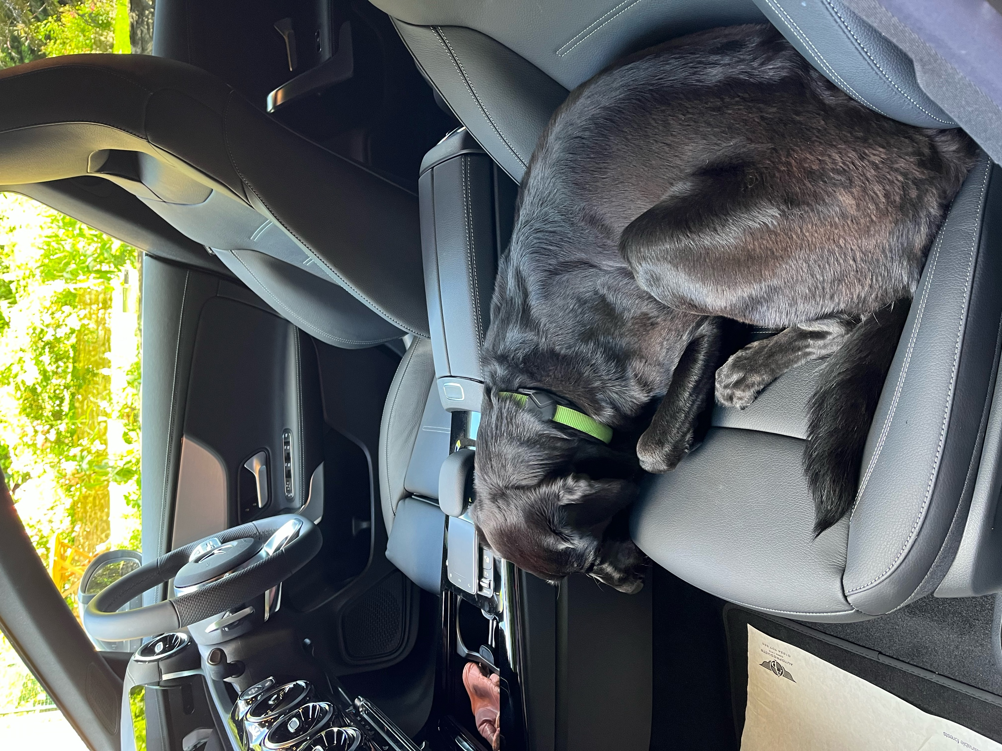
The Supreme Court decision in Johnson
A sense of calm restored….mostly……

Slide 16
The Supreme Court decision in Johnson
The Court emphasized that the commercial context of a transaction was important when determining whether a fiduciary duty arose.
Reference should be made to the contractual terms on which the parties engaged and the duties and responsibilities assumed by a contracting party.
‘It is important not to distort the commercial bargain between the parties to a contract by too readily implying fiduciary obligations into the commercial relationship’, (Johnson at [102]).

Slide 17
The Supreme Court decision in Johnson
The Supreme Court held that the nature of the relationship between a motor dealer and the customer was not one that gave rise to a fiduciary relationship.
The Court of Appeal was wrong to segregate the different elements of the purchase transaction and not to look at the composite whole.
The Court observed (at [277]) that:
“No reasonable onlooker would think that by offering to find a suitable finance package to enable the customer to obtain the car, the dealer was thereby giving up, rather than continuing to pursue, its own commercial objective of securing a profitable sale of the car.”.

Slide 18
The Supreme Court decision in Johnson
The Supreme Court conducted a thorough review of the authorities and the law relating to bribery and the consequences and available remedies in equity and at common law.
The Court rejected a submission on behalf of the lenders that the tort of bribery should be abolished altogether.
The Court held that only the existence of a full fiduciary duty will engage the tort of bribery; a ‘disinterested duty’ is insufficient.
There is nothing inherently wrong with paying a commission to an agent but to avoid the consequences of bribery, the principal’s fully informed consent to the payment must be obtained.

Slide 19
The Supreme Court decision in Johnson
Not quite the end of the story: Mr Johnson had asserted that the relationship between Mr Johnson as borrower and FirstRand as lender was unfair within the meaning set out at s.140A(1) CCA.
The motor dealer, acting as agent for the lender, failed to disclose in a prominent way the existence of any financial arrangements with the lender that might impact upon the dealer’s impartiality in promoting a credit product to Mr Johnson, by failing to explain the existence and/or amount of commission.
Mr Johnson also alleged an express or implied representation that his credit agreement was competitive and represented the best available terms for him.

Slide 20
The Supreme Court decision in Johnson
In Mr Johnson’s case, the commission payable to the motor dealer by FirstRand was £1,650.95 which equated to 70% of the cost of the credit to Mr Johnson.
Mr Johnson was also unaware of commercial ties between the motor dealer and FirstRand which effectively gave FirstRand first refusal on finance deals.
The Supreme Court held that the high level of undisclosed commission was a ‘powerful indication’ that the relationship between Mr Johnson and the lender was unfair and came to the ‘clear view’ that the relationship was unfair.

Slide 21
The aftermath…..
Drawing the threads together:
in the ordinary course, the relationship between motor dealer and customer will not give rise to a fiduciary relationship;
the tort of bribery remains, but only a fiduciary relationship can engage the tort of bribery and remedies at common law and in equity;
however, undisclosed commissions and/or commercial ties between motor dealer and lender may provide fertile ground for allegations of an unfair relationship under s.140A CCA.

Slide 22
The aftermath….
Sensible to anticipate that claims management companies will continue to promulgate motor finance claims alleging an unfair relationship.
Compliance with applicable FCA rules on commission disclosure will not insulate a lender from allegations of an unfair relationship because the test of unfairness for the purposes of s.140A(1) CCA is a distinct test, (Plevin v. Paragon Personal Finance Ltd [2014]).
The principles discussed in Johnson are not confined to the motor finance sector; they apply wherever a transaction is introduced by an intermediary who receives a commission for the introduction.

Slide 23
The aftermath
Separately, the FCA is currently consulting on the final details of a redress scheme relating to motor finance commissions for agreements entered into between April 2007 and November 2024. (FCA CP 25/27).
Previously, the FCA outlawed ‘difference in charges’ (DIC) commissions which effectively allowed a motor dealer to set interest rates within a permitted range for a customer and earn higher commission with higher interest rates.
The scheme will come into effect next year and will offer compensation to customers who were not told of:
a discretionary commission arrangement
a high commission arrangement
contractual ties between the lender and the dealer conferring exclusivity or near exclusivity on the lender to provide credit.

Slide 24



Some cars….
This Photo by Unknown Author is licensed under CC BY-SA
This Photo by Unknown Author is licensed under CC BY-SA

Slide 25

A driver…..

