Slide 1
Guildhall Chambers Annual Employment Seminar 2026
4th March
We the Curious

Slide 2
‘Beyond Severance’ Drawing the line on workplace surveillance
Julian Allsop
Employment Team Annual Seminar
5 March 2026

Slide 3

Agenda
1. Legal Framework
2. Employer surveillance
4. Q&A
3. Employee surveillance

Slide 4
Legal Framework

Slide 5
The Legal Framework
The Data Protection Act 1998
The UK General Data Protection Regulation (“GDPR”)
The Data Use and Access Act 2025 (“DUAA”)
RIPA and LBP Regulations 2000
The Investigatory Powers (Interception by Businesses etc) Regulations 2018
Article 8 ECHR
ICO Employment Practices : Monitoring at Work (2023)

Slide 6
Personal Data – Art 4(1) GDPR
“…any information relating to an identified or identifiable natural person (‘data subject’); an identifiable natural person is one who can be identified, directly or indirectly, in particular by reference to an identifier such as a name, an identification number, location data, an online identifier or to one or more factors specific to the physical, physiological, genetic, mental, economic, cultural or social identity of that natural person”.

Slide 7

Principles of Data Processing (Art 5)
Lawfulness, fairness and transparency
Purpose limitation- but now amended by DUAA
Data minimisation
Accuracy
Storage limitation
Integrity and confidentiality (security)
Accountability

Slide 8
Lawful Processing (Art 6)
Is there a legitimate interest behind the processing?
Is the processing necessary for that purpose?
Is the legitimate interest overridden by the person’s interests, rights or freedoms?
Six Lawful Bases:
Consent
Contract
Legal Obligation
Vital Interests
Public Task
Legitimate Interests

Slide 9

Special Category Data– Art 9
Personal Data which reveals or concerns something intrinsic to the person, e.g. protected characteristics under the EqA 2010 , genetic data, biometric data, TU membership.
Limited exceptions – Art 9(2), which must be satisfied along with a lawful basis, for lawful processing.

Slide 10
LBP Regulations / The Investigatory Powers (Interception by Businesses etc) Regs 2018
LBP Regs permitted the interception of electronic communications in the workplace in limited circumstances.
Updated by the 2018 Regulations (made under s.46 of the Investigatory Powers Act 2016).
Monitoring to comply with regulatory obligations
Ensuring system integrity
Preventing or detecting crime
Recording business transactions
NB: All reasonable efforts must be made to inform people that communications might be intercepted -----must be advertised!

Slide 11
Article 8 ECHR
Article 8 is a qualified right to respect for an individuals’ private and family life, home and correspondence.
Applicable to public authorities- this includes Hybrid Authorities, Courts & Employment Tribunals
Interface with unfair dismissal and admissibility of evidence
Employees retain Article 8 privacy rights at work (e.g. Halford v UK, Copland v UK, Barbulescu v Romania)
Interference must have a proper legal basis
Monitoring must be in furtherance of a legitimate aim
It must be proportionate and necessary- least intrusive means
Advertised

Slide 12
Employer Surveillance

Slide 13
Data Protection Impact Assessment (Art 35)
“Where a type of processing in particular using new technologies, and taking into account the nature, scope, context and purposes of the processing, is likely to result in a high risk to the rights and freedoms of natural persons, the controller shall, prior to the processing, carry out an assessment of the impact of the envisaged processing operations on the protection of personal data. A single assessment may address a set of similar processing operations that present similar high risks.”

Slide 14
DPIA triggers
Art 35(3) – 3 types of processing that will always require a DPIA.
Systematic and extensive profiling with significant effect
Large scale use of sensitive data
Public monitoring
ICO has published (Art 35(4)) guidance on what are likely to be high risk activities requiring a DPIA, which include usage of innovative technology or the novel application of existing technologies, processing of biometric data, genetic data and tracking etc.

Slide 15

CCTV and Video

Slide 16
CCTV and Video (overt, ‘in’ the workplace)
Physical & CCTV Surveillance in the workplace is generally permissible
Data Protection Impact assessment (DPIA) should be conducted.
Should target areas of particular risk.
Should not cover private spaces such as toilets or changing rooms- particular challenges for home working.
Nature and extent of surveillance should be advertised to the workforce and third-party visitors
Continuous video or audio monitoring is only like to be justified in exceptional circumstances.
Leading Case: Lopez Ribalda and others v Spain (2019) – ECHR

Slide 17
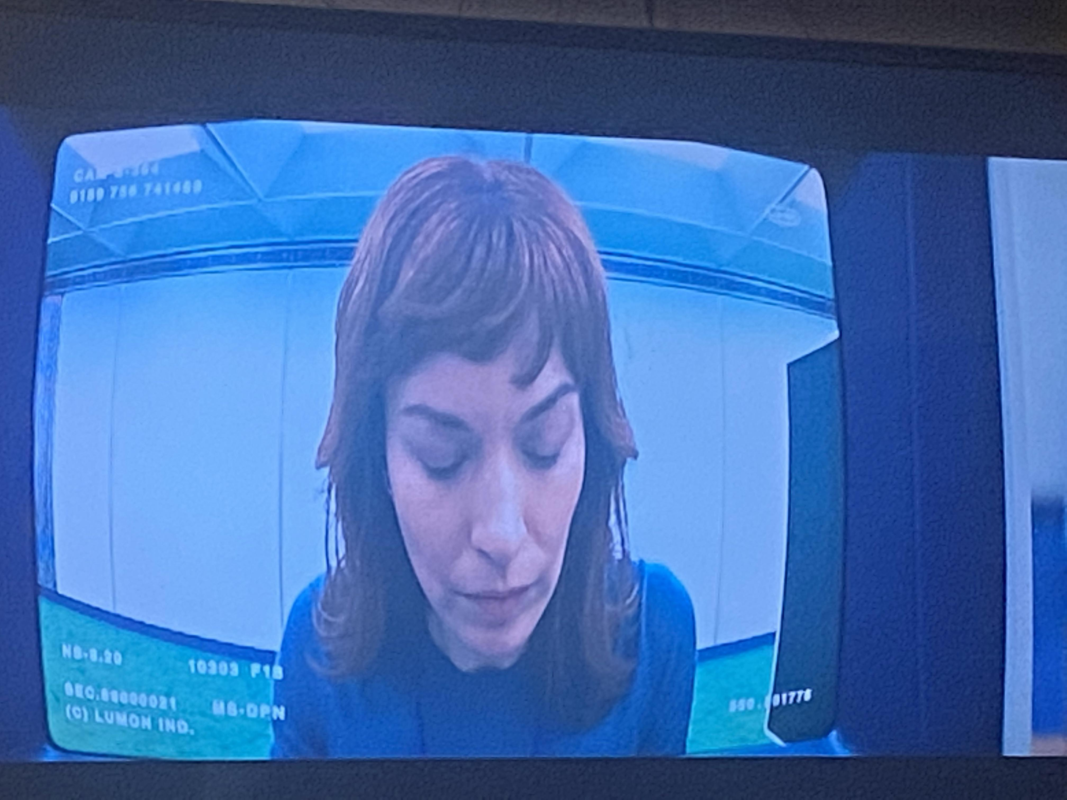
Covert CCTV and Video
Exceptional
DPIA
Article 8 considerations-
Reasonable expectation of privacy
Employee’s home working space?
Private Investigator should be contractually obliged to comply with DPA principles.
Easier to justify if criminal behaviour / gross misconduct –
e.g. McGowan v Scottish Water; City and County of Swansea v Gayle; Lopez Ribalda

Slide 18
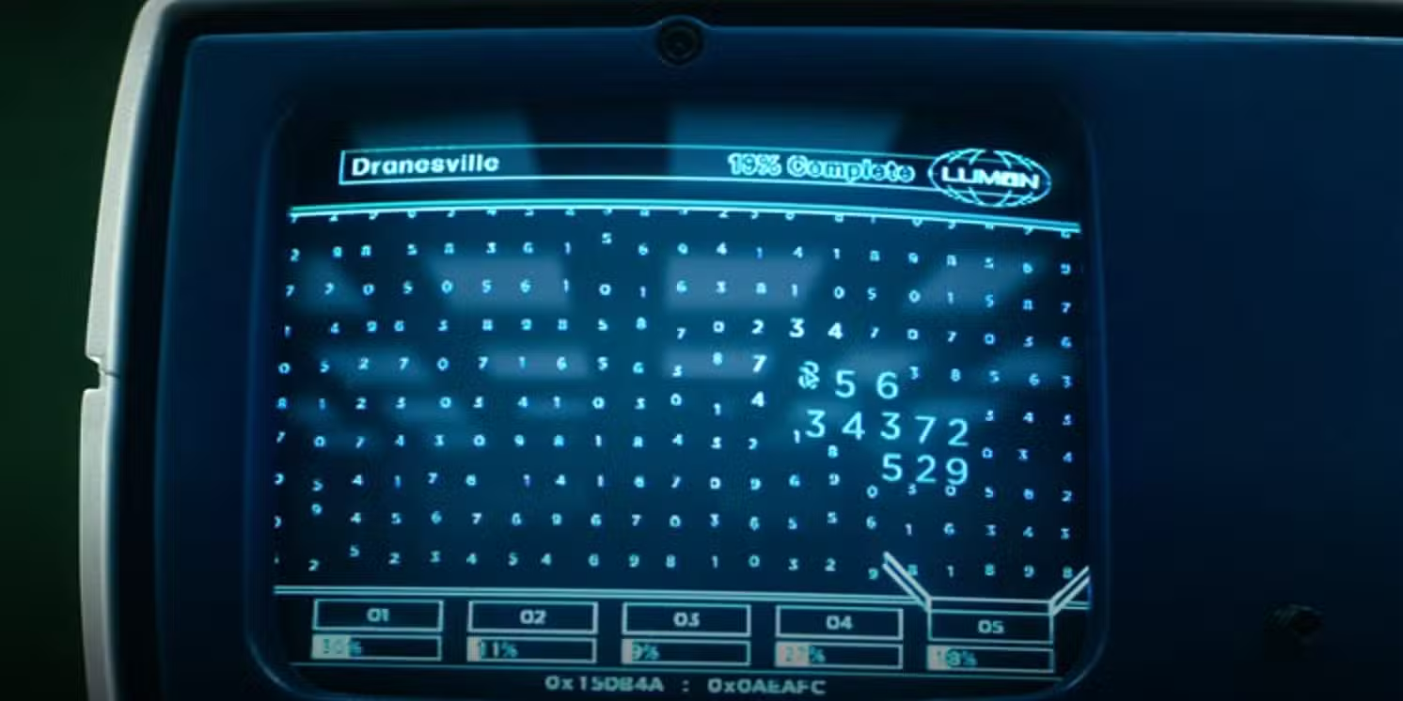
Computer / Screen Capture / Keystroke Monitoring
High Risk -DPIA
Transparency and notification to employees
Should be targeted, not blanket and limited in duration.
Should only be implemented to meet a real legitimate aim
Consider less intrusive alternatives, such as meta data instead of screen content recording, or not recording every key stroke if flagged events will do.
Purpose limitation issues (subject to DUAA amendments).

Slide 19
Computer / Screen Capture / Keystroke Monitoring
May be justified
Would not be justified
Targeted investigation of suspected data expropriation
Cyber security threat / suspected compromised account
Regulated Sector compliance (e.g. financial trading
Always on keystroke logging for “productivity scoring”
Screen capture revealing personal or non work content on remote workers’ devices
Monitoring a worker with disability to ”check” on absence or productivity.

Slide 20
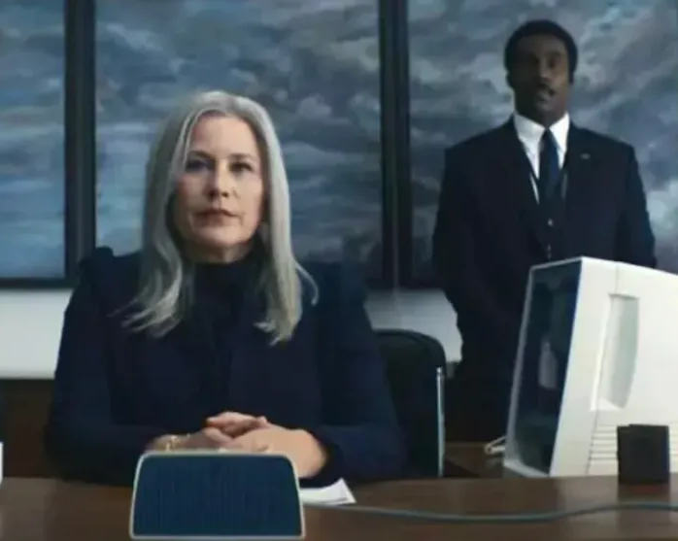
Calls, Email, Social Media and Internet Monitoring
DPIA
Prior and sufficiently specific warnings.
Lawful basis, Proportionality and necessity
Opening of emails etc should be kept to a minimum, try to keep monitoring to the email addresses and headings
Encourage the usage of personal and private markings on emails
Copland v UK; Barbulescu v Romania

Slide 21
Calls, Email, Social Media and Internet Monitoring
May be justified
Would not be justified
Targeted email review for specific suspected misconduct
Internet usage monitoring for cyber security threats
Review of publicly accessible social media posts where there is cause to do so.
Routine inspection of private or personal emails
Accessing private social media accounts / asking for passwords
Full browser history for “productivity checking”.

Slide 22

GPS and Vehicle Tracking

Slide 23
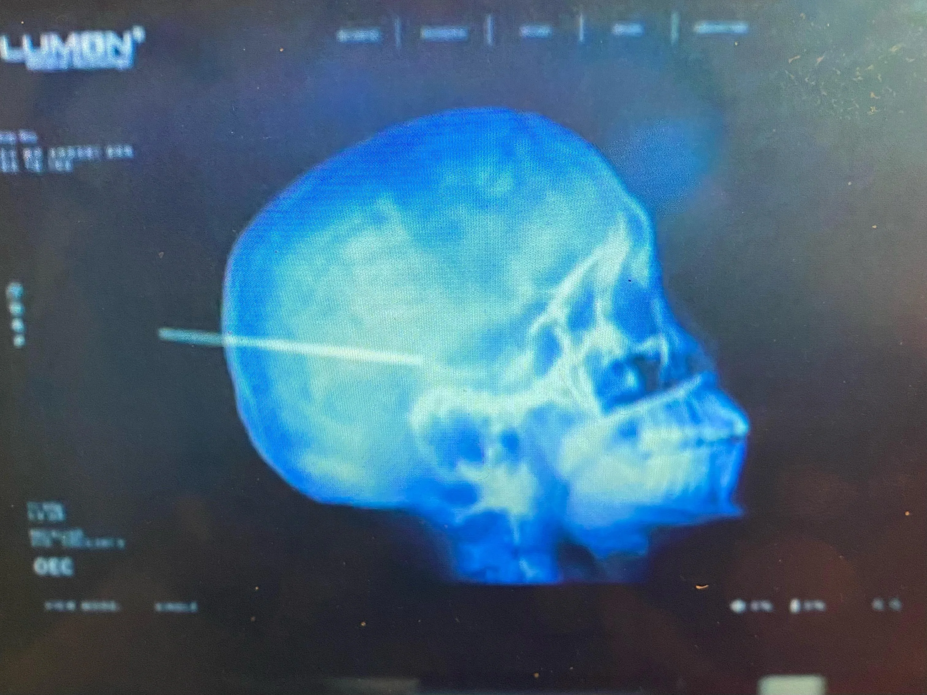
Biometric Surveillance
E.g. Finger prints, facial recognition, iris, recognition, voice recognition, ear recognition- for unique identification.
Now includes - AI powered surveillance–e.g. powered emotion tracking
Special Category data!
Cautionary tale of ICO v Serco Leisure (2024)

Slide 24

DPIA
Article 9 GDPR strict compliance
Explicit consent in most cases.
Article 8 ECHR
Ongoing monitoring of specific risks
Risk of Discrimination.

Slide 25
Biometric Surveillance
May be justified
Would not be justified
Secure Access to safety critical areas
Identity verification in a high-risk of fraud environment
Regulatory compliance requiring robust authentication.
Facial recognition to track worker attendance by the minute
Monitoring employee mood, stress or engagement by facial analysis
Applying to remote workers “just in case”.

Slide 26
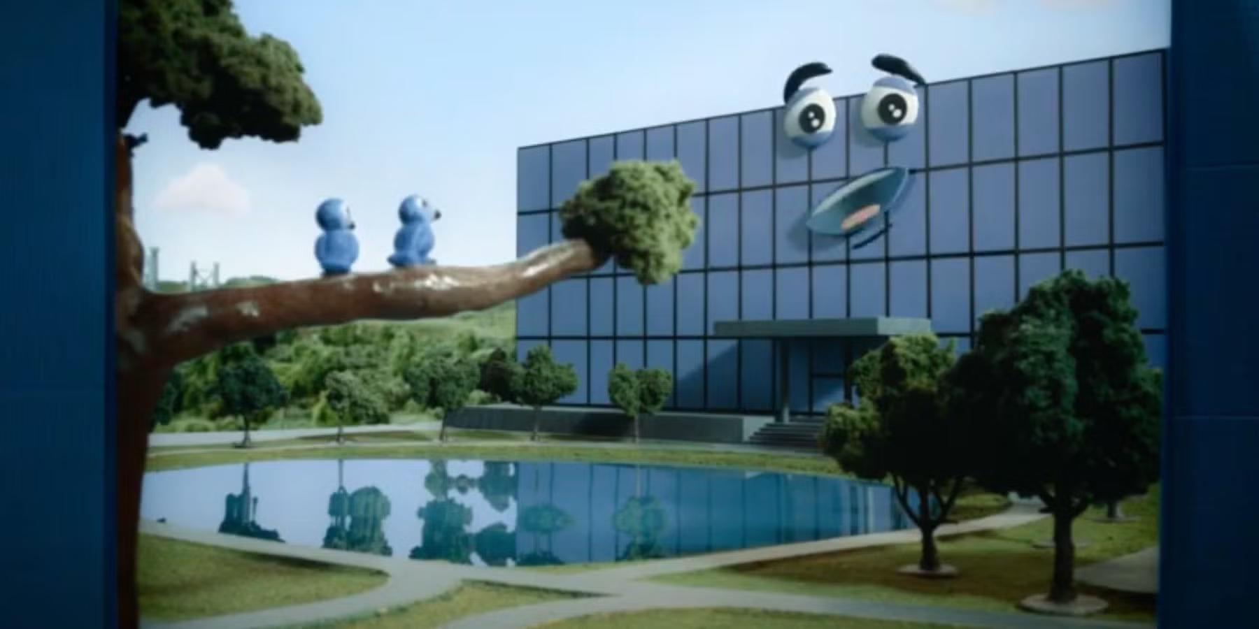
AI
Amplifies every legal , ethical and operational risk associated with biometric surveillance
Will always require a DPIA, with safeguards, consideration of less intrusive alternatives
Reasonable to assume that most AI driven-biometric monitoring will be considered disproportionate unless employer can show an exceptional, safety critical justification
Greater Art 8 EHCR intrusion due to continuous and invisible monitoring
Risk of bias / discrimination
Generation and storage of more sensitive biometric data
Subject to requirements of Art 22 GDPR, including explicit consent

Slide 27

What about wearable technologies?
Smart Watches
Rings
Glasses
Smart clothing
Implants

Slide 28
Employee Surveillance

Slide 29
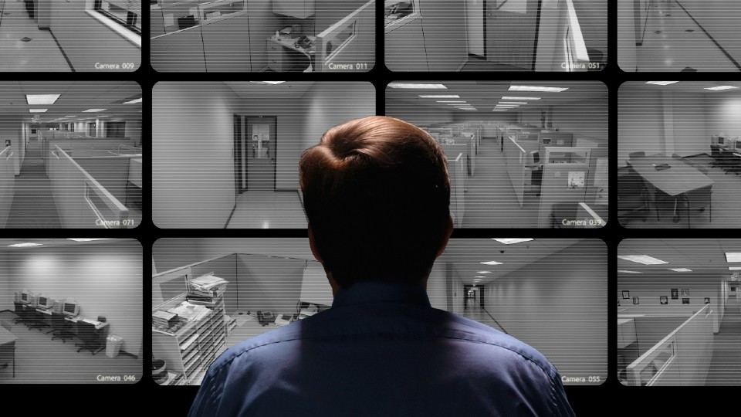
Secret Recordings

Slide 30
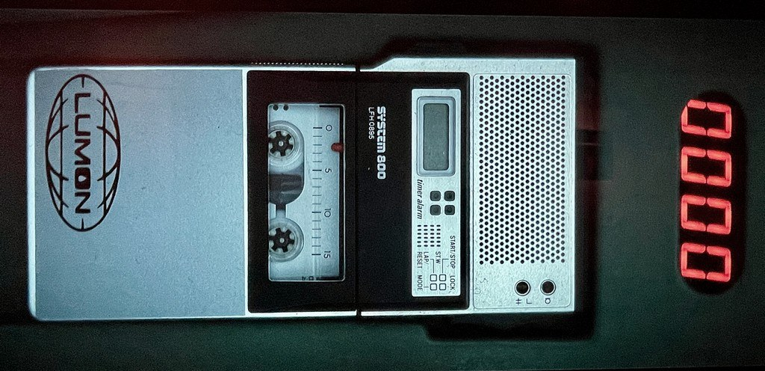
Secret Recordings
Whilst sometimes distasteful, secret recordings of disciplinary and grievance proceedings are (in general) admissible
Evidence of the private deliberations of a disciplinary or grievance panel will not be admissible on public policy grounds
Chairman and Governors of Amwell View School v Dogherty ;
Williamson v Chief Constable of the Greater Manchester Police and another
Vaughan v London Borough of Lewisham and others
Position might be different if those deliberations are outside the area of legitimate consideration of the panel.
Punjab National Bank (International) Ltd and others v Gosain
Fleming v East of England Ambulance Service NHS Trust

Slide 31
Phoenix House Ltd v Stockman [2019] IRLR 960
Covert Recording made of a meeting by the employee.
Held that the covert recording did not amount to a breach of the implied term of trust and confidence in the circumstances.
Covert recordings are not automatically gross misconduct – the EAT held they must be evaluated contextually, not treated as inherently deceptive.
Intent matters – tribunals must consider why the employee recorded (e.g., self‑protection vs entrapment) when assessing blameworthiness.
Covert recordings increasingly common – modern technology means secret recordings are no longer rare; tribunals should take a realistic approach.
Admissible where relevant – following Dogherty, covert recordings may be used as evidence if they help determine fairness.
Misconduct does not bar compensation – such behaviour may justify a reduction, not removal, of compensation (Stockman received a 10% deduction).
Employers might wish to provide for disciplinary consequences of covert recording.

Slide 32

‘Beyond Severance’
Julian.Allsop@guildhallchambers.co.uk

Slide 33
Refreshments Break

Slide 34
Psychiatric Injury and expert evidence - An overview from the front line
Nick Smith
Employment Team Annual Seminar
5 March 2026

Slide 35

Psychiatric Injuries

Slide 36
Psychiatric Injuries – Overview
Claimants can claim damages for personal injury caused by, e.g., unlawful discriminatory acts (Sheriff v Klyne Tugs[1999]).
There is no rule requiring specific evidence of injury in the ET, but in reality, evidence of some sort will be needed.
Personal Injury claims are often complex and require real thought from the outset – they are not an afterthought.
There are often issues about causation and / or divisibility.
Expert evidence may be required.
No requirement that harm was foreseeable!!!

Slide 37
Psychiatric Injuries – Divisibility
Divisible harm – different acts cause different damage; parties only liable for harm for which it is truly responsible.
Indivisible harm – multiple acts result in same harm:
Monocausal – all acts operate in same way to cause harm, impossible to tell which was the actual cause.
Multicausal – single condition caused by several factors, the cumulative effect of which combine to produce single form of harm.
Relevant not only to PSLA award, but also to losses flowing from the discriminatory act.

Slide 38
Psychiatric Injuries – Divisibility
‘More likely that an injury will be indivisible if competing causes are closely related to injury and difficult to separate out consequences’ Olayemi v Athena Medical[2015].
BAE Systems v Konczak [2017] CA:
Employers should only pay for harm caused unless truly indivisible.
Burden on employer to raise apportionment.
ET must try to identify rational basis on harm can be apportioned.
If can be apportioned should be, even if rough and ready.
Consider pre-existing disorders and account for chance of harm occurring in any event.

Slide 39
Psychiatric Injuries – assessing quantum
ET ‘obliged to approach assessment of damages on the same basis as a common law court’ (Salmon v HM Prison Service[2001]).
JC Guidelines, 17th Edition, relevant factors such as:
(a) Ability to cope with life and work.
(b) Effect on relationships with family and friends and those come into contact with.
(c) Extent to which treatment would be successful.
(d) Future vulnerability.
(e) Prognosis.
(f) Whether medical help sought.
(g) Whether injury results from sexual/physical abuse/breach of trust, if so nature of relationship between victim and abuser.

Slide 40
JC Guidelines: PSLA
1. Less severe: between £1,880 and £7,150 temporary symptoms impacting daily activities
2. Moderate between £7,150 and £23,270 where marked improvement has been made by the date of the hearing prognosis good.
3. Moderately severe: between £23,270 and £66,920 unlawful conduct leading to permanent or long-standing disability preventing a return to comparable employment.
4. Severe: between £66,920 and £141,240 serious problems with factors set out in (a) to (d) above.

Slide 41
PSTD
Please note that the JC Guidelines have a separate section for assessing PSLA in these types of cases with awards typically securing more in each category.
Increasing no of claims in which PTSD is being alleged as a consequence of treatment at work.
Please note that this would be very rare save for cases such as sexual assault or incidences of profoundly traumatising events.
Allege this with care.

Slide 42

Expert Evidence

Slide 43
Expert Evidence - Admissibility
Appropriate for ETs to apply test in CPR 35.1 when considering whether to permit expert evidence (Morgan v Abertawe Bro Morgannwg ULHB[2019]EAT).
Kennedy v Cordia Services[2016]SC:
Will the proposed skilled evidence assist the court in its task?
Does the witness have the necessary knowledge and experience?
Is the witness impartial in his or her presentation and assessment of the evidence?
Is there a reliable body of knowledge or experience to underpin the evidence –what is range of medical opinion?

Slide 44
Expert Evidence – Procedure
De Keyser Ltd v Wilson[2001]:
Explore with ET at directions hearing or in correspondence if such evidence is likely to be acceptable.
Joint instruction is usually the starting point.
Letter of instruction should specify in detail questions and the subjects the expert is required to address.
Avoid partisanship.
Separate experts should meet in an attempt to resolve conflict.
Costs can be an issue if one party fails to comply with normal procedure.

Slide 45
The desirability of a single joint expert
Most ET’s will expect this to be the starting point typical reasons include:
Speed:
one interview, one witness, one report.
Cost- an especially big issue with impecunious LIP’s.
Reduces the length of any remedy hearing.
Questions in writing can often resolve conflict.
Less common to need to call the expert to give evidence.

Slide 46
Expert Evidence – Choice of Expert
Normal for one party to produce a list of suitable experts and for the other party to make final choice of expert.
Main points to consider:
What is the injury / illness? PTSD, depression or other psychiatric injury?
How much experience does the expert have in the field?
How credible is the expert? Have they been subject to adverse judgments? What is their track record?
When is the report needed? Can the expert complete the work in time?
Where is the expert located? Will they need to meet Claimant in person or remotely?

Slide 47
Concerns over bias?
It would not be uncommon for a successful claimant to express concerns over the employer’s preferred choice for a SJE.
A large employer might consider it desirable to pay for the report in its entirety. There is no obligation to do so but it might be a better ‘look’.
A highly eminent expert will undoubtedly be more costly.
Good tactic for R to pay?

Slide 48
Should you adopt a ‘PI style’ approach and hold out for your own expert?
Commonly C will have disclosed medical evidence in advance of liability hearing.
Is it desirable to have you own expert?
-Control over the narrative,
-Conferences,
-Potential to seek more than one view,
-Better preparation for giving evidence,
-Tactics and advice.
But cost and significant likelihood ET will not permit.

Slide 49
Expert Evidence - Questions
Key to put all relevant points to expert in written questions.
Common issues:
Causation
Divisibility
JC Guideline points:
Ability to cope with life and work.
Effect on relationships with family and friends and those come into contact with.
Extent to which treatment would be successful.
Future vulnerability.
Prognosis.
Whether medical help sought.
Whether injury results from sexual/physical abuse/breach of trust, if so nature of relationship between victim and abuser.

Slide 50
Questions for the expert
Duration of recovery time?
Role post recovery?
Nature and cost of treatment?
Does the condition fall within the DSM- the Diagnostic and Statistical Manual of Mental disorders. No 5 (American Psychiatric Association). This is the globally leading and highly detailed diagnostic manual for clinically recognised mental disorders.
Whether the individual would have developed the condition in any event if so when?

Slide 51
Challenging the Joint Expert
Common to put questions arising from reports to expert in writing in the first instance.
If points of disagreement remain a party MUST challenge by cross examination in respect of points which it is said ET should not accept (TUI v Griffiths).Factor cost of this in.
Look for any inconsistencies.
Look for points on which expert likely to agree but which have not been addressed in the report.
Less is sometimes more – if the experts report is helpful, why raise something that might lead to a different answer?

Slide 52
Has the expert been mislead by the claimant?
What if you think the expert has been the subject of a concerted effort to exaggerate the truth as to impacts?
Nb. GP records are not holistic.
Cynical claimants can seek ramp up the effects. Call the expert to give live evidence? A difficult balancing act.
A senior and robust expert good for both sides?
Usual for experts to simply by-pass the issue of veracity by confirming that this is a question for the ET.
Merely asking the question can plant the seed of doubt in the ET’s mind.

Slide 53
Major concerns over SJE’s report?
Where there are legitimate grounds to do so you can seek another report for use by one party. Permission is required and it is a high hurdle to leap. Ultimately the test is whether it is just and accords with the overriding objective see D (A Child) v Walker as per Woolf MR [2000] and Cosgrove v Pattison[2001] as per Neuberger J(as he then was).see also Daniels v Walker[2000].
Factors:- questions not sufficient to clarify, nature and scale of issues, scale of quantum, reputational issues impact on proceedings, delay.
Case study:- Sharma v University of Portsmouth[2025]

Slide 54
Adjustments to award
Remember the wrongdoer is only liable for the harm it committed.
The award will be adjusted to take into account the extent to which an act of discrimination was causative of the injury.
Commonly this will be on the basis of a % reduction.
It can be a rough and ready assessment

Slide 55
Overlap with Vento?
Expert evidence can provide useful evidence in respect of Injury to feelings awards. But remember they are different!
Vento covers subjective feelings of upset, frustration, worry anxiety mental distress, fear, grief anguish, humiliation, unhappiness stress and depression.
There can be a clear overlap with PSLA awards.
Beware ‘double counting’ it is not easy to define where ITF finishes and PI starts.

Slide 56
Lunch

Slide 57
The ERB has landed: Litigating in the New ERA
Allan Roberts
Lottie Mallin-Martin

Slide 58
1
3
4
5
2
Agenda
Family Friendly Rights
Harassment
Unfair Dismissal
Zero Hours
Fire and Rehire

Slide 59
1
3
4
5
2
Agenda
Family Friendly Rights
Harassment
Unfair Dismissal
Zero Hours
Fire and Rehire

Slide 60
1
3
4
5
2
Agenda
Family Friendly Rights
Unfair Dismissal
Harassment
Zero Hours
Fire and Rehire

Slide 61
1
3
5
2
4
Agenda
Unfair Dismissal
Harassment
Zero Hours
Fire and Rehire
Family Friendly Rights

Slide 62
1
3
4
2
5
Agenda
Unfair Dismissal
Harassment
Family Friendly Rights
Fire and Rehire
Zero Hours

Slide 63
1
2
3
4
5
Agenda
Unfair Dismissal
Fire and Rehire
Harassment
Family Friendly Rights
Zero Hours

Slide 64
Unfair Dismissal
Qualifying Service and Statutory Cap

Slide 65
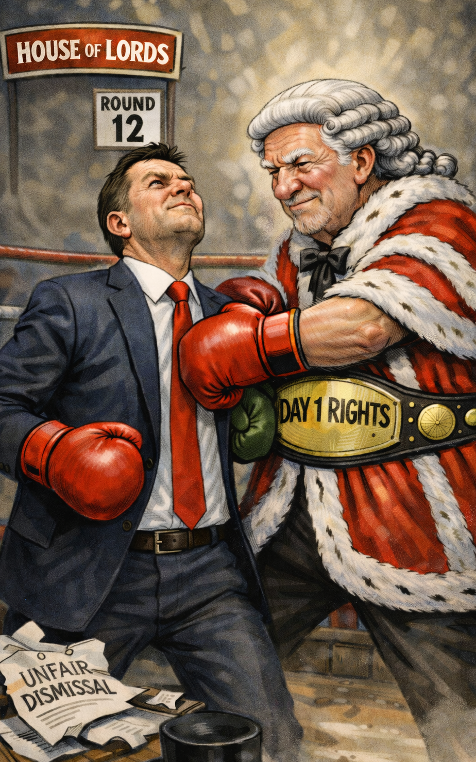
Unfair Dismissal Section 25 amends ERA 1996
S. 108: Qualifying Period reduced to six months.
S. 124: Compensatory limits removed.
S. 209: SOS power to amend removed for s 108.
Notes:
Day 1 Rights Gone
Initial Period of Employment: Gone
Statutory cap now gone.
Show of hands: who thinks this is an improvement for business?

Slide 66
Timing: In Force
Section 25: Expected 1 January 2027
Section 108: Immediately affects anyone employed before 1 July.
“continuously employed for a period of… [6 months] ending with the effective date of termination”
Section 124: From EDT or Remedy hearing?
Notes:
Section 159 Commencement by SOS (including mechanism).

Slide 67
Immediate Implications
Increased/more aggressive dismissals before 1 July 2026?
Increased recruitment before 1 July 2026?
Much more robust interview processes
Rigorous performance processes in first 3-6 months

Slide 68
Thinking ahead
Revise recruitment techniques
Increase use of agency staff
More fixed term contracts
Package review (ad hoc bonuses / share schemes)
Robust probationary/capability processes
Independent investigations
Johnson v Unisys Exclusion Zone?

Slide 69
Fire and Rehire

Slide 70
Three new clauses
S.104I ERA: Variation of contract of employment – restricted variations
S.104J ERA: unrestricted variations
S.104K ERA: replacement of employees with people who are not employees
Notes:
Restricted variations (subsection (5)
Term affecting pay / pensions
Number of hours
Timing of shifts
Reduction of time off
A term in regulations…… and can exclude identified expenses
The inclusion of a variation clause……
Unrestricted variations:
Examples of non restricted variations include:
a. changes in working patterns;
b. changes in duties or job titles;

Slide 71
Date of implementation: food for thought
Expected 1 Jan 2027
Insert unilateral variation clauses NOW?
Pay rises = new Ts & Cs?
Covers actual and constructive dismissal, expiry of FTC

Slide 72
Tricky issues (1): financial circumstances test
If proposed change is a RV (s.104I ERA), not allowed unless:
Non-LA employer: linked to ‘going concern’ or PS employer and ‘financial sustainability of carrying out... statutory functions’ – s.104I(8) ERA
LA employer: relevant intervention direction given for financial difficulty, RV made to significantly reduce / mitigate effect of financial difficulties
‘…could not reasonably have avoided’ RV: Public sector employers (inc. Las) – assessed on JR principles
Note: FC test also applies in s.104K ERA
Notes:
Relevant intervention under s.15 LGA 1999 – had a good dig around, could not find any in place in SW
Best Value Duty -
104I (13) ERA: The reference in subsection (9)(a) to a relevant intervention direction includes a relevant intervention direction given before the day on which the Employment Rights Act 2025 was passed
Judicial review:

Slide 73
Tricky issues (2): matters to be considered
ss.104I(11) + 104J(5) ERA: matters that must be considered are the same
Tribunal considerations can be boiled down to:
Consultation
Quid pro quo
SAVE THAT: s.104J ERA, no fin circs test (s.104J(5)(a) ERA)
What is Eer’s business case?
Notes:
Save that ‘reason for variation’ under s.104J ERA for obv reasons bc worked that out at fin circs test

Slide 74
Tricky issues (3): changes to the workforce
ss.104I(3) and 104J(3) ERA vs. s.104K ERA
Dismissal of employee to employ same or new staff member on varied terms = s.104I(3) / 104J(3) ERA
Note expiry of FTC
Dismissal of employee to replace individual not as employee (self-employment, agency rel, etc.) = s.104K(2) ERA
Includes individual being dismissed and re-engaged as S-E
Notes:
Save that ‘reason for variation’ under s.104J ERA for obv reasons bc worked that out at fin circs test
Includes expiry of FTC > no requirement to be offered varied contract and to refuse (contrast with s.104I(2) / 104J(2) ERA).

Slide 75
Harassment
Failure to prevent Liability

Slide 76
Sexual Harassment Section 20 amends Section 40A EqA
Section 40A EqA
Only enforceable:
Directly by EHRC
ET uplift under s.124A for section 40 claim.
Section 22 inserts a new Section 40B:
“must take all reasonable steps to prevent.”
Power to make provisions, incl what amounts to a reasonable step.
Notes:
Duty to prevent: “sexual harassment of employees of A in the course of their employment”
Initially amended by Worker Protection (Amendment of Equality Act 2010) Act 2023
Lord removed the word “all” in 2023
All reasonable steps would be akin to the “all reasonable steps defence”
Hands up if you’ve ever succeeded
Section 40B: Regs may specify certain matters, including what will be regarded as reasonable steps.
Section 23 also amends Part VIA ERA to include sexual harassment as a qualifying disclosure.

Slide 77
Third Party Harassment Section 21 amends Section 40 EqA
ER (A) must not permit a third party to harass EE
Permit means if:
“(a) the third party harasses B in the course of B's employment by A, and
(b) A failed to take all reasonable steps to prevent the third party from doing so.”
Notes:
S. 40(2)-(4) EqA 3PH for all PCs was repealed in 2013
Govt previously tried to introduce but HL defeated.
HL proposed exception rejected: 3P expressions of opinion of a political, moral, religious or social manner in conversations or speech
Also provisions in s.22: power to mak

Slide 78
Thinking Ahead Amendments expected Aug - October 2026
Risk Assessments
Meaningful training
Reporting structures
Cultural Leadership
Investigative rigour
Monitor and evaluation
Clear policies
Notes:
Risk Assessments: Identify high-risk environments, (lone working, power imbalances, client/customer relations)
Policies: make these purposeful.
Training: including addressing bystander intervention
Reporting structures: multiple channels, confidential options
Cultural Leadership: sounds vague but impactful (not just about box ticking)
Investigation: may not sound like prevention, but often proliferation.
Monitor and evaluate process: this is going to be an iterative learning experience

Slide 79
Family Friendly Rights

Slide 80
Family friendly rights
Flexible working
Ordinary parental leave
Paternity leave
Bereavement leave
Enhanced maternity dismissal protection

Slide 81
Flexible working – amends to s.80G ERA
Not due until sometime in 2027…
Same statutory grounds – but must be at least one of them.
AND must be reasonable to refuse the request on those grounds.
Employer must state the reasons and explain the grounds.
Follow the Acas Code of Practice on flexible working.
Notes:
Acas confirmed Fri 27th Feb on their site would review COP when law comes into effect.

Slide 82
Paternity / parental / bereavement leave
From 6 April 2026: Paternity leave / ordinary (unpaid) parental leave = day one rights.
From 6 April 2026: eligible fathers and partners will be able to take up to 52 weeks of unpaid bereaved partner's paternity leave if the mother or primary adopter dies (not ERA, but BPPL Regs 2026)
Sometime in 2027: bereavement leave.
Notes:
From 18 February 2026, newly eligible employees can give notice that they intend to take leave.
The notice period for paternity leave has been temporarily reduced from 15 weeks to 28 days – only if the expected due date is between 5 April and 25 July 2026. If the due date is 26 July 2026 or later, the usual 15-week notice period will apply.
Bereavement leave:
No right to pay
Scope to be subject of consultation
Power in regulations: so secondary legislation
Must be for at least a week and taken within 56 days of the death

Slide 83
Maternity dismissal protection
From sometime in 2027: dismissal only allowed for redundancy and ‘specific circumstances’ within 6 months of return to work.
Consultation closed 15 Jan 26, re: whether to:
Narrow circumstances for potentially fair dismissal?
Extend to other family leave e.g. adoption / SPL / neonatal care leave…?

Slide 84
Zero Hours

Slide 85
Guaranteed Hours Offer: headline points
See new Part 2A ERA (ss.27BA-27BZ3)
Reforms apply to ZHWs, min hour workers, and AWs.
Entitlement: (1) vary worker’s existing terms to guarantee hours worked, or (2) issue a new contract.
Agency situation: GHO obligation will be on the end hirer
If default, liability on agency
Implementation sometime in 2027…
Notes:
Sometime in 2027: new Part 2A ERA (ss.27A – 27BZ3)
If only hours are being guaranteed, no other terms may be changed. If a new contract is offered, its terms must not be less favourable overall.

Slide 86
Guaranteed Hours Offer: tricky issues (1)
“Low” hours workers
If worker has guaranteed for fewer than [undefined number of] hours, has a right to request a GHO…
Likely to be 12-week reference period…?
Subject of further consultation and regulations…?
Notes:
Sometime in 2027: new Part 2A ERA (ss.27A – 27BZ3)
The exact hours threshold and the length of the reference period will be set by future regulations, but the reference period is anticipated to be 12 weeks. This means, at the end of each reference period, employers will be required to offer an affected worker a contract guaranteeing them hours that reflect the actual hours worked in that period, until the worker is no longer a 'qualifying worker'.

Slide 87
Guaranteed Hours Offer: tricky issues (2)
A GHO, if accepted, re-casts issue of ‘mutuality of obligations’ in the employment contract.
Effect = gives Ees day 1 rights?
Unfair dismissal
New GHO caught by fire and re-hire?
Notes:
Sometime in 2027: new Part 2A ERA (ss.27A – 27BZ3)
27BBRequirements relating to a guaranteed hours offer
(1)An offer by an employer to a qualifying worker is a guaranteed hours offer for the purposes of this Chapter if it is an offer—
(a)to vary the worker’s terms and conditions of employment (but see subsection (6)), or
(b)to enter into a new worker’s contract,
and the terms and conditions as varied or (as the case may be) the new worker’s contract will require the employer to provide the qualifying worker with work, and the qualifying worker to do work, for a number of hours that reflects the reference period hours in the relevant reference period.

Slide 88
Guaranteed Hours Offer: tricky issues (3)
Seasonal workers – s.27BB(9) ERA
GHO cannot be a fixed term contract unless it is reasonable which includes:
Only needed for specific task
Only needed until occurrence of an event
Only temporary need for worker and contract expires at a time when reasonable to consider need ends
Notes:
Sometime in 2027: new Part 2A ERA (ss.27A – 27BZ3)

Slide 89
Outro
A thought on settlements

Slide 90
Final thoughts: settlement prospects?
Time Limits (s 152 and Sch 12): Most claims will be 6 months
NDA (s 24 creates new 202A ERA): Void certain contractual terms
If relates to relevant harassment/discrimination
SOS may make regs providing for an “excepted agreement.
Notes:
Time Limits: More or fewer claims?
More time to resolve and settle
Longer deadline allows more claims to be issued in time
Cap increase makes settlement less likely
NDAs:
If prevents making an allegation or disclosure of relevant harassment or discrimination or ERs response to such conduct or allegations disclosure
Relevant means harassment by a Er or W of employer or of a W of E.
Excepted agreements:
Should apply where requested by a worker
Not imposed by employer
But can still allow (regs) the disclosure or allegation to be made to a specified person

Slide 91
Workshop Sessions

