Slide 1
Guildhall Chambers Annual Property Seminar
12th March
Bristol Marriott Royal

Slide 2
I Hereby Declare…Or Do I?
Where we stand with trusts of land in 2026
Ollie Murrell & Zachariah Pullar

Slide 3
What we will be looking at
National Iranian Oil Co v Crescent Gas Corp [2025] EWCA Civ 1211: s.53(1)(b) and agents, plus execution by companies
Khan v Khan [2025] EWCA Civ 1436: s.53(1)(b) and emails, De Bruyne, and detrimental reliance
Conway v Conway [2025] EWHC 33314 (Ch): s.2, proprietary estoppel, and an argument a debate

Slide 4


Notes:
(L) Strait of Hormuz. Iran to the North, Persian Gulf off to the East. (R) NIOC House in Westminster.

Slide 5
NIOC: Two Key Issues
Did NIOC’s agent’s signature count as signed writing for the purposes of s.53(1)(b) LPA 1925?
If not – what is the status of a trust of land not ‘manifested and proved’ by signed writing?

Slide 6
s.53(1) Law of Property Act 1925:
  No interest in land can be created or disposed of except by writing signed by the person creating or conveying the same, or by his agent thereunto lawfully authorised in writing, or by will, or by operation of law;
  A declaration of trust respecting any land or any interest therein must be manifested and proved by some writing signed by some person who is able to declare such trust or by his will;
  A disposition of an equitable interest or trust subsisting at the time of the disposition, must be in writing signed by the person disposing of the same, or by his agent thereunto lawfully authorised in writing or by will.

Slide 7
NIOC v GSC: my hot takes (pending appeal to UKSC)…
Does s.53(1)(b) really require, in all cases, a personal signature, including for companies?
s.53(1)(b) as a mandatory provision?

Slide 8
Khan v Khan: s.53 and emails
"I want Essex Grove out of my name by 2014. This belongs to the three sisters as stated clearly.
I never wanted this property in my NAME. I did it because no one else had the responsibility, care or inclination to deal with it.
You are not even grateful to the fact that between myself and Ahmed we have maintained, argued with neighbours, improved, fought against tenants, blood sweat and tears, cleaned toilets. So you guys have a block of flats that have at least 40-50 percent equity, not to mention a valuable home should you need it."

Slide 9

Khan v Khan: De Bruyne

Slide 10

Khan v Khan: Detrimental Reliance

Slide 11
Conway v Conway
s.2 Law of Property (Miscellaneous Provisions) Act 1989:
"(1) A contract for the sale or other disposition of an interest in land can only be made in writing and only by incorporating all the terms which the parties have expressly agreed in one document or where contracts are exchanged in each.[…]
(5) Nothing in this section affects the creation or operation of resulting, implied or constructive trusts."

Slide 12
Ollie: Proprietary estoppel can circumvent s.2(1) to enforce otherwise void contracts for the sale of land
Zach: Proprietary estoppel cannot contravene s.2(1) by giving effect to a contract Parliament has deemed to be void
Notes:
2 or 3 minutes.

Slide 13
The Verdict?

Slide 14
Howdy, Partner!
A refresher and update on partnership dissolution
Nicholas Evans and James Fuller

Slide 15
What this seminar will cover
Partnerships under the Partnership Act 1890 (“PA 1890”)
Dissolution
Distinction between technical and general dissolution
Winding up
Syers orders
Bahia v Sidhu [2024] EWCA Civ 605
Cobden v Cobden [2025] EWCA Civ 1612

Slide 16
What this seminar will not cover
Limited Partnerships, governed by the Limited Partnerships Act 1907
Limited Liability Partnerships, governed by the Limited Liability Partnerships Act 2000

Slide 17
What is Dissolution?
Dissolution is not defined under the PA 1890.
Lindley & Banks on Partnership (21st ed) at 24-01:
  “In the case of a partnership, [dissolution] invariably refers to the moment of time when the ongoing nature of the partnership relation terminates, even though the partners may continue to be associated together in a new partnership or merely for the purposes of winding up the old firm’s affairs.”

Slide 18
What is Dissolution?
Two types of dissolution:
  Technical
  General
Not to be confused with dissolution of a company or LLP where dissolution marks the conclusion of winding up, rather than potentially the commencement.

Slide 19
Technical Dissolution
This arises where a change in the composition of a partnership (e.g. one partner dies or retires) results in a dissolution of the existing firm and the creation of a new firm.
The new firm will usually take on the assets and liabilities of the old firm, without any break in the continuity of the business.

Slide 20
General Dissolution
Refers to a dissolution leading up to the full scale winding up of the business and assets.
Once the winding up is complete, the creditors and other liabilities are satisfied, and the remaining assets distributed among the partners, the partnership is at an end.

Slide 21
General Dissolution
May be brought about by:
Mutual unanimous agreement of the partners (s.19, PA 1890).
The exercise of an express power to dissolve reserved by a partnership agreement.
Rescission of the partnership for fraud of misrepresentation (s.41, PA 1890)

Slide 22
General Dissolution
Occurrence of an event specified in the PA 1890, e.g.:
  Expiration of a fixed term, the end of the venture for which the partnership was established or, by any partner giving notice (ss.26(1) and 32, PA 1890)
  Bankruptcy, death of a partner, or a charge created on a partner's share in the partnership property for payment of their separate debts (s.33, PA 1890); or
  An event making it unlawful for the business to be carried on, or for the partners to carry it on in partnership (s.34, PA 1890).

Slide 23
General Dissolution
By court order under one of the s.35 grounds:
  Permanent incapacity of a partner;
  Conduct calculated to prejudice the carrying on of the business;
  Deliberate or persistent breach of the partnership by a partner; and
  Partnership business carried on only at a loss; or
  That dissolution is "just and equitable".

Slide 24
Winding Up
Once a firm has been dissolved, the next step is usually to wind up the partnership business and assets.
Every partner is entitled to have the partnership property applied in payment of all the firm's debts and liabilities and to have any surplus divided between the partners in accordance with their respective entitlement (s.39, PA 1890).
S.39 will apply automatically unless the partners have agreed some alternative structure and stated that section 39 shall not apply.

Slide 25
Winding Up
Usual position on winding up the partnership is the sale of the assets, and the distribution of any surplus to the partners.
A sale of the partnership is usually the most appropriate way to ensure liabilities/creditors are repaid and any surplus is fairly distributed.

Slide 26
Winding Up
A partnership agreement may alternatively provide for a partner's share on a technical dissolution to be bought out at the option of the continuing partners if the partner dies, retires or is expelled and that on a general dissolution some partners may buy out the interest of others in the business.

Slide 27
Syers Orders
A court may order an alternative course of action on dissolution by allowing the majority of the partners to buy out the minority partner.
Such an order is known as a “Syers order” as it was in Syers v Syers (1876) 1 App Cas 174 when the Court first ordered the majority partners to buy out the minority on the dissolution of the partnership.

Slide 28
Syers Orders
Only available where a partnership has dissolved and can relate to the shares of several partners so long as they form, together, a minority of the partnership.
Can relate to the entire minority's share or just specific assets belonging to that minority partner.
Some businesses will benefit from such an order over a general sale of partnership business and assets as an open market sale could have a prejudicial effect on the value of the continuing business.

Slide 29
Syers Orders
“It is I think notorious in the Chancery Division that Syers v Syers is an authority far more frequently cited by counsel than applied. But the discretion which it gives seems to me a valuable one which I think judges should not hesitate to use when it suits the justice of the case.”
Hoffman LJ in Hammond v Brierley (1992, unreported)

Slide 30
So, when can the Syers Order Discretion be exercised?
Bahia v Sidhu [2024] EWCA Civ 605 gave a recent helpful overview of the relevant principles and outlined when a Syers order can be made.
Cobden v Cobden [2025] EWCA Civ 1612 revisited the issue and gave advice on whether the list in Bahia was inclusive or exclusive.

Slide 31
Bahia v Sidhu [2024] EWCA Civ 605
The overriding principle, Andrews LJ at [45]:
  “… a sale by auction would not serve the interests of justice. It would not maximise the value of the assets or, even if it would, it would unduly favour one of the parties or unduly disadvantage the other(s) a sale would not serve the interests of justice.”
The Judge below erred in considering that a Syers order was optional even where a sale on the open market could take place. It required ‘exceptional circumstances’.

Slide 32
Bahia v Sidhu [2024] EWCA Civ 605
The exceptional circumstances: Andrews LJ at [44]
  (i) where one partner has a very small stake in the partnership, and selling would create disproportionate injury.
  (ii) A sale in the open market is obviously not going to maximise the value of anyone's share in the partnership.
  (iii) A sale would breach the express or inferred terms of the partnership agreement.
  (iv) (possibly) where it is established one partner wants to artificially inflate price to the detriment of another.

Slide 33
Cobden v Cobden [2025] EWCA Civ 1612
HHJ Russen KC (the Judge below) held the following:
  That the list of exceptional circumstances in Bahia was inclusive and not limited to the four circumstances outlined.
  There was a further circumstance when a “proprietary estoppel-ish" equity arose between the partners.
  This enabled the court to intervene and make a Syers Order.

Slide 34
Cobden v Cobden [2025] EWCA Civ 1612
The CoA agreed that :
  The list in Bahia was inclusive and not limited to the four circumstances outlined. They were only ‘examples’, see Newey LJ at [32].
  Where a party could show a case in proprietary estoppel, then a court may order a Syers order if a party elects to choose that remedy rather than their entitlement under a traditional proprietary estoppel claim for transfer of title.
  A Syers order may be made where it is necessary to do so in order to avoid unfairness or injustice, see Lewison LJ at [57].

Slide 35
Cobden v Cobden [2025] EWCA Civ 1612
The CoA thought that HHJ Russen KC could have explained in more detail what the “proprietary estoppel-ish" claim was.
Lewison LJ referred to the summary provided by Lord Briggs in Guest v Guest [2022] UKSC 387 at [13].
If a judge finds the constituent elements necessary for an estoppel to arise have been proven on the facts, that would justify the making of a Syers order.

Slide 36
Where Now?
Is the Syers jurisdiction in broadly the same place as it has been for some decades but with greater clarity concerning the principles, application and limits?
Or is there now potential scope for future arguments?

Slide 37
Injunction or Damages in Lieu: Where are we?
Christopher Stoner KC and Jay Jagasia

Slide 38
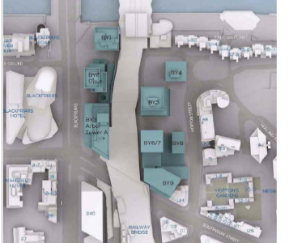
Injunctions or Damages in Lieu
Cooper v Ludgate House Limited [2025] EWHC 1724 (ch)
Fancourt J
Rights of Light case: 2 flats in issue
Injunction claim related to Arbor Tower (BY3)

Slide 39
Setting the scene
An infringement with rights of light was established.
The diminution on capital value for each flat caused by the loss of light was £60,000 and £20,000.
The cost of demolishing and rebuilding Arbor was about £250m.
The value of the net gain of the notional cut-backs was £30m
A fair share representing negotiating damages was 12.5%, namely £3.75m
The share attributable to the flats was £1.25m

Slide 40
Injunctions
In Cooper Fancourt J confirmed:
“…Fen Tigers is to be taken as establishing a new approach, in which the court has a broad discretion whether to grant an injunction or award damages for nuisance, taking account of all relevant factors, but with the legal burden of persuasion to award damages lying on the defendant.”

Slide 41
Injunction Refused
Factors relevant to refusal of injunction included:
The tenants of Arbor had not been joined.
Likely to be futile – Arbor might be demolished and a new equally large building erected using s.203.
The harm to the public, the tenants of Arbor and D's legitimate interests disproportionate to harm to C's.
Public benefit in retaining Arbor
D's conduct was not an issue.
Other tenants of flats had settled.

Slide 42
Damages in lieu
Important aspect of Cooper judgment.
Wrotham Park Estate Co Limited v Parkside Homes Limited [1974] 1 W.L.R. 798 - "Wrotham Park damages"
One Step (Support) Limited v Morris-Garner [2019] A.C. 649 - "Negotiating damages"
Fancourt J accepted submission that One-Step creates "a new principled basis for whether negotiating damages are available."

Slide 43
Damages in lieu
Negotiating damages appropriate "...as it is a claim to enforce an easement, where an injunction is refused as a matter of discretion in favour of damages under Lord Cairn's Act". [319]
"...loss of the right to enforce a property right, such as an easement, is a typical case where what has been lost by the withholding of equitable relief is the economic value of the right itself – as it is lost forever – and the effect is otherwise to require the claimants to permit infringement with their rights." [321]
Common law damages inadequate

Slide 44
Assessing negotiation damages
Judge started with reference to Amec Developments Ltd v Jury's Hotel Management (UK) Ltd (2001) 82 P & CR 22.
Hypothetical negotiation between a willing seller and a willing buyer – therefore wrong to assume a ransom arises:
"The negotiations are not a ransom exercise because the Claimants are deemed to be willing to sell at a reasonable price and the developer is deemed to be willing to buy at a reasonable price" [339]

Slide 45
Assessing negotiating damages
Holistic view including matters such as:
Extent and nature of injury to C's property
Value of the property injured
Extent and value of benefit to D
The number of claims and their possible value
Whether C should be rehoused; costs of improvement
Whether C has right to compensation on other grounds

Slide 46
Assessing negotiating damages
It is important, probably as a last step, to stand back and ask whether the sum 'feels right'
In Amec Anthony Mann QC said:
"As important as any of the above factors is this. In any negotiation science and rationality gets one only so far. At the end of the day the deal has to feel right..."

Slide 47
Assessing negotiation damages
Postscript: be careful to consider context. Thus:
In covenant cases, there can be an application under s.84(1) for modification, where damages are assessed on diminution in value basis.
In RoL cases, 'book value' may still be appropriate, e.g. if very remote chance of an injunction.

Slide 48
Encroachment cases
Harrow LBC v Donohue [1995] 1 EGLR 257 (CA)
Half of garage erected by D encroached onto C’s land, C having refused to sell land to D [found D was aware of encroachment but built anyway]
First instance decision = damages in lieu of injunction [NB assumed by parties that matter of discretion]
CA decision = injunction and appeal allowed [NB prompting by CA = “The case has been looked at here on a more fundamental footing. Was there really any discretion at all?”]

Slide 49
Different approach in encroachment cases?
…in a situation such as the present where the land owner has been totally dispossessed…the plaintiff does indeed have an option. He may say "Thank you very much" and accept the encroachment as an accretion to his land with which he is free to deal as he pleases; or he may take his remedy at court. If he follows the latter course, he is entitled as of right to one or other of two remedies; that is to say to an order for possession, or to a mandatory order…The court may well retain a limited discretion…in making a choice between those two remedies.

Slide 50
Distinguishing encroachment cases from other interferences
Wrotham Park line of authority distinguished - expropriation
“…there was no authority which provided a precedent for a court allowing total dispossession to be achieved by means of an award of damages in lieu of an injunction or in lieu of a possession order”
Does Harrow remain good law and has it survived more recent developments in area?
NB doubts expressed in Site Developments (Ferndown) Ltd v Barratt Homes [2007] EWHC 415 (Ch) – “this decision is very difficult to reconcile with the main stream of authority in this area” – possibility that Harrow better rationalised as a case of poor conduct by D and/or significant encroachment

Slide 51

Nasty Neighbours

Slide 52
Bad Conduct: 3 centuries of jurisprudence
High-handed and unneighbourly conduct and/or indifference - deterrence
Shelfer [1895] 1 Ch 287: “There may also be cases in which…the defendant by his conduct, as, for instance, hurrying up his buildings so as if possible to avoid an injunction, or otherwise acting with a reckless disregard to the plaintiff’s rights, has disentitled himself from asking that damages may be assessed in substitution for an injunction”
Jaggard v Sawyer [1995] 1 WLR 269 – conduct relevant to court’s consideration of all the circumstances
Fen Tigers [2014] AC 822 – Lord Neuberger endorsed observations of Lord Macnaghten in Colls [1904] AC 179
Alexander Devine v Millgate [2020] 1 WLR 4783 – bad conduct highly relevant at discretionary stage (RCs and s.84 apps)
Notes:
Jaggard – Millett LJ: “At one extreme, the defendant may have acted openly and in good faith and in ignorance of the plaintiff's rights, and thereby inadvertently placed himself in a position where the grant of an injunction would either force him to yield to the plaintiff's extortionate demands or expose him to substantial loss. At the other extreme, the defendant may have acted with his eyes open and in full knowledge that he was invading the plaintiff's rights, and hurried on his work in the hope that by presenting the court with a fait accompli he could compel the plaintiff to accept monetary compensation”
Fen Tigers: Lord Macnaghten’s observations: ““In some cases, of course, an injunction is necessary—if, for instance, the injury cannot fairly be compensated by money—if the defendant has acted in a high-handed manner—if he has endeavoured to steal a march upon the plaintiff or to evade the jurisdiction of the court. In all these cases an injunction is necessary, in order to do justice to the plaintiff and as a warning to others. But if there is really a question as to whether the obstruction is legal or not, and if the defendant has acted fairly and not in an unneighbourly spirit, I am disposed to think that the court ought to incline to damages rather than to an injunction. It is quite true that a man ought not to be compelled to part with his property against his will, or to have the value of his property diminished, without an Act of Parliament. On the other hand, the court ought to be very careful not to allow an action for the protection of ancient lights to be used as a means of extorting money.”

Slide 53
Disentitlement in action: Beaumont
Beaumont Business Centres Ltd v Florala Properties Ltd [2020] EWHC 550
Rights to light case
C entitled to injunction requiring D to cut back development or to negotiating damages in lieu (at C’s option)
“I do so because, for the reasons I have given (i.e. Florala went ahead with the development knowing of the risk that it was taking and ignoring the offer to develop with a cutback) it acted in my judgment in a high handed, or at least unfair and unneighbourly, manner”

Slide 54
Rogers
Rogers v Humphrey [2017] EWHC 3681 (QB)
RC case - RC negotiated and agreed between parties!
C entitled to injunction and appeal dismissed – required to demolish substantial building works
Reprehensible conduct by D taken into account as part of multi-factorial discretionary assessment
“…the Judge made extensive relevant findings of fact. These included that in late 2012 the Defendants constructed a new building, the NAB, in plain breach of the covenant. There followed discussions between lawyers for both parties over a new covenant, but this was not executed. Once again, without asking consent or notifying them, the Defendants began substantial building works. This was being, "fully aware that the Claimants were opposed to residential development on his land"

Slide 55
Ottercroft
Ottercroft v Scandia [2016] EWCA Civ 867
Rights to light case
C entitled to injunction and appeal dismissed even though only minor infringement
Reprehensible conduct played important role
D breached undertaking proffered in lieu of interim injunction!
“at all material times [Dr Rahimian] was fully aware that he might be infringing the rights of his neighbours, but wished them to remain in ignorance of what he was planning on doing”

Slide 56
Risk-taking vs bad conduct
Cooper: “Risk-taking is a necessary part of commercial life and should not be regarded as synonymous with recklessness. The authorities suggest instead that “acting in a high-handed manner”, “attempting to steal a march”, “acting with reckless disregard” or “acting wantonly and quite unreasonably” are the hallmarks of a case where the court might not be receptive to a disproportionate harm argument”
Not a case where developer acted “unfairly, exploitatively or covertly” and so D entitled to “advance the points of futility, waste of resources, oppression and public harm as reasons for refusing injunctive relief”

Slide 57
Other factors
De minimis injury and delay – prevailing countervailing factors to bad conduct in Ketley v Gooden (1997) P&CR 305 – bad conduct in itself might not be sufficient
Curious case of delay – (1) failure to apply for interim relief not generally considered a bar to obtaining final injunctive relief (Mortimer v. Bailey [2005] 2 P&CR 9) – (2) BUT C who does not apply runs risk that “it will be oppressive at trial to order a defendant to pull down a building which he has put up in the meantime” (Beaumont)
Futility, waste of resources, other affected persons, public vs private interests
Notes:
Mortimer – Peter Gibson LJ – doubted that a claimant who failed to apply for an interim injunction "should generally be debarred'' from obtaining a final injunction, because depending on the circumstances it might be entirely reasonable for him, having put the defendant on notice, to proceed to trial instead, without taking the risk of expending money wastefully in seeking interim relief

Slide 58
Break

Slide 59
Binding Boundaries
The re-assertion of the force of boundary agreements
Kate Harrington, Michael Selway and Jakub Kaluza
The material contained in this presentation is provided for general information purposes only. It does not constitute legal or other professional advice. No responsibility is assumed by any member or pupil of chambers for its accuracy or currency, and reliance should not be placed upon it. Specific, personal legal advice should be obtained in relation to any case or matter. Any views expressed are those of the named author or speaker.

Slide 60
Boundary Agreements
General position up to 2025, esp. re. validity/binding successors
Caselaw in 2025: White v Alder, Byrne v Archer, Bishop v Jaques
Agreed expert determination; alternative dispute resolution

Slide 61
Several ways of fixing/determining boundaries
Conveyance (interpretation)
Legal presumptions
Adverse possession
Statutory/judicial authority
Proprietary estoppel

Slide 62
Boundary Agreement
Another way of fixing/determining boundary – clarify if unclear, lost or unknown (ancillary to/supersede conveyance?)
nb. marking out agreed boundary before sale as part of surrounding circumstances in interpreting conveyance

Slide 63
Valid and Binding on Successors in Title?
Obvious policy reasons to promote boundary agreements
But legal analysis?
Validity: compliance with formalities?
Binding successors in title: registration?

Slide 64
Neilson v Poole (1969) 20 P & CR 909
Boundary had been staked out and orally agreed in same position as court later found on true interpretation of conveyance – if court wrong on latter, did boundary agreement bind successor in title?
Held: distinction between boundary agreements (i) to demarcate boundary and (ii) to convey land around boundary; to be (rebuttably) presumed that boundary agreements are of the former type
Such agreements occur where – as here – boundary unclear and parties seek to clarify it, so no conveyance of land or at least not consciously
Boundary agreements of demarcation type bind successors in title to land, despite lack of land charges registration, as not agreements to convey

Slide 65
Joyce v Rigolli [2004] EWCA Civ 79
Express oral agreement as to position of boundary, staked out on ground, fence subsequently erected there
Might have involved both sides giving up small pieces of land, one party consciously thought they were doing so
Held: Still boundary agreement of demarcation type even if trivial disposition of land consciously made; to be (rebuttably) presumed that any such disposition trivial for this purpose
Such boundary agreement valid, though not in writing, as not required to comply with Section 2

Slide 66
Melhuish v Fishburn [2008] EWCA Civ 1382
Oral agreement as to boundary, whereby defendant gave up strip of land in exchange for small additional pieces of land, subject to any equalisation payment
Held: agreement demarcating boundary, amounts of land transferred were trivial; so valid, not having to comply with Section 2
Conclusion not affected by agreement providing that defendant would have to pay where he benefitted from it

Slide 67
Yeates v Line [2013] Ch 363
Parties reached oral agreement to compromise boundary dispute
No finding that parties intended any disposition of land, but effect of agreement was disposition by one side to other of considerably more than trivial amount of land
Held: Although agreement to demarcate has disposing effect, of more than trivial amount of land, not void under Section 2 which refers to agreement with disposing purpose
Demarcation agreement which has disposing effect not caught by Section 2 unless it has disposing purpose and disposes of more than trivial amount of land

Slide 68
General Position up to 2025
Nata Lee Ltd v Abid [2015] 2 P&CR 3 (CA)
Gibson v New [2021] EWHC 1811 (QB)
Boundary agreements binding on successors?

Slide 69
Boundary Agreements and Expert Determination
A Boundary Agreement is a contract
  Can be avoided in the same way as any other contract
The importance of being clear whether a joint surveyor is giving non-binding advice or a binding expert determination:
  Ely v Simmons [2012] EWCA Civ 1674
  Gibson v New [2021] EWHC 1811 (QB)
  Crea v Camp [2025] EWHC 2638 (KB)

Slide 70
Crea v Camp [2025] EWHC 2638 (KB)
Key Issue: Whether the parties made a binding determination agreement is assessed on offer/acceptance principles
Crea on 6 Dec 2016: “As a surveyor has to be involved to assess the wall, we will also ask him to assess the disputed boundaries.”
Camp on 9/11 Dec 2016: “We are advised that the best way forward is to jointly instruct a Boundary Surveyor…and agree beforehand to accept their result.”
Crea 12 Dec 2016: ”We are content that a joint surveyor be appointed to assess the boundary and your suggestion of using Lewis Brown is acceptable.”

Slide 71
Crea: The Expert Report of Mr Brown
Instruction clarity matters: “assess” vs “determine the legal boundary”
“I was asked to ascertain the location of the legal boundary between the two properties forming the eastern boundary of Sunnyside and the western boundary of The Heathers”
“As it is not possible, with the evidence to hand, to determine the exact legal boundary, I believe the best solution is to create a new Determined Boundary that agrees with my findings, but provides a practical solution to an unanswerable question, G or G1”

Slide 72
Crea: The Boundary Agreement
The trial judge found a boundary agreement
On appeal: Parties had entered into a binding agreement as to the demarcation of their boundary
Important points:
  Caution over parties agreeing a surveyor to “assess” a boundary
  Relevance of Nata Lee Ltd v Abid [2014] EWCA Civ 1652 if surveyor’s determination transfers more than “trivial” land?
    “While a plot measuring some three metres by four metres may be trivial in the context of a field or a garden, where it enables the recipient (by adding it to his existing land) to obtain a car parking place in a busy urban setting, it is of real significance”

Slide 73
Boundary Agreements in Applications for Determined Boundary
Form DB
  A plan or plan and verbal description identifying exact line
  An arguable case that this is the exact line
  Identify all the owners of land adjoining the boundary
If an objection is not groundless then referred to FTT
Can achieve finality even without a DB outcome

Slide 74
Witt v Woodhead [2020] UKUT 0319 (LC)
Judge Cooke [at 69]:
“That leaves the parties without a determined boundary. However, all my findings about the position of the boundary were made in order to decide what direction should be given to the registrar. They therefore create an issue estoppel between the parties, which means that they cannot be questioned in any future proceedings between the parties in which the position of the boundary is in question. The parties will of course have to sort out the fence in the back garden, and will be able to do so in the light of my findings”

Slide 75
Why Boundary Agreements Matter?
Between 2019 and 2024, there have been 258,177 completed boundary agreements through HM Land Registry. (HM Land Registry: Freedom of Information disclosure log)
Research conducted by Opinium in 2022 estimated that:
  In 2021, 6.6 million homeowners have argued about boundaries.
  The average area in dispute was just 27.5 sq ft – this is 2% of a typical garden.
  20% of disputes concerned under 10 sg ft of land.

Slide 76


Slide 77
White v Alder [2025] EWCA Civ 392
The Appellant and Respondents were neighbouring freehold owners of Willow Cottage and The Old Stores, both purchased in November 2005.
In October 2005, their predecessors orally agreed the boundary line and later recorded it in writing with a text and plan.
In 2016, the Appellant demolished part of the boundary wall and began constructing an extension. In 2020, the Respondents issued proceedings seeking, Declarations confirming the correct boundary line between the two properties

Slide 78
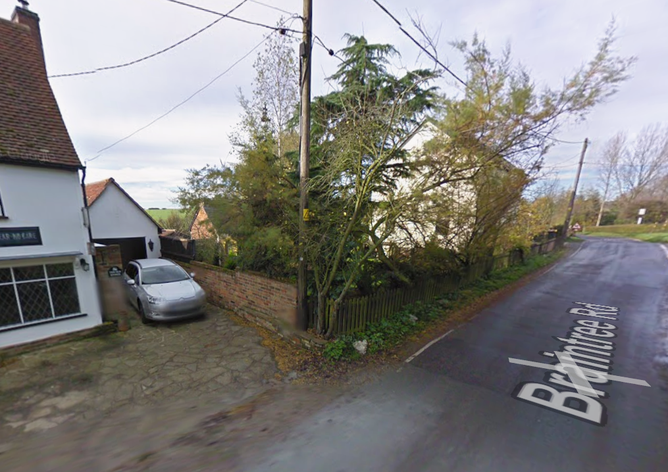
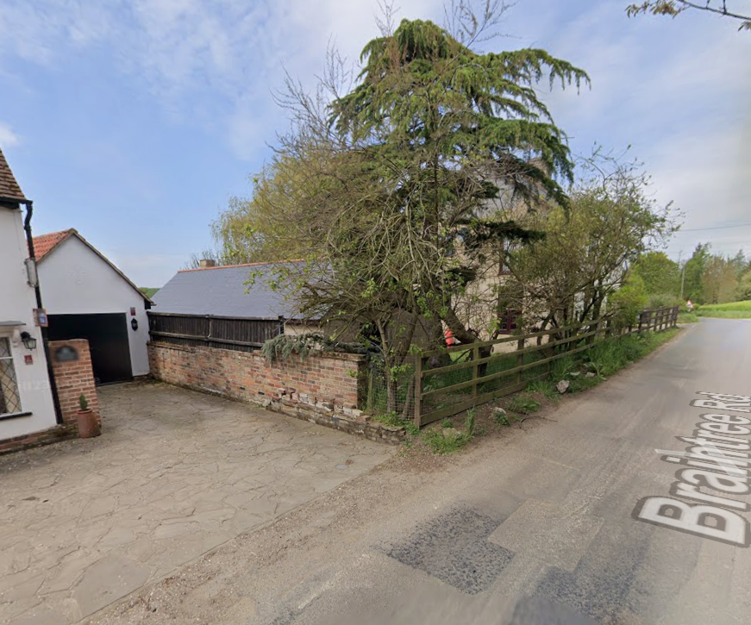

Slide 79
White v Alder & Anor [2025] EWCA Civ 392
The District Judge made three findings.
First, the Boundary Agreement was reached before the sale of Willow Cottage to the Appellant, and The Old Stores to the Respondents.
Secondly, the Boundary Agreement clarified an uncertain boundary; it was not a contract to convey land.
Thirdly, Boundary Agreement bound the Appellant, and the Respondents, as successors in title.

Slide 80
White v Alder & Anor [2025] EWCA Civ 392
Court of Appeal confirmed two types of boundary agreements following Neilson v Poole (1969) 20 P & CR 909. The Court also accepted that there is no need to act upon the boundary agreement by building any fence or similar feature. Boundary agreement is valid as long as it clearly defines the boundary.
Most importantly the Court held that:
Boundary Agreements bind successors in title
Knowledge of the existence of the agreement is not relevant

Slide 81
Boundary Demarcation Agreement bind successors in title
[54] “Such an agreement has proprietary effect and, as a result, also binds successors in title. … It defines and delineates the boundary between the properties as from the root conveyance or transfer. Such an agreement is, of its very nature, a delineation of the property transferred or conveyed and is so for all purposes. As no one is able to transfer or convey more than they own, such an agreement effectively “binds” successors in title whether or not they have knowledge of it. It does so because it defines what they purchase. …. a legal boundary does not move because the land is subsequently conveyed or transferred.”
Asplin LJ

Slide 82
Knowledge is not required
[58] “None of the authorities, including those concerned with successors in title, turns upon or for that matter, makes mention of whether the person seeking to avoid the effect of the boundary agreement had notice or knowledge of it. That is not surprising. A boundary demarcation agreement is neither an equitable interest for the purposes of unregistered conveyancing nor an overriding interest for the purposes of registered land. It clarifies the border or boundary between the properties shown in the conveyance or transfer. It does not turn on knowledge, therefore.”
Asplin LJ

Slide 83
Bishop v Jaques [2025] UKUT 141 (LC)
The case concerned a long‑running boundary dispute between Mr Bishop (owner of The Avenue) and Mrs Jaques (owner of Beacon Cottage), regarding which property owned a narrow strip of land where a row of pine trees once stood.
A 1971 written memorandum was signed by the then‑owners, Mr Noble (North Lodge/The Avenue) and Mr Dewar (Beacon Cottage), stating that the strip of land with pine trees formed the western boundary of Beacon Cottage and belonged to the Dewars.

Slide 84
Memorandum
This is to certify that it is agreed between Stewart Grant Dewar of Beacon Cottage, Battle, and Charles Patrick Cay Noble of North Lodge, Battle, that the strip of land and the trees thereon which forms the western boundary of Beacon Cottage is the property of the said Stewart Grant Dewar

Slide 86
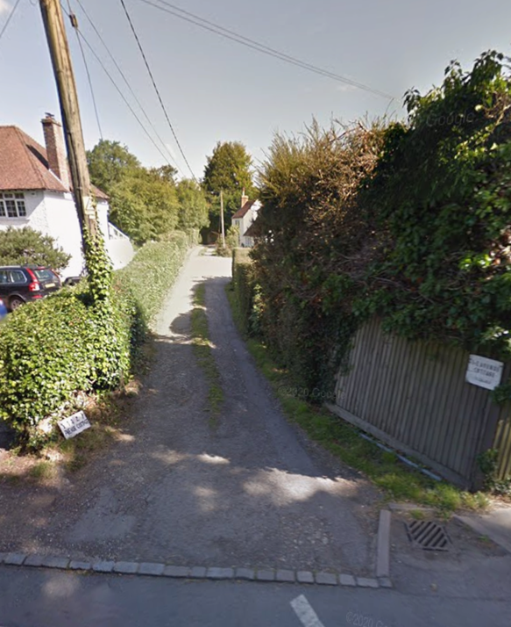

Slide 87
[41] “The original parties having agreed that the trees and the strip of land on which they stood (a reference to the verge on the eastern side of the Avenue) were part of Beacon Cottage, it is immaterial for the purpose of these proceedings that the precise position of the trees was not specified. The stumps of the trees are still present and their location is not in doubt. Nor is there any need for a boundary agreement to satisfy the technical requirements of a determined boundary application. What matters is that the owners of land on both sides of the boundary agreed that the trees and the strip of land they stood on form the western boundary of Beacon Cottage. That is enough to defeat Mr Bishop's application to determine a boundary up to three or four metres to the east of the trees.”
Martin Rodger KC

Slide 88
Byrne v Archer [2025] EWHC 1136
Neighbour dispute between owners of Hillsway (Byrnes) and Brookfields (Archers) over the Southern and Western boundary hedges.
Claimants argued that, during planning for Brookfields (2006), the Archers agreed the hedge marked the boundary. Court found no evidence of any such agreement.
Defendants argued that Claimant’s predecessors met them during pre‑contract enquiries in 2019 and confirmed the Archers owned both hedges. The court did find this amounted to a binding boundary demarcation agreement.

Slide 91
Byrne v Archer [2025] EWHC 1136
The Court held the Southern Hedge lay wholly within Brookfields, and the Western Hedge, originally straddling the line, became wholly Brookfields’ via the 2019 agreement.
Byrne demonstrates how boundary demarcation agreements can arise informally, even via pre‑contract discussions or emails.
It confirms the strong judicial policy preference for certainty and neighbourly agreements.

Slide 92
Key Takeaways
Boundary Agreements bind successors in title.
Lack of knowledge is immaterial !!! (Especially relevant in conveyancing process – Title Insurance may be solution)
There are no technical requirements for boundary agreements, but they must be precise as to the boundary location.
Boundary agreement is an “act of peace” but it is a powerful weapon in boundary disputes.

Slide 93
A big year for Property, and a bigger year coming for Landlords and Tenants?
Oliver Mitchell and Jessica Sharratt

Slide 94
Nazir and another v Begum [2025] EWCA Civ 587, [2025] 4 All ER 72
Land Registration Act 2002 Sch 6 para 12:
“A person is not to be regarded as being in adverse possession of an estate for the purposes of this Schedule at any time when the estate is subject to a trust, unless the interest of each of the beneficiaries in the estate is an interest in possession.”

Slide 95
Nazir and another v Begum [2025] EWCA Civ 587, [2025] 4 All ER 72
Administration of Estates Act 1925 section 33(1):
“On the death of a person intestate as to any real or personal estate, that estate shall be held in trust by his personal representatives with the power to sell it.”
Is this a trust for the purposes of paragraph 12?

Slide 96
Nazir and another v Begum [2025] EWCA Civ 587, [2025] 4 All ER 72
King’s Bench Division (Freedman J): No
CA: No. Para 96, per Zacaroli LJ:
“the judge was correct to find that land held by personal representatives in an unadministered estate is not “subject to a trust” within Paragraph 12. I would therefore dismiss this appeal.”
Contains information licensed under the Open Justice – Licence v1.0.

Slide 97
Hot on the heels of Brown v Ridley
Brown v Ridley and another [2025] UKSC 7, [2025] AC 1155 decided February 2025
LRA 2002 Sch 6 para 5(4)(c):
“for at least ten years of the period of adverse possession ending on the date of the application, the applicant (or any predecessor in title) reasonably believed that the land to which the application relates belonged to him”
What does that mean?

Slide 98
Valero Energy Ltd and others v Persons Unknown and others [2026] EWHC 397 (KB)
Newcomer injunctions, 2 years on from Wolverhampton City Council v London Gypsies and Travellers [2023] UKSC 47
Requirement for ‘strict temporal and territorial limits’
What approach is to be taken on review?
HS2 v Persons Unknown [2024] EWHC 1277 (KB)
Rochdale MBC v Persons Unknown [2025] EWHC 1314 (KB)

Slide 99
Valero Energy Ltd and others v Persons Unknown and others [2026] EWHC 397 (KB)
Has there been a material change?
Extension may be granted so long as procedural and legal rigour has been observed and fulfilled
(HS2 v Persons Unknown [2024] EWHC 1277 (KB)
Prospective, but still need to demonstrate
how effective the order has been;
whether any reasons or grounds for its discharge have emerged;
whether there is any proper justification for its continuance; and
whether and on what basis a further order ought to be made
(Wolverhampton and Rochdale MBC v Persons Unknown [2025] EWHC 1314 (KB))
N
Y
‘Expanded’ renewal hearing?
De novo hearing?
In either event, likely to need to address the Wolverhampton criteria / questions in full
Expired injunction – start again?!

Slide 100
Gotti v Perrett [2025] EWCA Civ 1168
Does a Part 23 application for an injunction, made prior to the issue of a claim, count as ‘proceedings’ under the CPR?
Injunction granted but no undertaking to issue a claim form given, no undertaking in damages, no claim form issued
Were these ‘proceedings’? Can the defendant later seek damages and costs?

Slide 101
Gotti v Perrett [2025] EWCA Civ 1168
Yes!
To suggest otherwise is an ‘affront to common sense’
Centrality of the claim form was a ‘compelling reason for the grant of permission to bring this second appeal, irrespective of its prospects of success’
The CoA was ‘acutely conscious of the intolerable position in which the Respondent has found herself as a consequence of this litigation and the protracted appeal process’

Slide 102
Darwall and another v Dartmoor NPA [2025] UKSC 20, [2025] AC 1292
Dartmoor Commons Act 1985 section 10(1):
“the public shall have a right of access to the commons on foot and on horseback for the purpose of open-air recreation”
Does this include wild camping?

Slide 103
Darwall and another v Dartmoor NPA [2025] UKSC 20, [2025] AC 1292
Chancery Division (Sir Julian Flaux C): No
CA: Yes
SC: Yes (pretty emphatically)

Slide 104
Casey and others v Environment Agency [2026] EWHC 178 (KB)
C registered owner of river bed
Dispute over ownership of river bank
C seeking possession against Ds’ houseboats

Slide 105
Casey and others v Environment Agency [2026] EWHC 178 (KB)
County Court (HHJ Simpkiss) makes possession order
King’s Bench Division (Bourne J):
  Possible to make order in respect of land more extensive than the precise footprint of the boats
  Riparian rights would not provide a right to moor permanently against the owner of the riverbed
  Possession order did not interfere with enjoyment of public right of navigation
  Appeals dismissed

Slide 106
Renters’ Rights Act 2025
Phase 1 : 1 May 2026:
Introduction of assured, periodic tenancies
Abolition of s.21 / reform of possession grounds
Limit on rent increases to once per annum and rent review clauses no longer valid
Ban on rental bidding and collecting more than 1 month’s rent in advance
Ban on discrimination against those with children or on benefits
Strengthened enforcement for local authorities
Rent repayment orders expanded

Slide 107
Renters’ Rights Act 2025
‘Late’ 2026:
Phase 1: Landlord Database ‘regional rollout’
Regulations to come, but database is expected to require Gas, Electric and Energy Performance Certificates
Phase 2: Public access to Database (no date yet)
Landlord Ombudsman to follow Database roll out
Mandatory sign-up to Ombudsman: likely 2028

Slide 108
Renters’ Rights Act 2025
‘Subject to consultation’:
Awaab’s law
Decent homes standards
Proposed 2035-37 implementation for DHS
Awaiting consultation outcome

Slide 109
Renters’ Rights Act 2025
Can continue to serve s.21 notices before 1 May 2026
Proceedings on old possession grounds to be brought by 31 July 2026
Ground 4A (HMOs for students): note need for written notification prior to commencement of tenancy (and by 31 May 2026 for tenants in situ)
Existing tenancies: landlords to provide prescribed information on RRA by 31 May 2026
If existing agreement is verbal: full written statement by 31 May 2026
New tenancies from 1 May 2026 - Written Statement of Terms and Information

Slide 110
Lowe v Governors of Sutton’s Hospital in Charterhouse [2025] EWCA Civ 857
Under RRA 2025, failure to comply with deposit protection information = no possession order (except ASB)
Are the prescribed information requirements met if there are minor errors within it?
Is the requirement for a ‘signed’ certificate met by providing a signed covering letter and an unsigned certificate?

Slide 111
Lowe v Governors of Sutton’s Hospital in Charterhouse [2025] EWCA Civ 857
Are the prescribed information requirements met if there are minor errors within it, if the error was obvious to a reasonable recipient? Yes (Mannai Investment applied)
Is the requirement for a ‘signed’ certificate met by providing a signed covering letter and an unsigned certificate? Yes
Permission granted to appeal to SC

Slide 112
Garraway v Phillips [2026] EWCA Civ 55
Can ‘rent’ include rent payable in kind, by way of services, for the purposes of the Housing Act 1988?
Was a tenancy provided in return for work an assured tenancy under the Act?
Sch 3, para 3: A tenancy under which, for the time being, no rent is payable cannot be an assured tenancy

Slide 113
Garraway v Phillips [2026] EWCA Civ 55
Services will not be ‘rent’ if there is no agreement as to, or agreed mechanism for quantifying, the monetary value of the tenant's services
This is consistent with the meaning of rent as judicially interpreted for the purposes of the Rent Acts
Tenancies for money or money's worth remain protected by the Protection from Eviction Act 1977

Slide 114
Thank You
The material contained in this presentation is provided for general information purposes only. It does not constitute legal or other professional advice. No responsibility is assumed by any member or pupil of chambers for its accuracy or currency, and reliance should not be placed upon it. Specific, personal legal advice should be obtained in relation to any case or matter. Any views expressed are those of the editor or named author.

