Slide 1
Personal Injury Claimant Seminar 2026
21st May
Bristol Marriott Royal

Slide 2
Rehabilitation of chronic neurological disorders:
Medicolegal implications of NICE guideline NG252
Dr Gaby Parker
Consultant Clinical Neuropsychologist

Slide 3
NG252: Rehabilitation of Chronic Neurological Disorders
The guideline referred to in this presentation was produced by the National Institute for Health and Care Excellence (NICE). The views expressed in this presentation are those of the authors and not necessarily those of NICE.
National Institute for Health and Care Excellence (2025) Rehabilitation of Chronic Neurological Conditions including Acquired Brain Injury. Available from https://www.nice.org.uk/guidance/ng252
Published October 2025
Notes:
Disclaimer required of me based on my role as a committee member
In the time available, I cannot possibly do justice to the scope of the guideline, and the breadth of recommendations made across physical, communicative, cognitive, social and functional domains, across the range of chronic neurological disorders (including acquired brain injury and functional neurological disorders). I respect the knowledge in the audience and encourage those who have not yet had time to connect with the guideline to do so.
My focus is on sharing some reflections on aspects of the guideline which may be of particular interest or relevance within the medicolegal context, including medicolegal experts and those who instruct them.
I do not speak on behalf of the committee as a whole – and nor do I speak on behalf of NICE. The guideline is NICE’s guideline, and the role of committee members is to support NICE with our specialist knowledge and experiences to create a guideline. I cannot speak to the content of internal discussions – my comments today are my own reflections on the implications of the guideline.

Slide 4
Topic Lead: Lisa Boardman Clinical Advisor: Charlie Fairhurst
Project Managers: Hayley Jones, Jon Littler Coordinator: Jen Francis
Senior Technical Analyst: Jennifer Francis Health Economics Advisor: Eric Slade
Technical Analysts: Adefisayo Abba-Abba, Shalmali Deshpande, Laura Elliff-O’Shea Victoria Freeman, Anja Fricke, Alice Navein, Armina Paule, Kelly Williams
Senior Guidance Content Designer: Joanna Perkin
Notes:
With thanks to the incredible NICE team; the workload and capabilities are very impressive indeed, exceeding all my expectations going into the role

Slide 5
Chair: Dr Ian Bernstein
Topic Advisors: Dr Rachel Keetley, Dr Emer McGilloway, Dr Parashar Ramanuj, Dr Jane Williams
Members: Dr Jenny Jim, Ms Hamise Smith, Dr Nassif Mansour, Dr Rachel Farrell, Dr Gaby Parker, Miss Joanne Powell, Mrs Jackie Dean, Ms Jill Kings, Ms Teresa Clark, Dr Lisa Bunn, Dr Mark Holloway, Mrs Gerry Roxburgh.
Lay Members: Dr Sue Williams, Mrs Yvonne Pettigrew
Commissioners: Mrs Caroline Jones
Notes:
And also to a fantastic group of colleagues on the committee, from whom I learned an enormous amount!

Slide 6
Aims for the session
Orientation to the guideline
Implications for medicolegal practice, touching on
  A shift towards holistic, long-term rehabilitation
  Focus on planned, goal-focused interventions and measurable change
  Broadening the definition of rehabilitation to include support provision
  The role of less visible disabilities
  Non-engagement
  Case management
  Equality, Diversity & Inclusion
Notes:
So with my disclaimers out of the way, what do I hope to cover?
Brief orientation to the guideline, respecting the knowledge there is already likely to be in the room. I’ll focus on an overview and then some of the areas which in my view have important implications with ML practice
I will be focusing on adults, as that is my sphere of practice.
There is also not time to do justice to the implications of the guideline for people with FND- a much under-served group, but worth highlighting that the guideline principles apply to all conditions ‘in scope’ unless specifically stated otherwise in the guideline. Accordingly, much of what I will say does indeed cover FND. This is an important step forwards in gaining greater equity of practice for FND- albeit likely does not go as far as might have been hoped.

Slide 7
NG252: ‘in a nutshell’
Assessment → Rehabilitation → Participation → Community Living
NG252 provides evidence-based guidance on rehabilitation for children, young people & adults with long-term neurological conditions (including ABI, FND, spinal progressive neurological conditions, peripheral nerve conditions.
Aims to guide people with the condition, their social networks, health and social care professionals, education, third sector, commissioners (and lawyers!) to understand what rehabilitation should be offered.
Core principle: Rehabilitation should be personalised, lifelong, focused on participation, and delivered in the least restrictive environment/s possible

Slide 8
NG252: ‘in a nutshell’
Principles of Rehabilitation (person-centred, lifelong, accessible)
Designing & Commissioning Services (case management, transition)
Assessment, Treatment Planning & Goals (holistic, functional, collaborative goals)
Rehabilitation of Function (physical, cognitive, communication, psychological & behavioural)
Rehabilitation for Participation & Community Integration (independent living, sex & relationships, leisure, education, employment & vocational rehab)
Woven throughout is an emphasis on EDI, and supporting autonomy whilst managing risk

Slide 9
From one committee member with lived experience
“As someone with a traumatic brain injury I know first-hand how difficult it can be living with a chronic neurological condition, and the challenges that can arise in accessing appropriate services.
This guidance makes a difference through highlighting the critical importance of providing an integrated, comprehensive and co-ordinated approach to rehabilitation that can support a person to live as well as possible with their condition.
The introduction of a single point of contact, and the recognition of providing appropriate support in all areas from activities of daily living to education, employment and social engagement, will make a positive difference to us all.”
Dr Sue Williams, Social Researcher & Expert by Experience (2025)

Slide 10
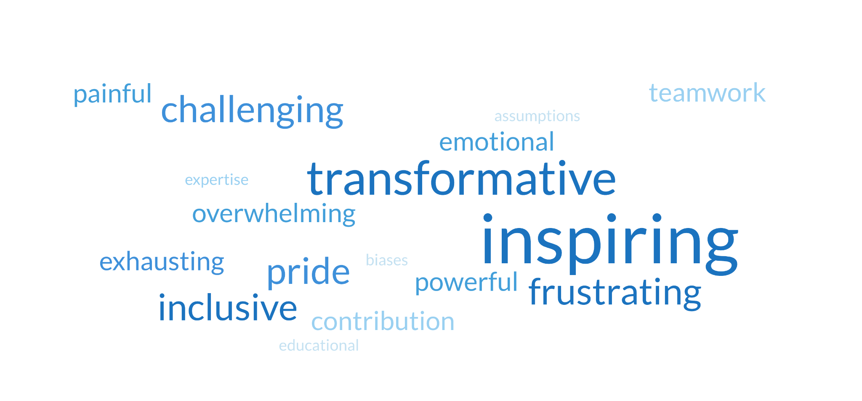
Notes:
Word cloud is from myself, Jackie Dean (OT) and Sue Williams (EbE) community members, prepared for the UKABIF summit in 2025. Our experience of working towards a guideline that was so far reaching, but also somehow felt like there remained so much left to do.

Slide 11
Why does NG252 matter in medicolegal practice?
Notes:
I will take elements of recommendations from the guideline, setting these out and then considering the opportunities and threats from both claimant and defendant perspectives

Slide 12
Arguably the most significant rehabilitation guideline affecting brain injury litigation in recent years
Clinicians, including those providing expert opinion, are expected to take NICE guidelines fully into account in their practice
NICE and other professional practice guidelines are very relevant evidence in disputes about reasonable care, and the planning and delivery of rehabilitation.
Whilst they are not a substitute for clinical judgement or expert opinion, they do act as evidence of accepted practice standards
Instructing parties can expect to see experts considering some or all of the following (non-exhaustive) elements of the guideline recommendations within reports moving forwards

Slide 13
Holistic & long-term neurorehabilitation
NG252 sets a new, higher benchmark for what ‘good’ looks like in rehabilitation, from injury/symptom onset to end of life
Core shift towards holistic, coordinated rehabilitation across settings: home, community, education, leisure, work & hospital
Legitimises long-term neurorehabilitation, delivered in the community, and working towards increasing and sustaining participation – not just reducing impairments or care needs
Emphasises specialist, interdisciplinary input for wide ranging goal areas including personal and domestic activities, work, relationships, sex, and education.
Notes:
Think about what to look for when evaluating the rehabilitation offered to a client – yourselves, and what you can expect your expert witness to look for, based on the NICE guidelines

Slide 14
Planned, goal-focused & measurable change
NG252 emphasizes that rehabilitation plans should specify:
Goals (ideally SMART), and spanning relevant domains including participation in ADLs, education, employment, social and leisure activities, relationships and sex
Timing, frequency and intensity of interventions required, and who will deliver the different elements
How professionals will work together, and what liaison is needed
How progress will be reviewed and monitored
Notes:
Think about what to look for when evaluating the rehabilitation offered to a client – yourselves, and what you can expect your expert witness to look for, based on the NICE guidelines

Slide 15
Implications for medicolegal practice
Opportunities
Supports access to future rehabilitation, re-assessment and lifelong review
Rehabilitation is framed around participation and quality of life outcomes, rather than change at an impairment level
Treating clinicians can be held accountable to provide more specific, measurable goals
Provides justification for interdisciplinary working towards shared, patient-led goals
Risks & Challenges
Open-ended recommendations risk being speculative and offering too wide a range of possible requirements to assist the Court
A wider range of expert opinions may be needed to address participation and quality of life outcomes, increasing time and cost of litigation
Not all recommendations have a clear evidence-base
Not all goals are readily measurable- this could impact on what gets funded
Duplication may be less easily challenged?
Notes:
‘no scientific way of estimating future contingencies’ – and yet statutory health services have to do this all the time to plan capacity and demand. The guideline legitimises efforts to do this, recognizing that for most people with CND further support will be needed at some point.

Slide 16
Broadening the definition of rehabilitation
NG252 adopts a broad definition of rehabilitation, which allows for restorative and compensatory interventions as well as disability management to be considered rehabilitation.
This includes (but is not limited to)
targeted medical interventions and treatment
therapies
formal support provision
equipment/aids and other compensatory tools
indirect work through family members/carers, with community providers, and workplaces

Slide 17
Implications for medicolegal practice
Opportunities
Rehabilitation Assistants and structured support provision can now be framed as part of active rehabilitation
Claims for specialist support provision for those with the most complex needs can point to the guideline
Risks & Challenges
Support worker records will need close analysis to determine if input is genuinely rehabilitative, or risks fostering dependence
Risk of encouraging ‘lifestyle enhancement’ rather than restoring the Claimant as far as possible to their pre-injury level?

Slide 18
Recognising the role of less visible disabilities
NG252 repeatedly recognises the role of hidden/ less visible disabilities on access to, and gains made in, rehabilitation interventions. This includes:
  Fatigue: physical and cognitive, which can lead to fluctuating abilities, reduced endurance, and delayed deterioration.
  Executive and social cognitive impairments: a person may ‘look well’, manage well in structured/familiar environments for short periods, but struggle in novel, changeable or stressful contexts
  Reduced insight/awareness: the person may not be aware of their needs, and decline support, minimise their requirements, and/or place themselves at risk accordingly
Superficial functioning may be misleading, and information from real-world contexts is needed
Notes:
These are our clients with TBI – ‘frontal lobe paradox’, as well as those with mTBI / FCD. Risk of their needs being under-estimated or attributed solely to psychological mechanisms,

Slide 19
Implications for medicolegal practice
Opportunities
Hard-to-evidence effects are validated by the guideline
Potential reduced pressure on Claimants from ‘snapshot’ evidence, including surveillance?
Risks & Challenges
Treating teams and experts will need to find objective ways to measure the impact of these hidden disabilities, rather than relying on subjective reports alone
Determination of non-credible patterns may be more challenging?

Slide 20
Non-engagement with interventions or support
People with cognitive, emotional and behavioural symptoms following an injury often present with complex rehabilitation needs that may not be well met in statutory services.
They are much more likely to:
‘fall through the gap’
be deemed ineligible for services (‘too complex’ vs ‘not complex enough’)
struggle to identify goals
fail to attend appointments or complete rehabilitation plans
be labelled as ‘not engaging’, ‘difficult’ or ‘aggressive’
... and hence fail to access the rehabilitation they need
However, people without these needs may choose to reject input for a range of reasons

Slide 21
Implications for medicolegal practice
Opportunities
The wide range of cognitive, emotional and systemic factors influencing engagement are explicitly recognized within the guideline, offering space for this to be better understood within litigation.
Harder to simply attribute non-engagement as refusal or unwillingness to mitigate losses
Risks & Challenges
Clear documentation is needed where persistent refusals exist, to determine the underlying causes and consider the implications for future care and support

Slide 22
The value of case management
It is widely recognised that people post-injury often experience fragmented care, poor discharge planning, failed transitions to community settings or a lack of coordination in care, which impacts outcomes.
Case managers act as a helpful single point of contact and coordination
This role is relatively rare in NHS/statutory contexts, but well established in the independent sector.
Notes:
Just touching on this briefly, as there are far better speakers to do justice to this element than me.
Increasing focus on case management – may help establish this as a standard element of care, not a helpful addition? Alternatively, could there be pressure to extract this from statutory services when this provision does not (yet, currently) exist in many areas.
How will funders interpret the tiers of complex key contact / key worker/ case management: what will constitute complex enough to need case management?

Slide 23
Implications for medicolegal practice
Opportunities
The guideline strongly supports the coordinating and monitoring roles of the case manager over the longer term
Statutory services may begin to develop better case management models, such that injured people receive better early care
Risks & Challenges
There needs to continue to be clear delineation of roles to avoid supplication, role overlap or inefficiencies
Push back for this to be managed via statutory services in the long term?
Estimation of case management needs over the longer term may be very challenging

Slide 24
Improving Equality, Diversity & Inclusion
NG252 emphasizes that rehabilitation is delivered in the socio-cultural and linguistic context of each particular client, and so should be adapted to those needs.
In practice, challenging issues arise where there are differences in frameworks adopted by treating teams, legal professionals, and Claimants and their families.
Common areas of conflict I have observed during my practice:
care which may appear restrictive or overly-involved to professionals, but is felt entirely appropriate by the personal support network
pathologising of hope grounded in religious/cultural belief as a ‘lack of insight’ or a barrier to rehabilitation
Notes:
Significant efforts made within this guideline to embed principles of anti-racism; an area that needs significantly greater attention within the medicolegal sphere.
We see time and again the ways in which clients and families are asked to adhere to norms or practices which do not match their own – or risk impacting their access to privately funded rehabilitation, negatively impacting quantum, and so on. In our treating practice in ANT, we frequently have to make a case for funded interpreters for therapy.
Not only is this discriminatory but it risks damaging the overall outcomes, reducing engagement in rehabilitation – and ultimately the person’s needs (and associated losses) being higher as a result.

Slide 25
Implications for medicolegal practice
Opportunities
Culturally competent provision for minoritised groups
Explicit consideration of how social, cultural or religious norms impact on common elements of loss (e.g., use of interpreters for appointments, inter-generational living) may enable more accurate funding decisions
Addressing these issues directly may support more integrated, effective rehabilitation
Risks & Challenges
Defining whether an adjustment or recommendation is reasonable/proportionate may be challenging, in the context of limited direct evidence base?

Slide 26
Get in touch:
dr.gaby.parker@ant-ltd.co.uk
office@ant-ltd.co.uk

Slide 27
(In)capacity: principles and compensation strategies in borderline cases
Tony Reddiford & Sophie Walmsley

Slide 28
Why capacity matters
Hayden J Tower Hamlets LBC v PB [2020] EWCOP 34:
“The presumption of capacity, section 1(2), is the benchmark for decision-makers in this sphere. To my mind it is every bit as important as the presumption of innocence in a criminal trial. The Act reinforces this by requiring that a person is not to be treated as unable to make a decision unless “all practicable steps to help him to do so have been taken without success”. The scope of these unambiguous provisions requires fully to be recognised and vigilantly guarded.”

Slide 29
Context of incapacity in PI claims
Whether a protected party: litigation friend/approval required.
Whether a protected beneficiary: costs of managing financial affairs need claiming.
Whether has testamentary capacity: costs of a statutory will claimable.
Limitation.
Whether C had capacity at the time they settled an earlier personal injury claim (e.g. CXC v Clarke & Anor [2024] EWHC 3138 (KB))

Slide 30
Capacity to litigate: the whole claim
Lady Hale Dunhill v Burgon [2014] 1 WLR 933:
“The proceedings themselves may take many twists and turns, they may develop and change as the evidence is gathered and the arguments refined. There are, of course, litigants whose capacity fluctuates over time, so that there may be times in any proceedings where they need a litigation friend and other times when they do not. … But a party whose capacity does not fluctuate either should or should not require a litigation friend throughout the proceedings. It would make no sense to apply a capacity test to each individual decision required in the course of the proceedings…”

Slide 31
MCA 2005: fundamental principles
Presumption in favour of capacity - s.1(2) MCA 2005
Capacity can be both time and decision specific
A person should not be treated as unable to make a decision merely because he makes an unwise one - s.1(4)
All practicable steps to be taken to enable him to make a decision without success – s.1(3)
A lack of capacity cannot be established merely due to age, appearance, a condition of his, or an aspect of his behaviour – s2(3)

Slide 32
MCA 2005: fundamental principles cont’d
Diagnostic and Functional test:
  Does the person suffer from an impairment of, or a disturbance in the functioning of, the mind or brain?
  A person is unable to make a decision for himself if he is unable to understand information relevant to the decision; retain that information; use or weigh that information as part of the decision-making process and communicate his decision
Is there a causative nexus?

Slide 33
MCA 2005: fundamental principles cont’d
Information relevant to the decision includes the consequences of that decision or failing to make the decision
It is the ability to make the decision and not the outcome of it which is in focus Kings College Hospital NHS Trust v C & V [2015] EWCOP 80

Slide 34
Fluctuating capacity
What is fluctuating capacity? A Local Authority v JB [2021] UKSC 2 per Lord Stephens at [64]
  capacity can fluctuate over time so a person can have capacity at one time but not another. The material time for the purpose of the Mental Capacity Act is whether they can make the decision at the time when it needs to be made.
  This usually involves a forward-looking assessment, but this can be appropriately qualified in the event capacity fluctuates.

Slide 35
Fluctuating capacity cont’d
Differences in approach re: capacitous or not
  The Court of Protection has adopted a “longitudinal approach” to those with fluctuating capacity; or
  Making anticipatory declarations at a time when P has capacity in relation to a matter, to cater for a time when P is predicted to lose capacity - An NHS Foundation Trust v Amira [2023] EWCOP 25 see Mostyn J:
    “In my judgment, the court cannot make a proleptic finding of incapacity, saying, pursuant to s2(4), that it is satisfied that it is more likely than not that at some point in the future that person will lose capacity, This is because Part 1 of the Act only applies to persons who are presently incapacitated, not to persons who are not incapacitated but who might become at some point in the future incapacitated.”

Slide 36
Fluctuating capacity cont’d
  Other cases show the courts being reluctant to declare someone lacks capacity if their capacity genuinely fluctuates instead emphasising the provision of supported decision-making in times where a person has capacity
  What is the nature of the decision that the person is being asked to make? For example, is it an ongoing act such as managing finances or a more specific act (e.g. such as making a will)
  What is the nature of the fluctuating capacity?
  Are there any particular external features or issues that can be associated with any fluctuations and are there steps that can be taken to manage these?

Slide 37
Evidence: expert
TBI: HHJ Bird Martin v Salford [2021] EWHC 3058 (QB):
“The field of expertise best suited to provide assistance with capacity (and in particular cognitive and executive impairment) is neuropsychology.”
Psychiatric: psychiatry.
Consider examination at home (Martin) or real-world test (e.g. “multiple errands task” as in King v Wright Roofing [2020] EWHC 2129 (QB))

Slide 38
Evidence: expert (cont’d)
Ensure experts address issue in interview – seeks real world examples
Ensure expert addresses MCA test and which limb C meets: “The claimant needs a litigation friend/help managing their affairs” is not good enough.

Slide 39
Other sources of evidence
Lay witness evidence: family; case manager; support worker.
Role of the court: judge not always rely on experts’ views: impression in court is important: Meric v Navis & QBE [2025] EWHC 759 (KB)

Slide 40
Procedure: appointment of litigation friend
Appointing a litigation friend: certificate of suitability/court order (CPR 21.5/21.6).
Not require a determination of lack of capacity (Mohammed v Ali & MIB [2026] EWHC 401 (KB))
D not normally have locus to dispute unless adversely affected (limitation/other procedural effect: e.g. Meric)

Slide 41
Procedure: approval
Court has inherent jurisdiction to approve even if presumption of capacity not clearly rebutted: Coles v Perfect [2013] EWHC 1955 (QB), Grimshaw v Hudson [2021] EWHC 425 (QB) and CTQ v King’s College Hospital NHS Trust [2023] EWHC 2975 (QB).
Test is whether there is sufficient potential concern/real and credible doubt re capacity.
Court declined approval where D (but not C) sought it and experts agreed not protected party: Forsyth v Howson & Allianz [2025] EWHC 653 (KB).

Slide 42
Costs of trust where C capacitous
If C is of full capacity, cannot recover costs of trust: Martin v Salford [2022] EWHC 532 (QB).
What if C has only “supported capacity” (i.e. s. 1(3) MCA “all practicable steps”)?
Trust unlikely to be the answer as offers little protection.
modest claim for paid assistance from accountant or solicitor or IFA when taking big financial decisions may be recoverable: A v Powys Local Health Board left the door ajar. Costs of a premier banking service were allowed for a capacitous C with severe CP.

Slide 43
Beware: warnings from the court
Lawyers under a professional duty to raise capacity issues promptly: SJ v Cardiff & Vale University Health Board & Anor [2025] EWCOP 54 and Aslam v Seeley & Madan (2025) EWHC 24 (Ch)
Professional deputies need to be alert to keep costs down, especially in partial recovery cases: Spiers v St George’s NHS Trust [2025] EWHC 337 (KB)

Slide 44
Questions?

Slide 45
Commonly encountered issues when dealing with acceleration injuries and the role of pain management expert evidence.
Oliver Manley & Jason Harvey, Consultant Orthopaedic Spinal Surgeon

Slide 46


Introduction
Refresh of relevant legal principles
The consequences of a finding of an acceleration injury
The interplay between chronic pain and acceleration injuries
Discussion of Scarcliffe v. Brampton Valley Group Ltd [2023] EWHC 1565 (KB) as an example
The medical view from Mr. Harvey
Conclusions/Discussion

Slide 47
The Legal Principles…..causation
Jobling v Associated Dairies Ltd [1982] AC 794, per Lord Wilberforce
“The facts of life which a judge takes into account have something to do with the character of the individual. In the case of concurrent causes, disease and the effects of accident, the incapacity is caused by each: see Harwood's case [1913] 2 K.B. 158 , 169-170. A man disabled by a natural disease is not entitled to recover in an action.

Slide 48
The Legal Principles……measure of damages
“The purpose of an award of damages is, in so far as a sum of money can do so,
to put a Claimant, as nearly as possible, in the same position as he/she was in
before the relevant injury was sustained (see generally Wells-v-Wells [1999] 1
AC 345). As a result, a Claimant is entitled to damages to meet his or her
“reasonable requirements” or “reasonable needs” arising from his negligently
caused disability”
(see e.g Sowden v Lodge [2004] EWCA Civ 1370, [2005] 1 All ER 581, [2005] 1 WLR 2129).

Slide 49
Consequences of an acceleration finding
In most cases it will cut off recovery of all damages at a point in time.
Costs trap – particularly in cases involving polytrauma
Impact on the costs of future treatment and surgery – treatments that would have been required in any event due to the pre-existing condition
Creates an enormous gulf in Claimant and Defendant valuations
Personal Impact on Claimants (Mr. Harvey’s stats 37-96%!)

Slide 50
Interplay between acceleration and chronic pain
Difference between acute/rapid onset arising from trauma and gradual deterioration from degenerative change
Has a chronic pain condition developed during the period of acceleration
If so, would the chronic pain condition have developed in any event at the point of any onset of symptoms due to the pre-existing degenerative change
Central Sensitisation
Not a panacea to sidestepping a finding of an acceleration injury

Slide 51
Scarcliffe v. Brampton Valley Group Ltd [2023] EWHC 1565 (KB)
38-year-old tree surgeon who suffered two transverse process spinal fractures after a large section of tree trunk fell on his back.
Contended for £6.1m at trial and D contended for £136k.
C’s ortho deferred to chronic pain as C ought to have recovered fully within a fairly short period from the fractures. As for the degenerative change this would have led to waxing and waning symptoms but no significant change to function and impact on work.
D’s ortho considered that within 5-10 years he would have ended up in the same state absent the accident.
C’s pain expert said pain condition caused by accident.
D’s pain expert said would have developed pain condition in any event.

Slide 52
Scarcliffe v. Brampton Valley Group Ltd [2023] EWHC 1565 (KB)
Trial was a disaster for the Claimant.
Both C’s orthopaedic and pain management experts changed their opinions and Cotter J found that absent the accident the Claimant would have been in a very similar position within 7.5 years, with chronic back pain and would have gone on to develop a chronic pain condition in any event.
Judgment for £275k.
At para 286 recognised the difference in onset of acute versus gradual and at para 287 accepted that losses did not drop a ‘cliff edge’ ay 7.5 years.
Interestingly allowed £600 for a recliner armchair as a future aid with ‘some hesitation’!

Slide 53
Mr. Jason Harvey’s turn!

Slide 54
“Acceleration” Injury of the Spine
Jason Harvey
Consultant Spinal Surgeon

Slide 55
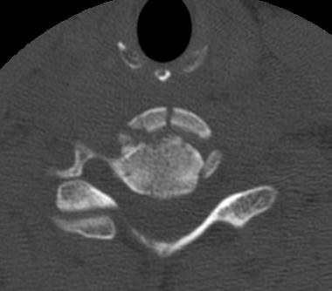
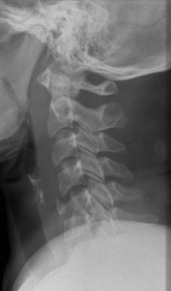
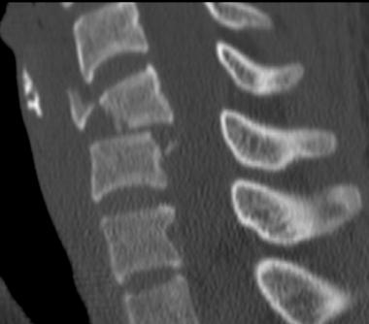
TRAUMA
L1

Slide 56
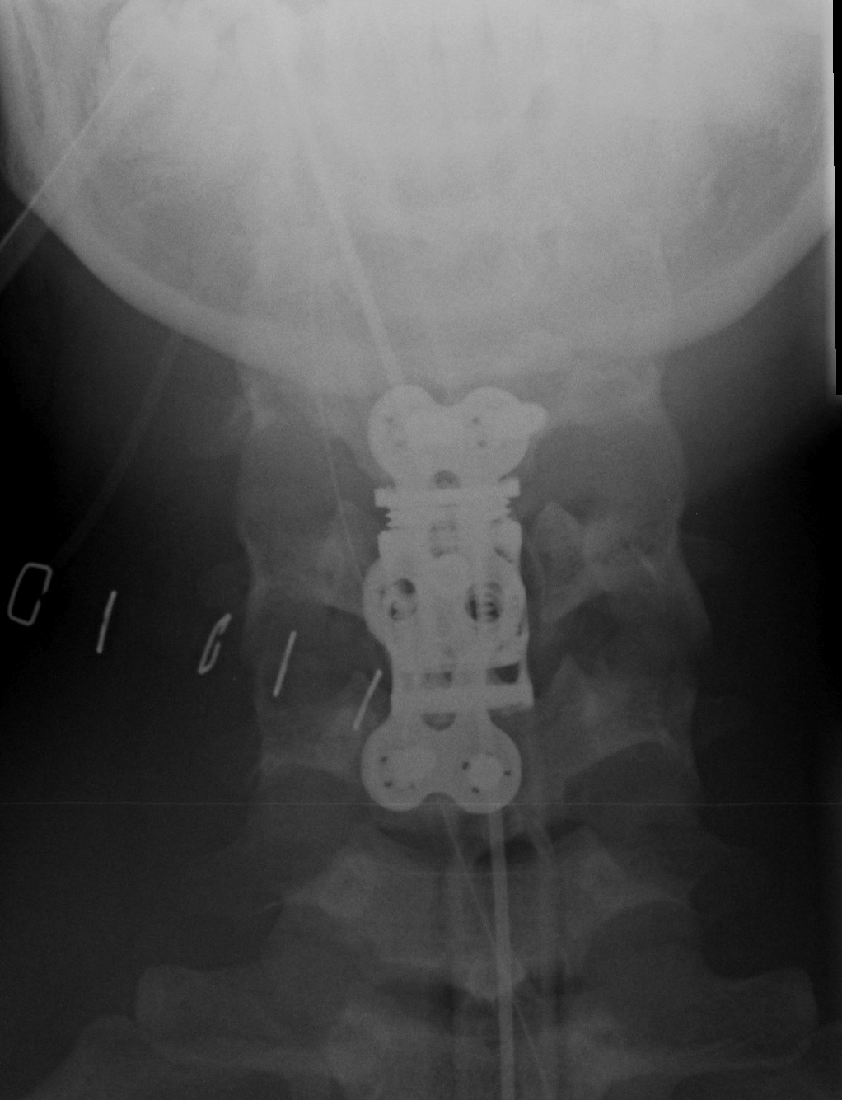
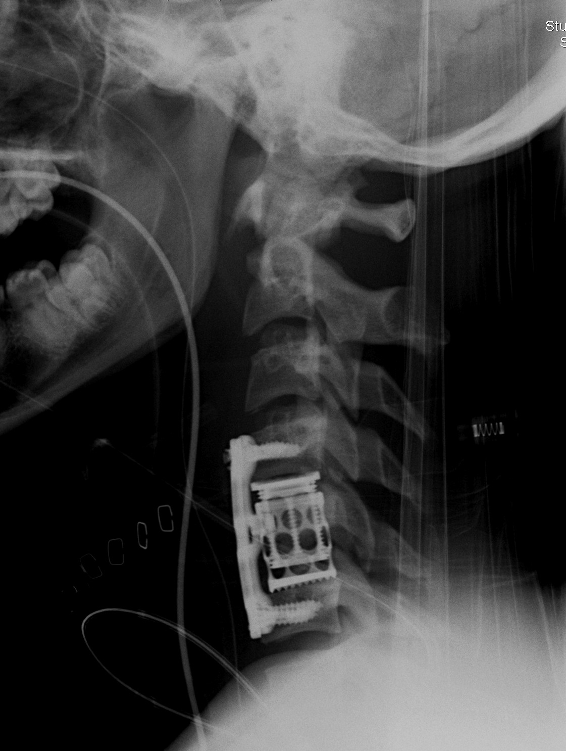
TRAUMA

Slide 57
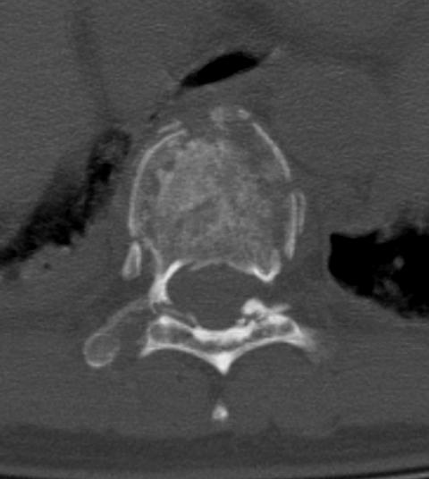
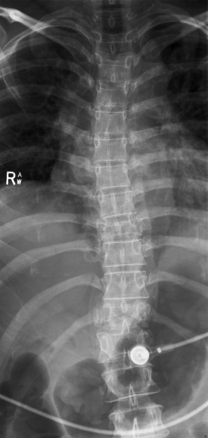
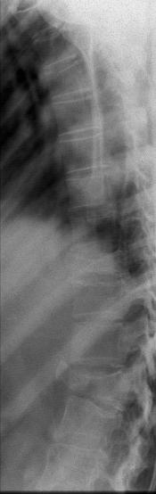
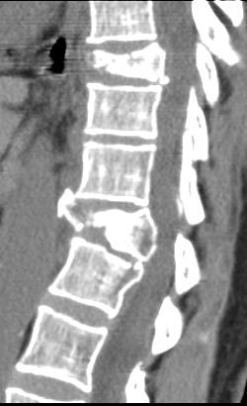
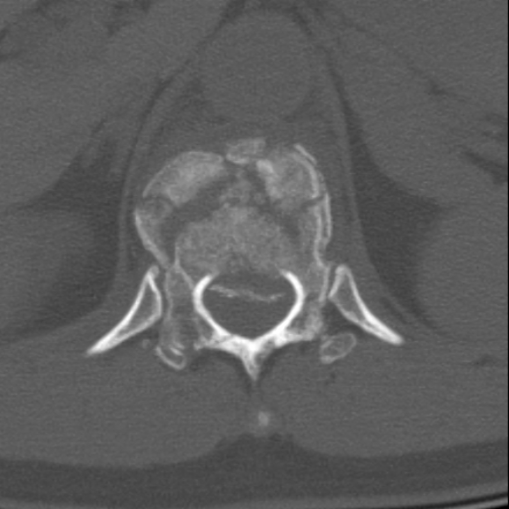
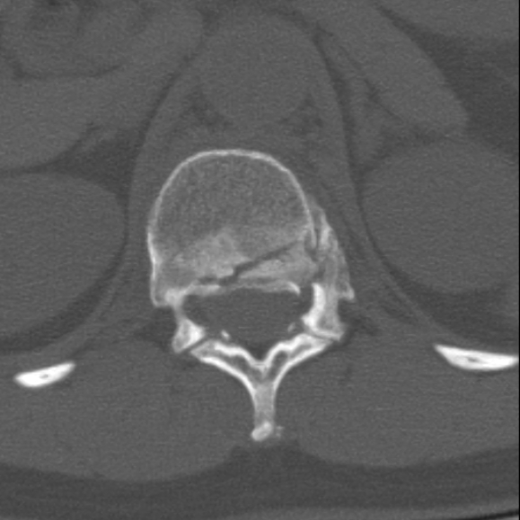
TRAUMA
T9
T12
L1

Slide 58
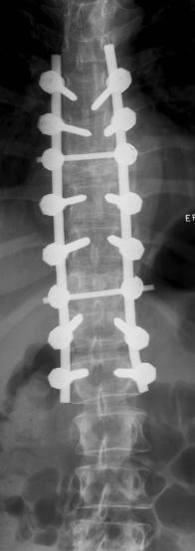
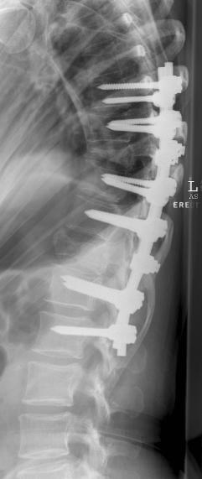

Slide 59
No Fracture and No dislocation.
The Claimant has persistent pain
No fracture
No dislocation
No soft tissue damage noted on imaging such as MRI
But degenerative changes noted
Was the pain inevitable?
How did the accident / incident?

Slide 60
Disc Anatomy

Slide 61
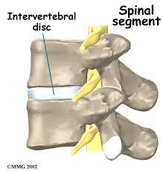
Anatomy and Biomechanics
Disc = Primary articulation / stabiliser between bones
Shock absorber
Contributes 25% total spine height
Significant determinant of the shape of the spine.
Shape of spine changes as we get older.

Slide 62
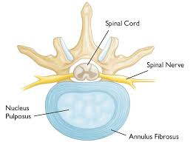
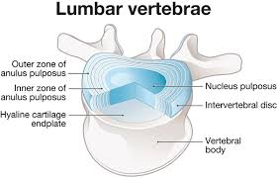
Disc Anatomy
Hybrid construction of two distinct regions
Fibrocartilage
Fibrocartilage with no blood supply.

Slide 63
Disc Biomechanics.
Designed for pure axial loading
Don’t like shear or torsion

Slide 64
Aging Disc Anatomy
No blood supply
Few cells present
Very little ability to repair if damaged.
Disc become dehydrated and stiffer making them more vulnerable
BUT function similar to a young disc.
No ingrowth of blood vessels or nerves

Slide 65
Degenerative Disc Anatomy
Approximately half of discs become degenerate
Tears in the annulus
Collapse of the disc
Blood vessels and nerves grow into the disc

Slide 66
Reasons for Disc Degeneration
Nutrition.
Genetic predisposition.
Biochemical.
Notes:
We know what happens to disc as age but why do they age?

Slide 67
1. Nutritional
Blood supply disappears during childhood
Diffusion thus only mechanism
Rate of degradation far outstrips repair

Slide 68
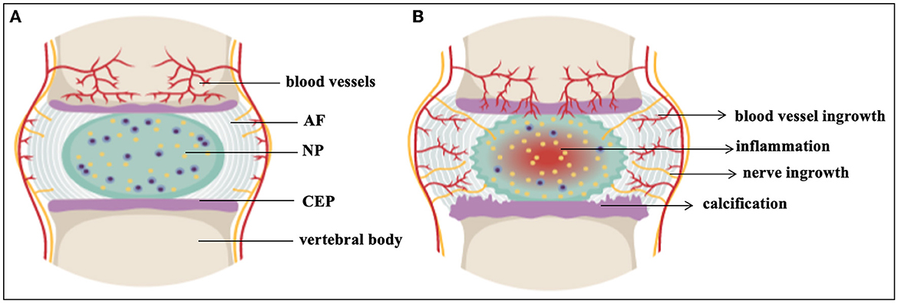
1 Nutritional
The degeneration outstrips the repair.

Slide 69
2. Genetics
The Twin Spine Study – multi centre – started 1991 and review 2008
Physical factors / Smoking / Occupation etc
Genetics by greatest influence on presence of disc degeneration
Multiple studies show same result
‘Back troubles in family’ influenced by
  Anatomy
  Collagen

Slide 70
3. Mechanical
Proven to be contributory on multiple twin studies
Sedentary jobs - lower lumbar
Manual labour - upper lumbar

Slide 71
Ageing Disc

Slide 72
Disc Pain
Intervertebral disc
Avascular
Alymphatic
Aneural
Sinuvertebral nerve endings

Slide 73
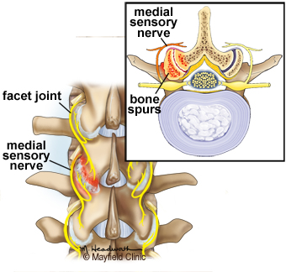
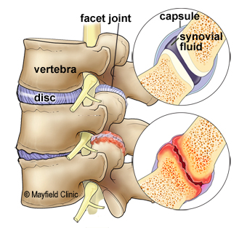
Facet Joint Degeneration

Slide 74
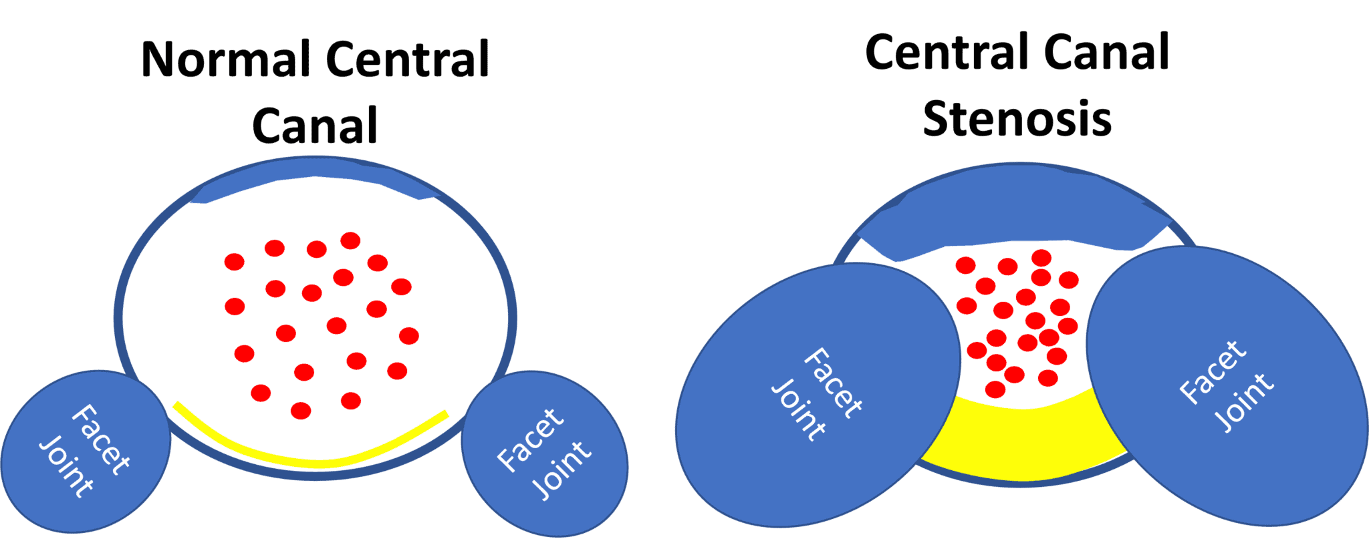
Other Changes

Slide 75
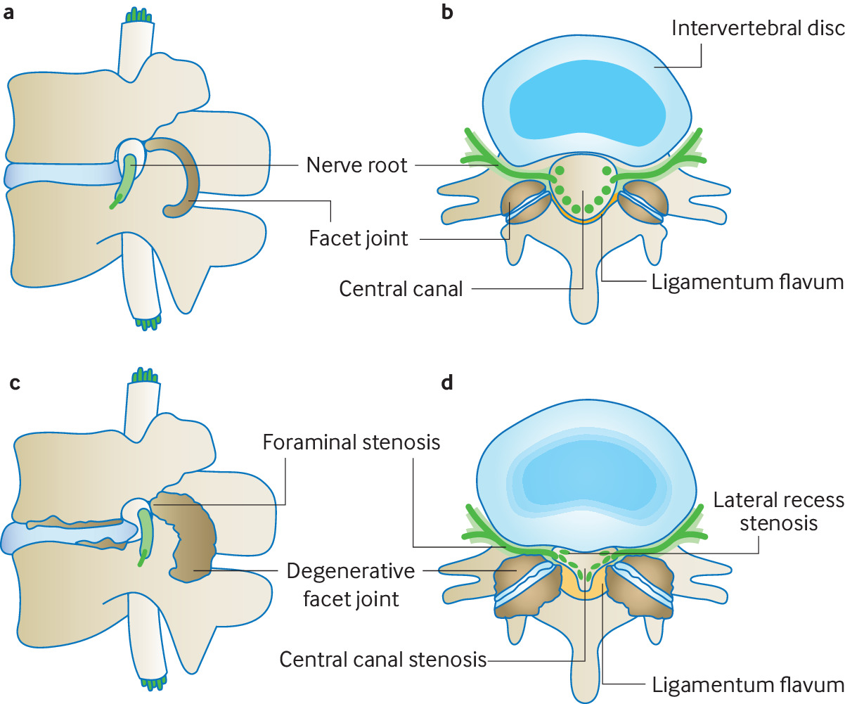
Pressure on nerves both sides

Slide 76
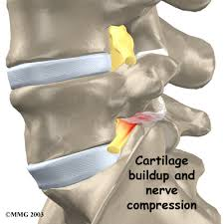
Degeneration Causing Compression.

Slide 77
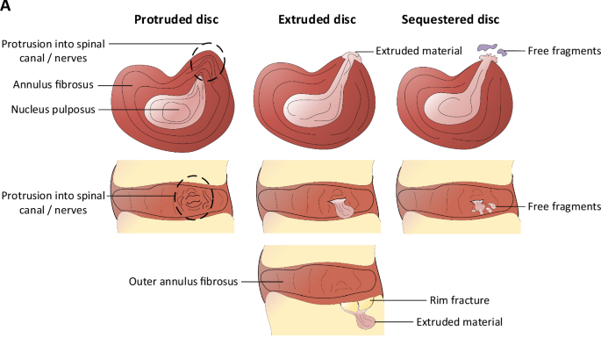
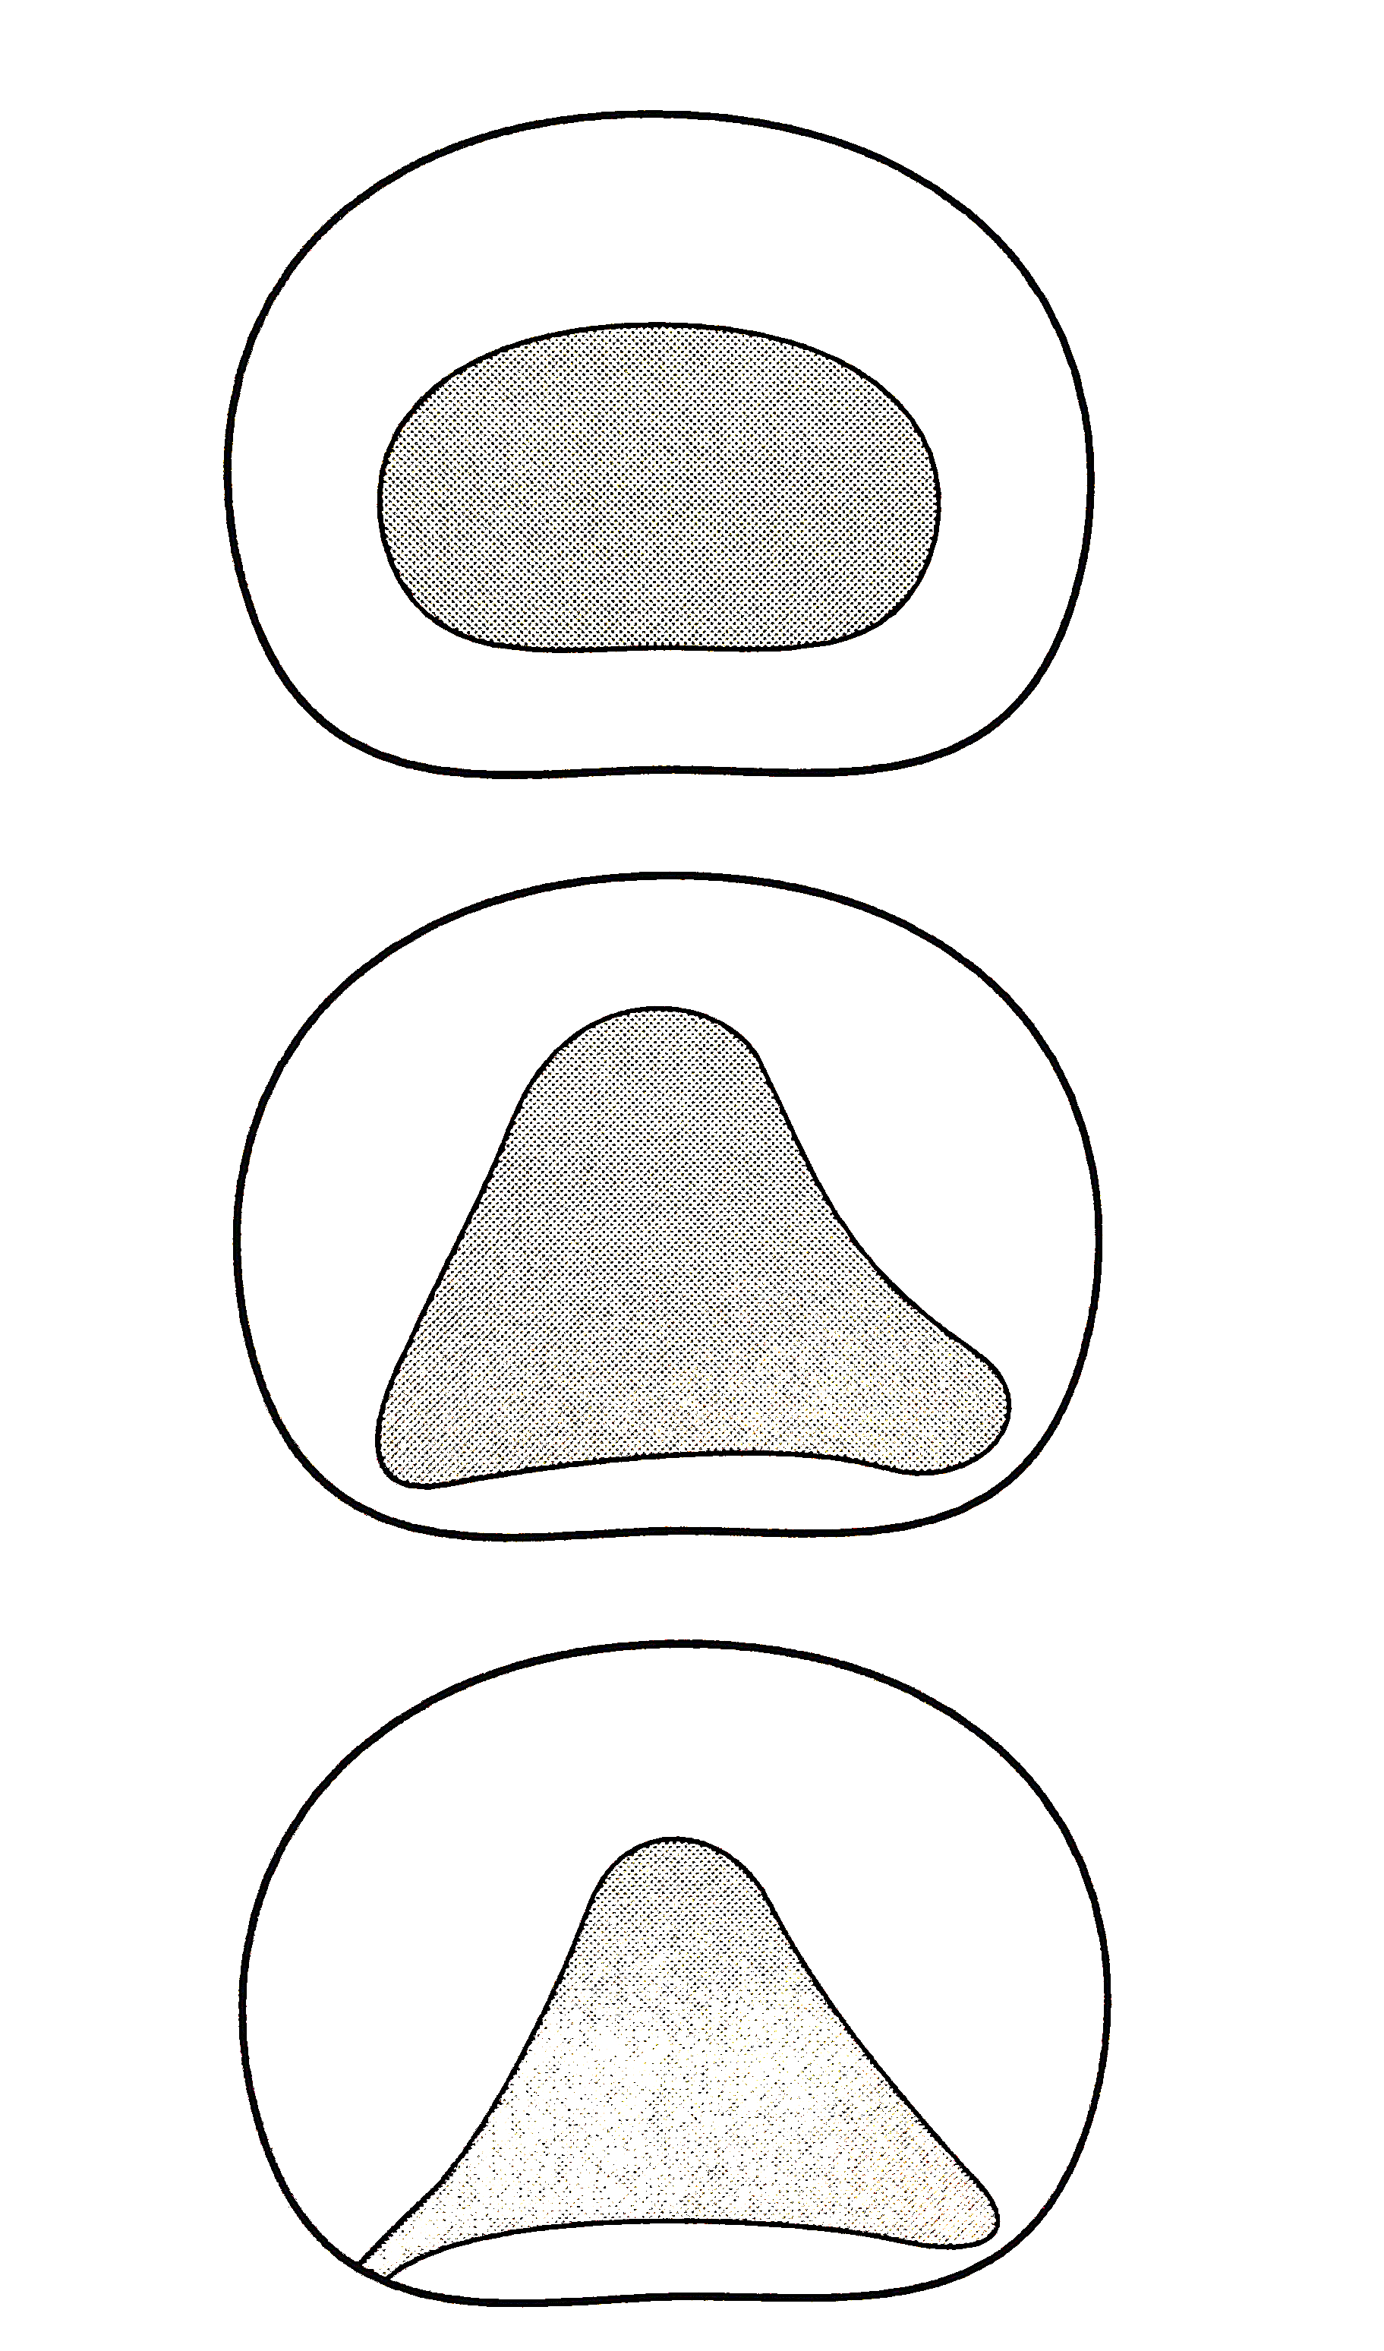
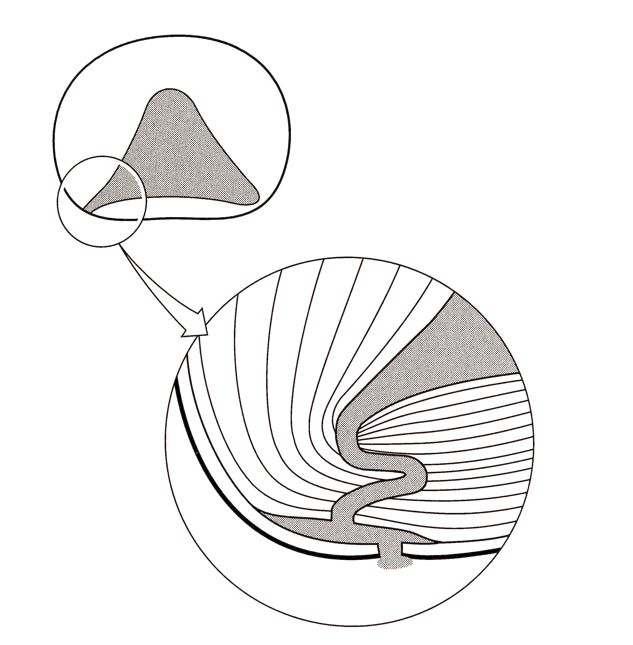
Biomechanics of Herniation
(Adams & Hutton 1982)

Slide 78
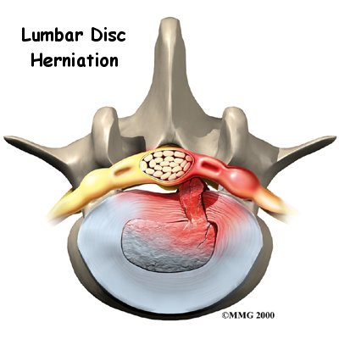
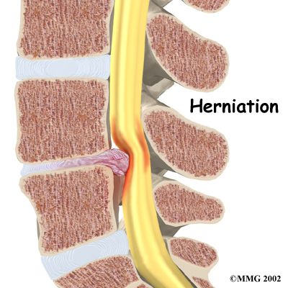
Patho-physiology
Lumbar disc prolapse causes variable amounts of :-
Mechanical compression
Chemical irritation (disc and annular tear)

Slide 79
Disc Degeneration Epidemiology
‘The prevalence of disc degeneration in asymptomatic individuals increased from 37% of 20-year-old individuals to 96% of 80-year-old individuals’.
Consider 10% per decade of life.
Significant degenerative changes may be asymptomatic.
Poor correlation between scan and symptoms.

Slide 80
Acceleration Period
Not a medical concept
Acceleration period, an attempt to quantify the effect of the injury on the progression of clinical symptoms.
Relative contribution from the preexisting condition and the “injury” that the spine was subjected to.
Differentiate “acceleration of symptoms” and ”acceleration of degenerative changes”

Slide 81
Acceleration
Lab studies have shown that excessive axial loading can reproduce degeneration.
“Injury” to the disc may occur in the absence of a high degree of trauma.
The load needs to exceed tissue strength.
There is poor blood supply to the disc, which limits repair.
MRI may not show an injury to the disc in contrast to a fracture being visible.

Slide 82
Acceleration
Is the cause of the pain due to;
  Preexisting degeneration changes influenced by genetic inheritance and aging.
  Due to the injury / excessive mechanical stresses that the spine is subjected to.
Relative importance of these two factors determines the relative contribution that can be attributed to the continuing symptoms.

Slide 83
Factors Considered in Quantifying a Period of Acceleration
The nature and magnitude of the trauma involved.
The temporal relationship of the onset of symptoms to the trauma. (noting that there may be other distracting injuries).
Corroboratory evidence of the injury and symptoms in medical records.
The preexisting past medical history of similar symptoms.

Slide 84
Acceleration
The injury was causative of the ongoing symptoms and disability.
  The trauma was significant
  The onset of symptoms were immediate
  No previous symptoms
The injury is irrelevant to the Claimants ongoing symptoms.
  The injury was insignificant.
  The onset of symptoms was purely coincidental.

Slide 85
Acceleration
3. The accident / incident or work practice has caused a soft tissue injury.
  The effects of which will last a finite period.
4. The injury has cause dan aggravation / exacerbation of the symptoms.
  Significant past medical history
  The injury has made these symptoms worse for a given period
5. The injury has brought forward what would have happened in the absence of the accident.
  There are preexisting degenerative changes
  The trauma was such that it would not have expected to cause prolonged symptoms.

Slide 86
Acceleration Types of Pain
  Nociceptive pain.
  Neuropathic pain.
  Non-organic (psychological) pain.

Slide 87
Acceleration
  Psychological and pain magnification issues.
  Need to be considered when the extent and or duration of symptoms are greater than can be reasonable attributed to the magnitude of the injury, having considered other preexisting factors.

Slide 88
Acceleration
  Most patients with back pain or sciatica do not recollect a specific injury that caused the onset of their symptoms.
  The relative strength of the disc is related to genetic factors and aging.
  If there is substantial mechanical strain, then the discogenic symptoms can be related with a greater degree of confidence to the to the mechanical provocation.
  “Liability should be apportioned according to to the relative importance of these preexisting and precipitating causes”
  (Adams 2014 Biomechanical studies)

Slide 89
Quantifying Acceleration: Summary
  History of the incident / accident and degree of trauma sustained
  Temporal correlation
  Clinical findings
  Objective tests such as MRI
  Preexisting condition clinically and or radiologically
  Psychological consideration.

Slide 90
Case Discussion
  19 years old female
  RTA
  Back pain 2 years post accident
  MRI
  Degenerate changes

Slide 91
Case Discussion
  19 years old female
  RTA
  Back pain 2 years post accident but did not complain of immediately
  MRI
  Degenerate changes L5/S1

Slide 92
Case Discussion
  High speed trauma
  Front seat passenger died at the scene.
  Multiple limb fractures
  Abdominal injury
  Splenectomy
  Partial liver resection
  Bowel resection and ileostomy
  Trauma or natural History?

Slide 93
Questions

Slide 94
Parting comments:
Chronic pain diagnosis does not necessarily avoid the consequences of a finding of acceleration.
Pre-existing vulnerabilities for the development of a chronic pain condition when combined with an acceleration injury mean that there is a real risk that the chronic pain condition would have developed absent the accident.
Beware of costs, risk of fast track or intermediate track and managing client expectations.

Slide 95
Thank you for listening…….
Please feel free to email me
with any questions
Oliver.manley@guildhallchambers.co.uk

Slide 96
Tea Break

Slide 97
PERSONAL INJURY CASE UPDATE
Alice Reeves & Jon Wong

Slide 98
Most expected
MH Site Maintenance Services Ltd v Watson
[2025] EWCA Civ 775

Slide 99
Most contentious
Lewis-Ranwell v G4S Health Services (UK) Ltd
[2026] UKSC 2

Slide 100
Most enthralling
O'Connell v The Ministry of Defence
[2025] EWHC 2301 (KB)

Slide 101
Most needed
Hakmi v East and North Hertfordshire NHS Trust
[2025] EWHC 2597 (KB)

Slide 102
Most cautionary
Chinda v Cardiff & Vale University Health Board
[2025] EWHC 2692 (KB)

Slide 103
Most perplexing
Smithstone v Tranmoor Primary School
[2026] EWCA Civ 13

Slide 104
Most anticipated
CCC v Sheffield Teaching Hospitals NHS Foundation Trust
[2026] UKSC 5

Slide 105
Most insightful
Lynch v The Princess Alexandra Hospital NHS Trust
[2026] EWHC 657 (KB)

Slide 106
PERSONAL INJURY CASE UPDATE
Alice Reeves & Jon Wong

