Slide 1
Annual Insolvency and Restructuring Seminar
Wifi – MarriottBonvoy_Conference
Password – Bristol@26
Bristol Marriott Royal
11/6/2026

Slide 2
Chairs
Address
Wifi – MarriottBonvoy_Conference
Password – Bristol@26

Slide 3
Information gathering in Insolvency Proceedings
James Hannant and Saisha Bacon

Slide 4

Topics to be covered
Intro: Functions and duties of office-holders
Mechanisms available: corporate insolvency: ss.234-236 IA 1986
Mechanisms available: personal insolvency: ss.334-337 IA 1986
Common issues: Privilege; non-attendance;

Slide 5

Investigatory provisions: ss.234-236 IA

Slide 6


Getting in the company’s property: s.234 IA 1986
“Where any person has in his possession or control any property, books, papers or records to which the company appears to be entitled, the court may require that person forthwith (or within such period as the court may direct) to pay, deliver, convey, surrender or transfer the property, books, papers or records to the office-holder.”

Slide 7

Duty to co-operate: s.235 IA 1986
Webb v Eversholt Rail Ltd [2024] EWHC 2217 (Ch) [29]
“Perhaps the most basic point is that section 235 expressly demands a reasonable requirement for the disclosure in question - see the words "such information … as the office holder may … reasonably require." That factor is therefore baked into the section. It is a statutory requirement or qualification.”

Slide 8

Inquiry into company’s dealings: s.236 IA 1986
(2)The court may, on the application of the office-holder, summon to appear before it—
                (a)any officer of the company,
                (b)any person known or suspected to have in his possession any property of the company or supposed to be indebted to the company, or
                (c)any person whom the court thinks capable of giving information concerning the promotion, formation, business, dealings, affairs or property of the company.
(3)The court may require any such person as is mentioned in subsection (2)(a) to (c) to submit [to the court] an account of his dealings with the company or to produce any books, papers or other records in his possession or under his control relating to the company or the matters mentioned in paragraph (c) of the subsection.”

Slide 9

Inquiry into company’s dealings: s.236 IA 1986

Slide 10


Inquiry into bankrupt’s dealings and property: s.366 IA 1986
(1) At any time after a bankruptcy order has been made the court may, on the application of the official receiver or the trustee of the bankrupt’s estate, summon to appear before it–
(a) the bankrupt or the bankrupt’s spouse or former spouse or civil partner or former civil partner,
(b) any person known or believed to have any property comprised in the bankrupt’s estate in his possession or to be indebted to the bankrupt,
(c) any person appearing to the court to be able to give information concerning the bankrupt or the bankrupt’s dealings, affairs or property.”

Slide 11



Inquiry into bankrupt’s dealings and property: s.366 IA 1986

Slide 12

Power of arrest: s.364 IA 1986
  That there are reasonable grounds for believing that he has absconded, or is about to abscond, with a view to avoiding or delaying the payment of any of his debts or his appearance to a bankruptcy petition or to avoiding, delaying or disrupting any proceedings in bankruptcy against him or any examination of his affairs.
  That he is about to remove his goods with a view to preventing or delaying possession being taken of them by the official receiver or the trustee of his estate.
  That there are reasonable grounds for believing that he has concealed or destroyed, or is about to conceal or destroy, any of his goods or any books, papers or records which might be of use to his creditors in the course of his bankruptcy or in connection with the administration of his estate.
That he has, without the leave of the official receiver or the trustee of his estate, removed any goods in his possession which exceed in value such sum as may be prescribed.
  That he has failed, without reasonable excuse, to attend any examination ordered by the court.

Slide 13
Power of arrest: s.364 IA 1986
"It would be best for the arrested person to be brought before the court either immediately (before being taken to prison) or no later than the next sitting day of the relevant court. We concede that there may be practical difficulties and that the person may not have solicitors to represent him by them; the hearing may not be fully effective, and it may not be possible at once to work out a suitable alternative to detention in custody. Nevertheless it seems to us necessary that some such hearing should take place at an early opportunity, even if it may not always provide an immediate effective occasion for a review of the committal order.“
Hickling v Baker [2007] EWCA Civ 287

Slide 14



Seizure of bankrupt’s property: s.365 IA 1986

Slide 15
Seizure of bankrupt’s property: s.365 IA 1986
Lasytsya v Koumettou [2020] EWHC 660 (Ch)
Principles: (i) the order should only be made if it is necessary and in the interests of justice (ii) it requires a strong arguable case with clear evidence and (iii) the damage prevented must be proportionate to the grant of this remedy.
Order requirements are quite strict.
Safeguards should be utilised

Slide 16

Common Issues: Privilege
Corporate insolvency: usually no recourse to resist disclosure on grounds of professional privilege
Personal insolvency: It depends on the facts! Re Ouvaroff [1997] BPIR 712; Re Murjani [1996] 1 W.L.R. 149.

Slide 17


Common Issues: conduct of a private examination
Attendance of office-holder and others…
Written records and transcripts.
Use of the record against the respondent
What about self-incrimination?

Slide 18


Slide 19

Charlotte May
Legal Authorities in Action
Manolete Partners PLC is an investment business focused on dispute finance. It is not a law firm and does not provide legal advice.

Slide 20



Re BM Electrical Solutions Ltd
[2020] EWHC 2749 (Ch)
Dividends not declared

Slide 21
Communications Co
£400k ‘interim dividends’
No dividends declared
Pursued as loan
Reserves/Insolvency irrelevant
Result: Case purchased June 2025, settled September 2025, paid March 2026

Slide 22

Re Ciro Citterio Menswear plc [2002] EWHC 662
Interest free loan might be a TUV

Slide 23
A&D Joinery Ltd [
2026] EWHC 1046 (Ch)
£748k newco loan to purchase shares
Poor covenant
S.1157 defence
S.238(5) Taqa Bratani defence

Slide 24

Re Fastfit Station [2023] EWHC 496 (Ch)
Co income diverted to newco

Slide 25
Property Co
£600k income diverted to newco
Argued council terminated contract
Co rendered insolvent as a result
Pursued as TUV / breach duty
Result: Case purchased March 2025, settled September 2025, paid October 2026

Slide 26

Sharp v Blank [2019] EWHC 3096 (Ch)
Taking advice enough for s.1157?

Slide 27
Manolete v Nag [2022] EWHC 153 (Ch)
Solicitor duty to advise even where advice not sought
62: a director should not need a solicitor to tell him whether his actions are bona fide

Slide 28

Re Finno Medical Limited
[2024] EWHC 2188 (Ch)
Burden on D for unexplained payments

Slide 29
Financial Services Co
£350k various heads
Ds claim disclosure to reveal all
D1 settled
D2 judgment – now enforcing
Also: Contract Natural Gas (Marketing) Limited v the Joint Liquidators of Contract Natural Gas Limited [2026] EWHC 707 (Ch)

Slide 30
Consultations
Insolvency Service – Corporate Civil Enforcement Reform
HMRC – close companies reporting
Fairer end to relationships – cohabiting rights on separation and divorce

Slide 31

Charlotte May
Manolete Partners PLC is an investment business focused on dispute finance. It is not a law firm and does not provide legal advice.

Slide 32
Refreshments Break

Slide 33
Carrying on and helping out: Fraudulent Trading & Dishonest Assistance
Simon Passfield KC
and
Govinder Chambay

Slide 34

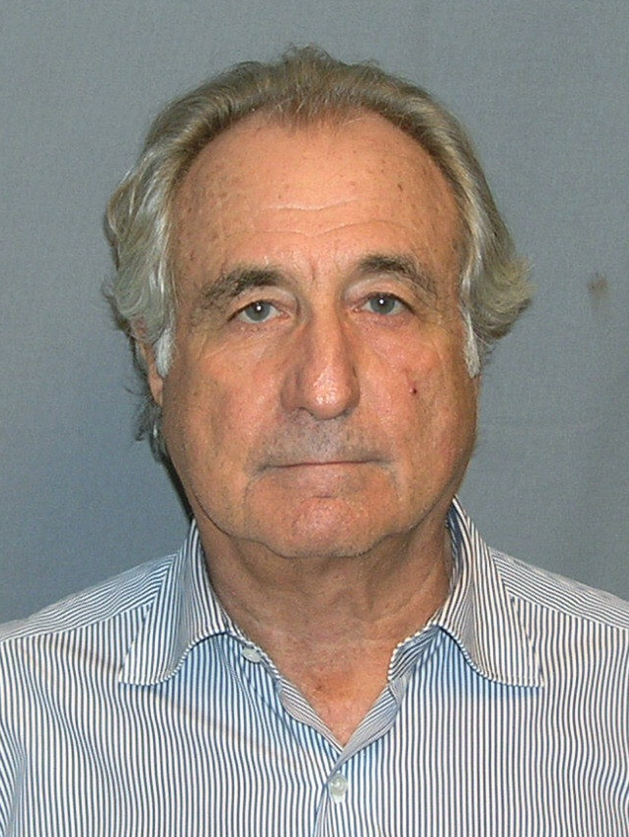
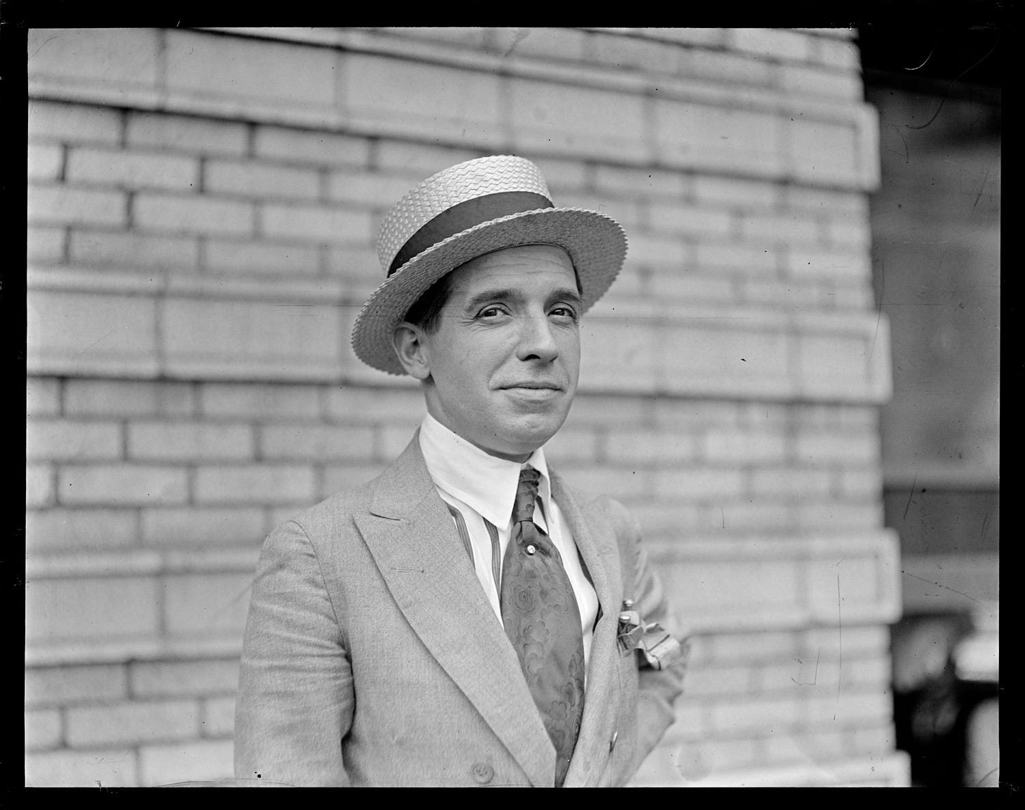
Fraudulent Trading

Slide 35
Fraudulent Trading: s.213 and 246ZA IA
(1) If [in the course of the winding up of a company/ while a company is in administration] it appears that any business of the company has been carried on with intent to defraud creditors of the company or creditors of any other person, or for any fraudulent purpose, the following has effect.
(2) The court, on the application of the [liquidator/administrator] may declare that any persons who were knowingly parties to the carrying on of the business in the manner above- mentioned are to be liable to make such contributions (if any) to the company’s assets as the court thinks proper.

Slide 36
Constituent Elements
Carrying on business
Intent to defraud creditors / fraudulent purpose
Participation
Knowledge

Slide 37
Carrying on business
Fraudulent Business / Fraudulent Transaction?
Carried on v carried out?
Insolubly bound up with the company’s business operations/model?
Defraud one creditor? Re Gerald Cooper Chemicals Ltd (in liq.) [1978] Ch. 262)

Slide 38
Intent to Defraud/Fraudulent Purpose
Dishonesty – Ivey Test & Subjective intent/reckless indifference
Fraudulent purpose is construed widely.

Slide 39
Intent to Defraud Examples
Participating in MTIC fraud
Manipulating account balances to conceal losses
Running a Ponzi scheme
Incurring credit?
Obtaining bounce back loans?
Implementing a tax avoidance scheme

Slide 40
Does s.213 apply to “outsiders”?
Bilta (UK) Ltd v Tradition Financial Services Ltd [2025] UKSC 18: third parties/outsiders who participate in, facilitate or assist fraudulent transactions by a company when they know that the company's business is being carried on for any fraudulent purpose are within the ambit of s.213

Slide 41
What amounts to participation?
Some positive step required
That step need not be fraudulent or deceitful
Accepting money may be sufficient
R must be party to carrying on of business not simply fraud

Slide 42

Knowledge

Slide 43
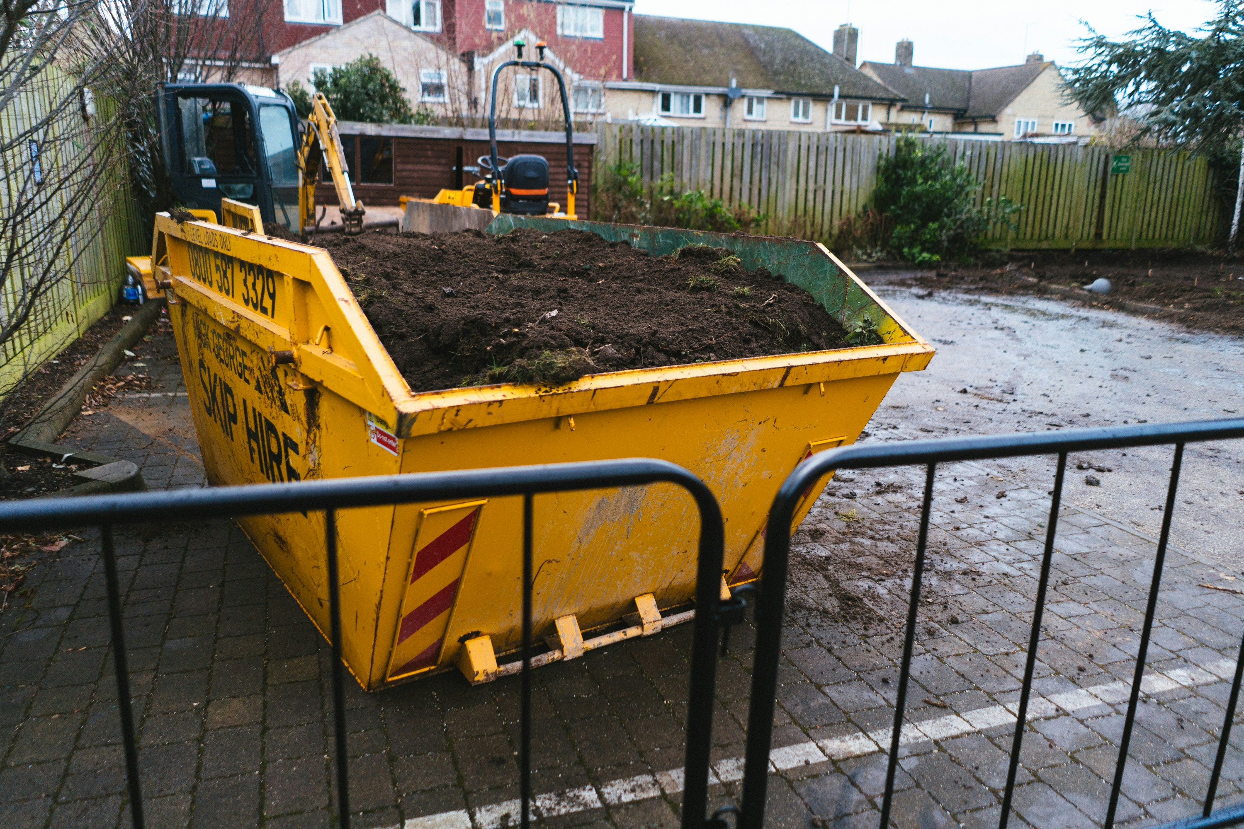

Hypothetical Examples?

Slide 44
Transworld Payment Solutions UK Ltd v First Curacao International Bank NV [2025] EWHC 2480 (Ch)
Liqs of MTIC Companies bring s.213 claims against TWPS, alleging that TWPS was knowingly party to MTIC Fraud carried on by MTIC Companies
Liq of TWPS brings s.213 claims against Mr Deuss and FCIB, alleging that they were knowingly party to carrying on of TWPS’s business for fraudulent purpose
Notes:
Stephen Hunt is Liquidator of TWPS and 10 of the MTIC Companies. Michaela Hall (6) and Kevin Goldfarb (3) are liquidators of other 9 MTIC Companies.

Slide 45
Transworld: s.213
No s.213 application issued against TWPS, therefore claims against it time-barred
In any event:
  TWPS not a party to carrying on of MTIC Companies’ business because the TWPS marketers had insufficient involvement in the activities of any of the MTIC Companies
  TWPS did not know that the MTIC Companies were carrying on business with intent to defraud HMRC or turn a blind eye to them doing so
NB: It would be possible for an introducer to be held liable under s.213 even if the only active steps which it took were innocent ones

Slide 46
REMEDIES
Such contribution as the court thinks proper: s.213(2); s.246ZA(2)
Must be nexus between loss caused to creditors and contribution ordered
Starting point may be net deficiency
Court may consider each defendant separately or jointly and severally

Slide 47
LIMITATION
Six years from entry into administration/liquidation
NB in compulsory liquidation, period runs from making of WUO, not presentation of WUP

Slide 48
Dishonest Assistance

Slide 49
DISHONEST ASSISTANCE
1. There is a trust.
2. There is a breach of trust by the trustee of that trust.
3. The defendant induces or assists that breach of trust.
4. The defendant does so dishonestly.
Lewin on Trusts 20th Ed at (43-014)

Slide 50
DISHONEST ASSISTANCE
Assistance = more than minimal and must enable commission of breach.
Dishonesty = Ivey test.
Blind-eye knowledge counts.
Suspicion or knowledge of wrongdoing sufficient.

Slide 51
Stevens v Hotel Portfolio II UK Ltd (In Liquidation) [2025] UKSC 28
Mr Ruhan director of Hotel Portfolio II UK Ltd (“HPII”).
HPII sold 3 hotels to overseas entities ostensibly owned by Mr Stevens, but in truth owned by Mr Ruhan. Ownership concealed from HPII.
Overseas entities sell hotels for significant profit, part of which received by Mr Ruhan. Mr Stevens receives £1.5m as a reward.
Mr Stevens assists Mr Ruhan in dissipating profits in overseas investments.

Slide 52
Stevens v Hotel Portfolio II UK Ltd (In Liquidation) [2025] UKSC 28
HPII successfully argue: (i) Mr Ruhan breached duties by concealing interest and dissipation; (ii) Mr Stevens dishonestly assisted.
Mr Stevens ordered to pay £102m.
Mr Stevens appeals to SC.

Slide 53
Stevens v Hotel Portfolio II UK Ltd (In Liquidation) [2025] UKSC 28
On Appeal:
Constructive trust more than just a remedy.
HPII suffered loss following dissipation.
Set off would defeat constructive trust purpose.

Slide 54
?

Slide 55
Workshop Session 1

Slide 56
Lunch

Slide 57
Workshop Session 2

Slide 58
Refreshments Break

Slide 59
The Latest Developments in
Part 26A Restructuring Plans
George Hobson (HMRC)
Simon Jerrum (Russell Cooke)
David Pike (GT)
Stefan Ramel (Guildhall)

Slide 60
A Primer on Plans
Stefan Ramel

Slide 61
The Law (CA 2006)
A company “… has encountered, or is likely to encounter, financial difficulties that are affecting, or will or may affect, its ability to carry on business as a going concern.” (901A(2)).
The company proposes a “… compromise or arrangement…” with its creditors (or a class) or members (or a class) the purpose of which is to: “eliminate, reduce or prevent, or mitigate the effect of, any of the financial difficulties” (901A(3)(b)).
Meetings of creditors / members vote on the RP (* but some creditors can be excluded: “none of the members of that class has a genuine economic interest in the company” – 901C(4)).

Slide 62
The Law (CA 2006) (ctd)
The court may sanction the RP if 75% in value of a class of creditors vote in favour (s. 901F).
But if one class votes against, the cross-class cram down power is engaged (s. 901G):
  Condition A: “… if the compromise or arrangement were to be sanctioned under section 901F, none of the members of the dissenting class would be any worse off than they would be in the event of the relevant alternative”;
  Condition B: “… the compromise or arrangement has been agreed by a number representing 75% in value of a class of creditors …. who would receive a payment, or have a genuine economic interest in the company, in the event of the relevant alternative”.
The RA is: “… whatever the court considers would be most likely to occur in relation to the company if the compromise or arrangement were not sanctioned under section 901F.”

Slide 63
Procedure
Practice Statement from the Chancellor of the High Court: Part 26 of the Companies Act 2006 (18/09/25, effective 01/01/26).
Practice Statement Letter (PSL) issued by PlanCo (“… in a concise form…”).
PlanCo Claim Form / Listing Note and evidence (including the ExPlan) (at least 14 days before convening).
Opposing creditors’ “para. 20 notice” (at least 7 days before convening).
Convening Hearing (leading to a convening order) (class composition / blots / 901C(4) / international / directions).
Sanction Hearing (leading to a sanction order) (cross-class cram down).

Slide 64
Key principles from the (developing) case law (CoA)
The ‘out of the money’ creditors misconception: Virgin Active overruled (Adler, Thames Water, Petrofac).
When is an RP fair / how should the court exercise its discretion (Petrofac):
  Burden on the PlanCo;
  Procedural fairness (creditor engagement /negotiation);
  Substantive fairness (fair share of the ‘benefits of the restructuring’).

Slide 65
The Latest Developments in
Part 26A Restructuring Plans
George Hobson (HMRC)
Simon Jerrum (Russell Cooke)
David Pike (GT)
Stefan Ramel (Guildhall)

Slide 66

“A man's got to know his limitations”
Richard Ascroft and Zachariah Pullar

Slide 67
Zedra Trust Co (Jersey) Ltd v THG plc and ors [2026] UKSC 6; [2026] 2 WLR 479
Company law case
Is an unfair prejudice petition under s 994 CA 2006 subject to any statutory limitation period?
Reversed the Court of Appeal which held yes
Significant implications for certain claims under IA 1986

Slide 68
Position under IA 1986 before Zedra v THG

Slide 69
In re Priory Garage (Walthamstow) Ltd [2001] BPIR 144
Transfer of two 125 year leases by the company to one of its directors challenged by liquidator as TUVs or voidable preferences under ss 238/239 IA 1986
Determination of preliminary issue whether claims statute barred
Common ground between the parties that a statutory cause of action created by IA 1986 was a ‘specialty’ within the meaning of ss 8 & 9 of the Limitation Act 1980

Slide 70
In re Priory Garage (cont)
Section 8 LA 1980 provides:
An action on a specialty shall not be brought after the expiration of twelve years from the date on which the cause of action accrued
Subsection (1) above shall not affect any action for which a shorter period of limitation is prescribed by any other provision of this Act.

Slide 71
In re Priory Garage (cont’)
Section 9 LA 1980 is in these terms:
An action to recover any sum recoverable by virtue of any enactment shall not be brought after the expiration of six years from the date on which the cause of action accrued.
Subsection(1) above shall not affect any action to which section 10 or 10A of this Act applies.

Slide 72
In re Priory Garage (cont’)
The Court (John Randall QC sitting as a deputy HC judge) concluded that:
An application under ss 238-241 IA 1986 to set aside one or more transactions is an action on a specialty within s 8(1) of LA 1980, and prima facie subject to a 12 year limitation period
There may be claims under ss 238-241 which are taken outside the scope of s 8(1) by the combined operation of ss 9(1) and 8(2) , meaning a 6 year limitation period. If the substance of the claim is to recover a sum of money, it will be subject to a 6 year limitation period

Slide 73
In re Priory Garage (cont’)
Where there is doubt whether a claim falls into the first category (12 year limitation period) or the second (6 year limitation period), the Court should adopt a “wait and see” approach as to how the claim is put, for which purpose the Court is not limited just to the words of the pleading

Slide 74
Law Society v Southall [2001] EWCA Civ 2001; [2002] BPIR 336
On the hearing of an appeal against a refusal by the judge below to strike out a claim under s 423 IA 1986, Peter Gibson LJ (with whom Mantell LJ and Wall J agreed) noted (at [6]) that nothing is said in ss 423-425 about any limitation period applying to a s 423 claim and that the court had heard no argument that there was any applicable limitation period.
Both parties proceeded on the basis that there was no limitation period.

Slide 75
Hill v Spread Trustee Co Ltd and anr [2006] EWCA Civ 542; [2007] 1 WLR 2404
This was an appeal against a decision that various transactions entered into by the bankrupt (N) were transactions defrauding creditors within s 423 IA 1986.
One of the grounds of appeal was whether the claims (all of which had been brought by N’s trustee in bankruptcy) were statute barred on limitation grounds.

Slide 76
Hill v Spread Trustee (cont’)
If there was a statutory limitation period, it was either 12 years or 6 (s 8 or s 9 LA 1980): Arden LJ at ¶108
Arden LJ went on to say (at ¶ 113) that there was no reason why claims under s 423 should not be subject to some time limit.
She considered (at ¶ 116) that insofar as the relief sought was not to recover any sum recoverable by virtue of” an enactment, within s 9 of LA 1980, she agreed with the judge below that the claim was an action for a specialty under s 8.

Slide 77
Hill v Spread Trustee (cont’)
Sir Martin Nourse (with whom Waller LJ agreed) could see no justification for claims under s 423 not to be subject to the provisions of the LA 1980.
He concluded that as the main claim was one to set aside an underlying trust settlement, the action as a whole was in substance ”an action upon a specialty” within s 8(1).

Slide 78
Hill v Spread Trustee (supra)
As to when the applicable limitation period (whether under s 8 or s 9) began to run, Sir Martin Nourse (and Waller LJ) agreed with the judge below that if the claim was brought by a trustee in bankruptcy, time did not begin to run until the making of the relevant bankruptcy order.
Arden LJ disagreed on this aspect, holding that a trustee could only bring a claim under s 423 if there was a victim of the transaction whose claim was not statute-barred.

Slide 79
Zedra Trustee Co (Jersey) Ltd v THG plc and ors [2024] EWCA Civ 158; [2024] Ch 318
Case arose out of an application to amend an unfair prejudice petition presented under s 994 CA 2006
At first instance Fancourt J allowed the amendment, holding that there was no statutory limitation period
On appeal it was acknowledged that it was undoubtedly received wisdom that no limitation period applied to such petitions but the Court of Appeal went on to reverse the decision below, holding that the proposed amendment fell within section 9 of the 1980 Act

Slide 80
On appeal to the UKSC
Allowed Zedra’s appeal by a majority: no limitation period applies to s.994 petitions.
Section 8 LA 1980: an ‘action upon a specialty’ is an action to enforce an obligation created by deed or statute.
Section 9 LA 1980: not applicable where the action gives the court wide-ranging discretion as to the relief to be granted.

Slide 81
Implications for IA 1986 claims – s.423
s.425(1): Without prejudice to the generality of section 423, an order made under that section with respect to a transaction may (subject as follows)—
(a) require any property transferred as part of the transaction to be vested in any person, either absolutely or for the benefit of all the persons on whose behalf the application for the order is treated as made;
(b) require any property to be so vested if it represents, in any person’s hands, the application either of the proceeds of sale of property so transferred or of the money so transferred;
(c) release or discharge (in whole or in part) any security given by the debtor;
(d) require any person to pay to any other person in respect of benefits received from the debtor such sums as the court may direct;
(e) provide for any surety or guarantor whose obligations to any person were released or discharged (in whole or in part) under the transaction to be under such new or revived obligations as the court thinks appropriate;
(f) provide for security to be provided for the discharge of any obligation imposed by or arising under the order, for such an obligation to be charged on any property and for such security or charge to have the same priority as a security or charge released or discharged (in whole or in part) under the transaction.

Slide 82
Implications for IA 1986 claims – s.423
THG v Zedra at §155:
  “…We consider that claims under statutory provisions which confer a wide discretion as to remedy are not claims to which section 9 applies. For these reasons also, we consider that Priory Garage, Hill v Spread Trustee and Rahman were wrongly decided as regards section 9 of the 1980 Act.”
at §117:
  “…We are also satisfied that, insofar as the parties in Priory Garage and the courts in Rahman and perhaps in Hill v Spread Trustee relied on the wider Collin view, they were wrong to do so. However, we have not been invited to overrule those cases nor have we heard argument as to whether they can be justified on another basis.”

Slide 83
Teixeira v Moaven [2026] EWHC 1215 (Ch)
Trusts and estates case; sham trusts and IHA 1975 claims
Alternative claim under s.423.
Judge (obiter) considered that – following THG v Zedra – no limitation period applies to s.423 claims: see §§213-223.
§218:
  “In the light of Zedra, it is, I think, completely clear that a claim under section 423 is not a claim on a ‘specialty’ and that the twelve-year limitation period attaching to such a claim, pursuant to section 8 of the Limitation Act 1980, is, simply, not applicable.”

Slide 84
Implications for IA 1986 claims – ss.239-241
Priory Garage (p. 149): “It is common ground between the parties that a ‘specialty’ includes an Act of Parliament and that prima facie a statutory cause of action created by the Insolvency Act 1986 will be a specialty within the meaning of ss.8 and 9 of the Limitation Act …”
Unlikely to survive majority’s analysis in Zedra.

Slide 85
If not limitation – what relevance has delay?
THG v Zedra at §170:
  “Whether or not there is a statutory limitation period, the court in addressing an application under section 994 of the CA 2006 may take account of unjustified delay by the claimant which has an adverse effect on a respondent or other persons when exercising its discretion to grant or refuse a particular remedy or any remedy. See In re Edwardian Group Ltd, Fancourt J at paras 571, 602—609; Cherry Hill Skip Hire, Andrews LJ at para 36; and Smith v Royal Bank of Scotland, Lord Leggatt at paras 54—60, Lord Hodge at para 89.”
E.g., Bown v Shipley [2026] EWHC 918 (Ch), §45.

Slide 86
Life as lawyer and on the bench
An interview with Hugh Sims KC

