Slide 1


Carrying on and helping out: Fraudulent Trading & Dishonest Assistance
Simon Passfield KC
Govinder Chambay

Slide 2
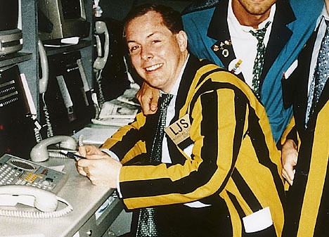
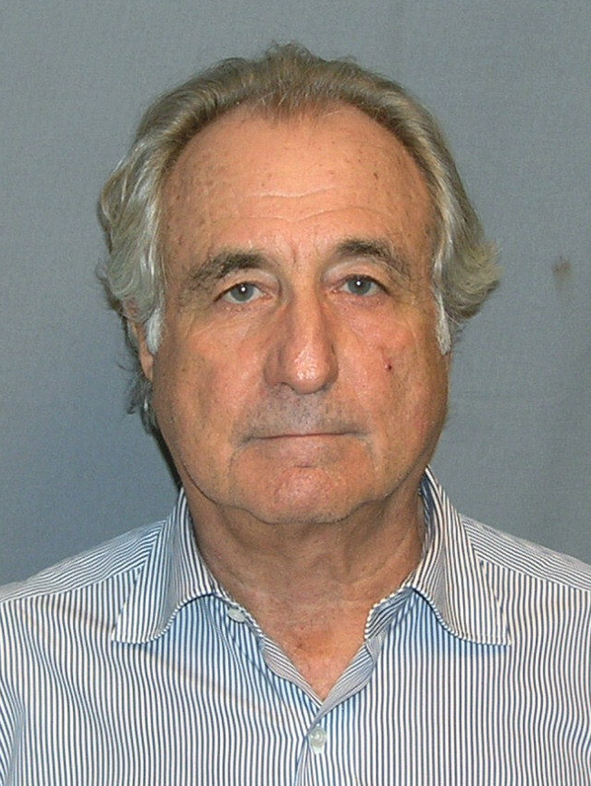
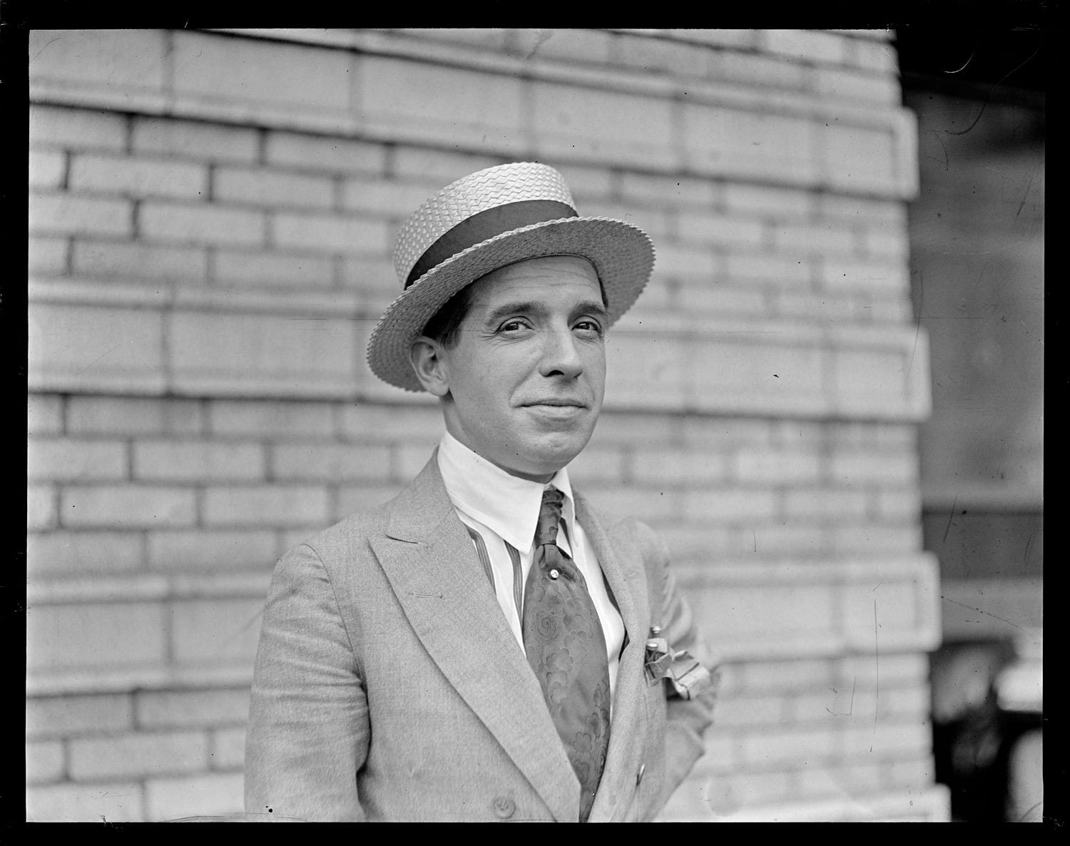
Fraudulent Trading

Slide 3

Fraudulent Trading: s.213 and 246ZA IA
(1) If [in the course of the winding up of a company/ while a company is in administration] it appears that any business of the company has been carried on with intent to defraud creditors of the company or creditors of any other person, or for any fraudulent purpose, the following has effect.
(2) The court, on the application of the [liquidator/administrator] may declare that any persons who were knowingly parties to the carrying on of the business in the manner above- mentioned are to be liable to make such contributions (if any) to the company’s assets as the court thinks proper.

Slide 4
Constituent Elements
Carrying on business
Intent to defraud creditors / fraudulent purpose
Participation
Knowledge

Slide 5
Carrying on business
Fraudulent Business / Fraudulent Transaction?
Carried on v carried out?
Insolubly bound up with the company’s business operations/model?
Defraud one creditor? Re Gerald Cooper Chemicals Ltd (in liq.) [1978] Ch. 262)

Slide 6
Intent to Defraud/Fraudulent Purpose
Dishonesty – Ivey Test & Subjective intent/reckless indifference
Fraudulent purpose is construed widely.

Slide 7
Intent to Defraud Examples
Participating in MTIC fraud
Manipulating account balances to conceal losses
Running a Ponzi scheme
Incurring credit?
Obtaining bounce back loans?
Implementing a tax avoidance scheme

Slide 8
Does s.213 apply to “outsiders”?
Bilta (UK) Ltd v Tradition Financial Services Ltd [2025] UKSC 18: third parties/outsiders who participate in, facilitate or assist fraudulent transactions by a company when they know that the company's business is being carried on for any fraudulent purpose are within the ambit of s.213

Slide 9
What amounts to participation?
Some positive step required
That step need not be fraudulent or deceitful
Accepting money may be sufficient
R must be party to carrying on of business not simply fraud

Slide 10
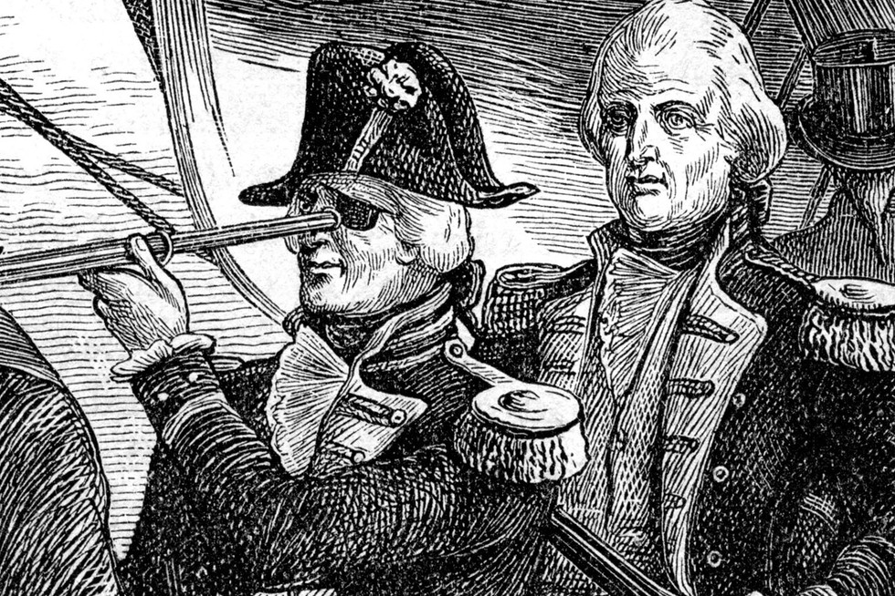
Knowledge

Slide 11
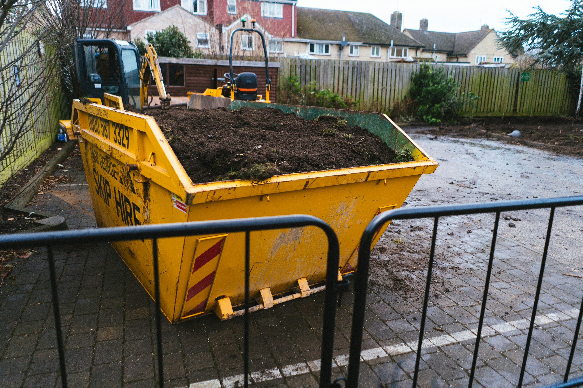
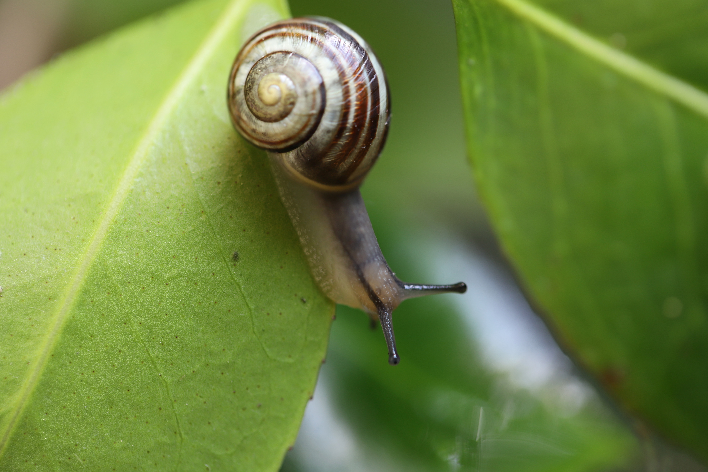
Hypothetical Examples?

Slide 12
Transworld Payment Solutions UK Ltd v First Curacao International Bank NV [2025] EWHC 2480 (Ch)
Liqs of MTIC Companies bring s.213 claims against TWPS, alleging that TWPS was knowingly party to MTIC Fraud carried on by MTIC Companies
Liq of TWPS brings s.213 claims against Mr Deuss and FCIB, alleging that they were knowingly party to carrying on of TWPS’s business for fraudulent purpose
Notes:
Stephen Hunt is Liquidator of TWPS and 10 of the MTIC Companies. Michaela Hall (6) and Kevin Goldfarb (3) are liquidators of other 9 MTIC Companies.

Slide 13
Transworld: s.213
No s.213 application issued against TWPS, therefore claims against it time-barred
In any event:
  TWPS not a party to carrying on of MTIC Companies’ business because the TWPS marketers had insufficient involvement in the activities of any of the MTIC Companies
  TWPS did not know that the MTIC Companies were carrying on business with intent to defraud HMRC or turn a blind eye to them doing so
NB: It would be possible for an introducer to be held liable under s.213 even if the only active steps which it took were innocent ones

Slide 14
REMEDIES
Such contribution as the court thinks proper: s.213(2); s.246ZA(2)
Must be nexus between loss caused to creditors and contribution ordered
Starting point may be net deficiency
Court may consider each defendant separately or jointly and severally

Slide 15
LIMITATION
Six years from entry into administration/liquidation
NB in compulsory liquidation, period runs from making of WUO, not presentation of WUP

Slide 16
Dishonest Assistance

Slide 17
DISHONEST ASSISTANCE
1. There is a trust.
2. There is a breach of trust by the trustee of that trust.
3. The defendant induces or assists that breach of trust.
4. The defendant does so dishonestly.
Lewin on Trusts 20th Ed at (43-014)

Slide 18
DISHONEST ASSISTANCE
Assistance = more than minimal and must enable commission of breach.
Dishonesty = Ivey test.
Blind-eye knowledge counts.
Suspicion or knowledge of wrongdoing sufficient.

Slide 19
Stevens v Hotel Portfolio II UK Ltd (In Liquidation) [2025] UKSC 28
Mr Ruhan director of Hotel Portfolio II UK Ltd (“HPII”).
HPII sold 3 hotels to overseas entities ostensibly owned by Mr Stevens, but in truth owned by Mr Ruhan. Ownership concealed from HPII.
Overseas entities sell hotels for significant profit, part of which received by Mr Ruhan. Mr Stevens receives £1.5m as a reward.
Mr Stevens assists Mr Ruhan in dissipating profits in overseas investments.

Slide 20
Stevens v Hotel Portfolio II UK Ltd (In Liquidation) [2025] UKSC 28
HPII successfully argue: (i) Mr Ruhan breached duties by concealing interest and dissipation; (ii) Mr Stevens dishonestly assisted.
Mr Stevens ordered to pay £102m.
Mr Stevens appeals to SC.

Slide 21
Stevens v Hotel Portfolio II UK Ltd (In Liquidation) [2025] UKSC 28
On Appeal:
Constructive trust more than just a remedy.
HPII suffered loss following dissipation.
Set off would defeat constructive trust purpose.

Slide 22
?

